Slide 1
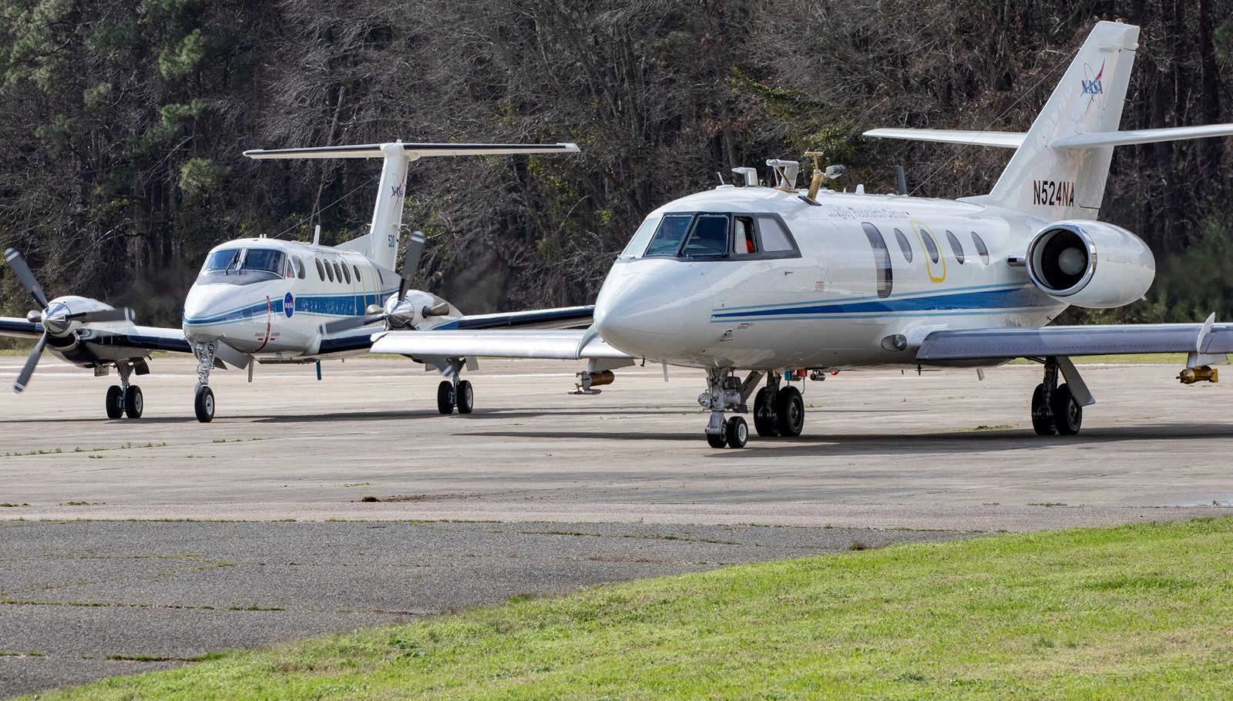
Tools for Analyzing Datasets from ACTIVATE (TADA)
Introduction: From Data Repository to Initial Figures
ACTIVATE Team
July 2022

Slide 2
Overview
Learning Objectives --- Slide 3
Motivation --- Slides 4-7
Data Workshop Review --- Slides 8-9
Google Colaboratory --- Slides 10-19
ACTIVATE Data Archive --- Slides 20-28
Visualizing Data from Archived Data Files --- Slides 29-37
Acknowledgements --- Slide 38
Questions --- Slide 39
Extra Slides --- 40-44
Activities:
• Install Google Colab and Initialize Google Drive --- Slide 19
• Download the Datasets --- Slide 28
• Python3 Dictionaries --- Slides 29-30
• In Situ Data --- Slides 31-32
• Remote Sensing Data --- Slides 33-35
• Comparing Flight Tracks --- Slides 36-37

Slide 3
Learning Objectives
1) Understand common file types and products of in situ and remote sensing instruments
2) Be able to use the Google Colaboratory (i.e., Google Colab) environment to examine atmospheric properties derived from both in situ and remote sensing products

Slide 4


Motivation
IPCC 5th Assessment (2013)
“Clouds and aerosols continue to contribute the largest uncertainty to estimates and interpretations of the Earth's changing energy budget”
“Aerosols and their interactions with clouds contribute to the largest uncertainty to the total radiative forcing estimate”
NASA Decadal Study Report (2018)
“Improving our understanding will require measurements capable of examining aerosol and cloud vertical profiles and sizes. Vertical profiles of aerosols are also essential for determining how and whether aerosols affect cloud microphysical properties.”
“It is likely that only such a combination of platforms (models, in situ observations, space-based platforms) would resolve the roles of the naturally-occurring and anthropogenic aerosols on clouds.”
Why such high uncertainty?
Complexity of clouds and difficulty in untangling influences from aerosols and meteorology.

Slide 5
Motivation
Sorooshian et al. (2019), BAMS

Slide 6
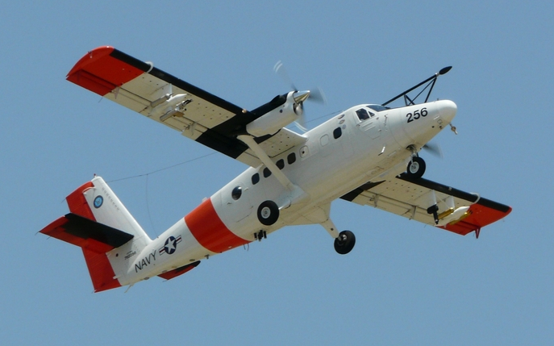
Motivation

Slide 7
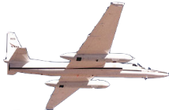

Motivation
King Air: ~9 km
Above Cloud Top (ACT)
Below Cloud Top (BCT)
Altitude
Above Cloud Base (ACB)
Below Cloud Base
(BCB)
HU-25 Falcon
Minimum Altitude
(MinAlt)
0
80
160
240
Track Distance (km)

Slide 8
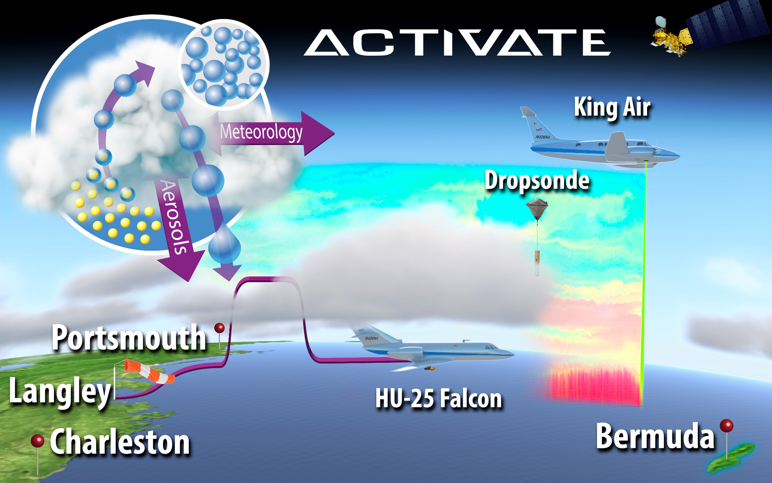
Data Workshop Review
A detailed presentation of the ACTIVATE methodology and data products is available at our 2021 open data workshop website: Virtual ACTIVATE Data Workshop (2021) – (https://www-air.larc.nasa.gov/missions/activate/docs/data_workshop/Oct2021.html)
Aerosol Cloud meTeorology Interactions oVer the Western Atlantic Experiment (ACTIVATE)
https://activate.larc.nasa.gov/

Slide 9
Data Workshop Review
Example ACTIVATE Flight

Slide 10
Google Colaboratory
Google Colab functions from Jupyter Notebooks that are written in the Python3 coding language
The Google Colab environment allows for the computational analysis of airborne data sets from any computer that has access to a web browser
Once set up, the procedures taken from this session can be modified and extended as needed

Slide 11
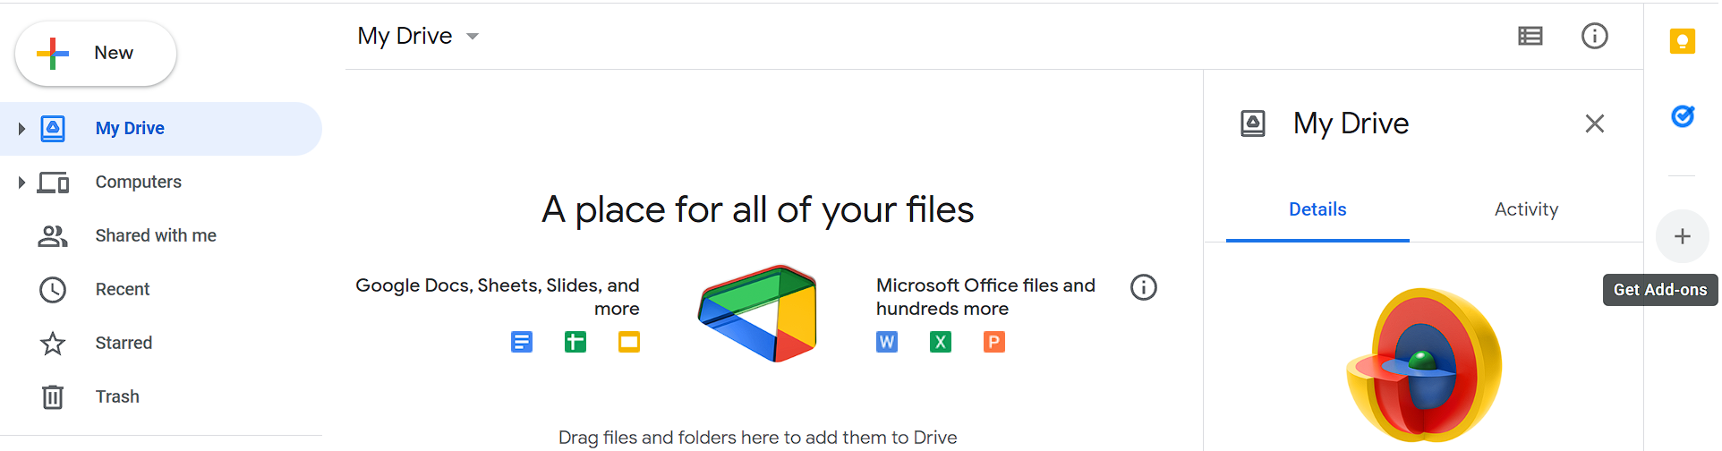
Google Colaboratory
This will be an overview of the first activity that will follow
Ensure you set up google account (See ‘CreateGmailAccount.pdf’)
1) Go to drive.google.com
2) Click the + on the right to display list of add-ons and install desired add-ons

Slide 12
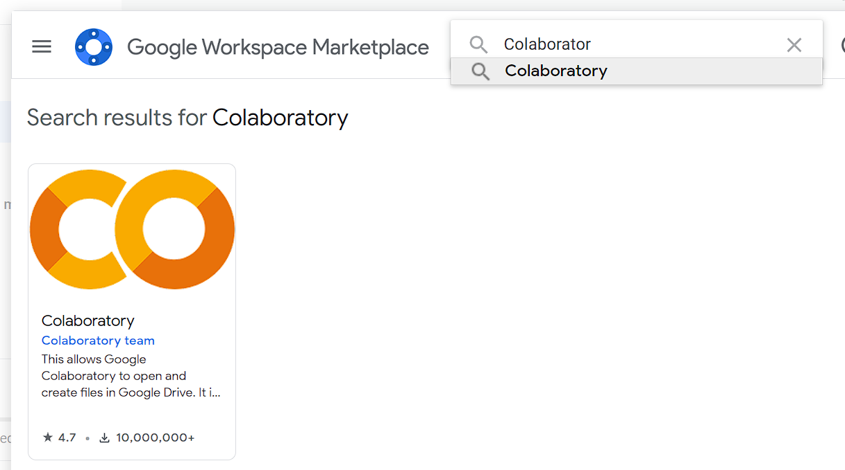
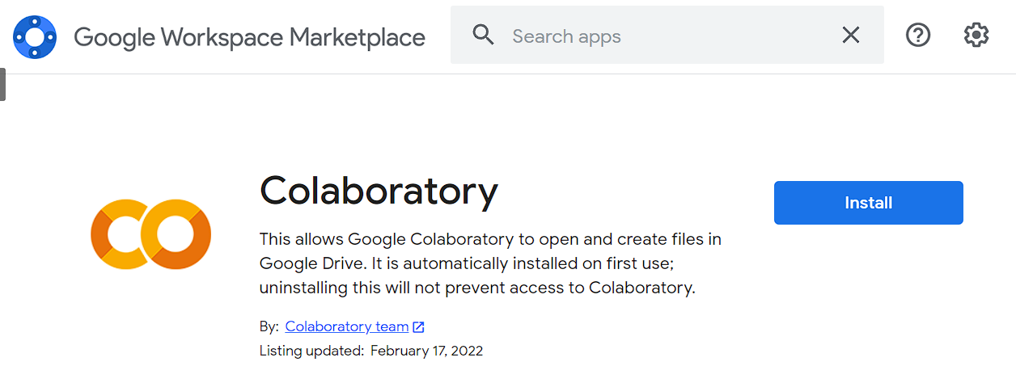
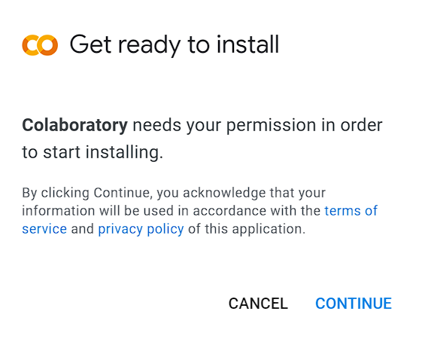
Google Colaboratory
3) Type “Colab” in the search box and hit enter
4) Select the “Colaboratory” add-on from the list of options
5) Select Install
6) After reading the service and privacy policy information, accept those by selecting continue

Slide 13
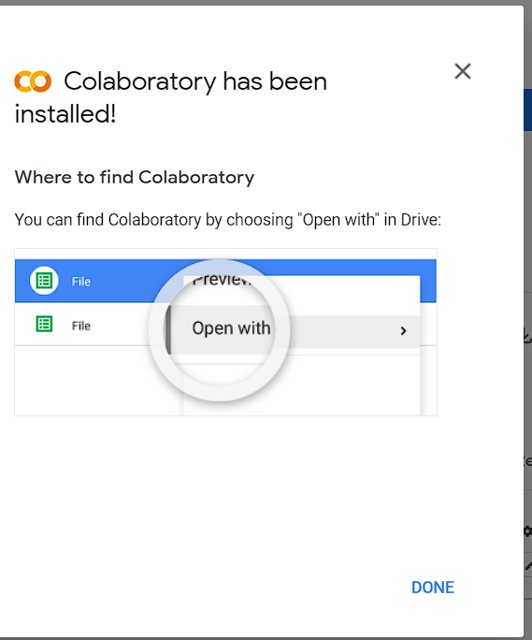
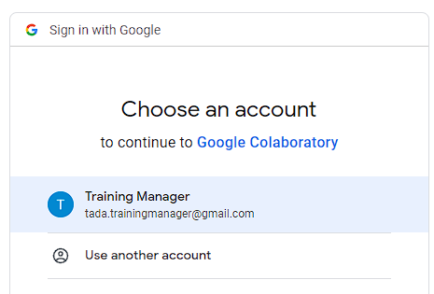
Google Colaboratory
9) Restart your browser by exiting and navigating back to drive.google.com
7) Select the account that you are using
8) Select done

Slide 14
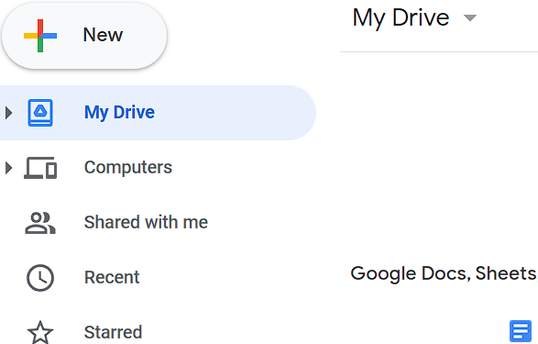
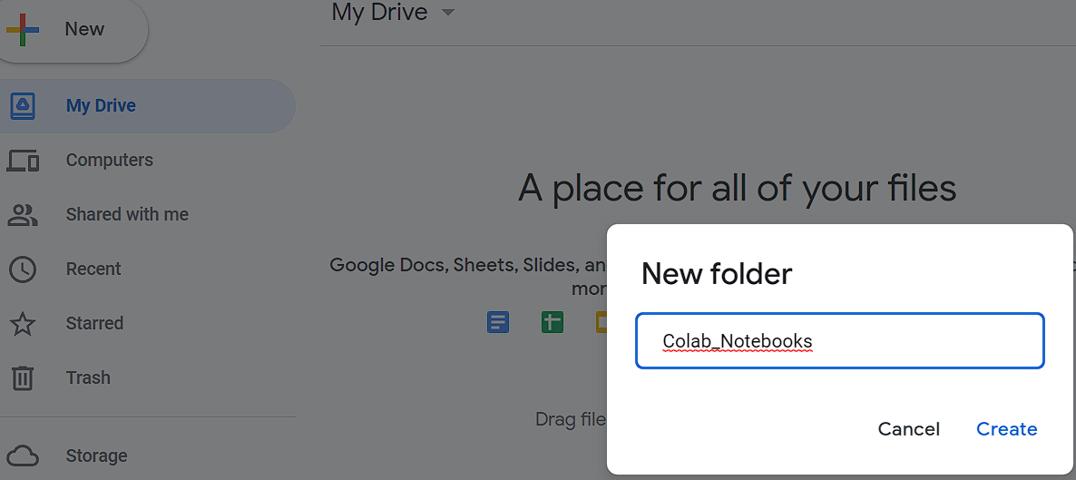
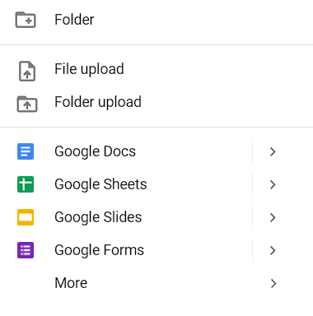
Google Colaboratory
10) Select “New” from your google drive
11) Select “Folder” from the dropdown to prompt the creation of new folder for your Colab Notebooks
12) Fill the text field with “Colab_Notebooks”
Note: This directory name must match exactly
13) Select “Create”

Slide 15
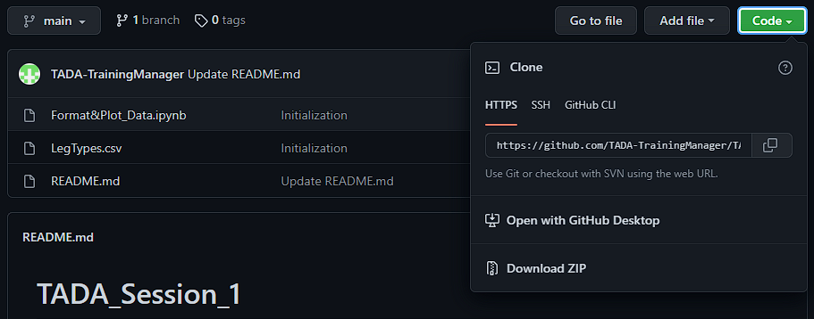
Google Colaboratory
14) Go to the following link: TADA_Session_1
(https://github.com/TADA-TrainingManager/TADA_Session_1)
15) Select “Code”
16) Select “Download ZIP” from the drop down

Slide 16
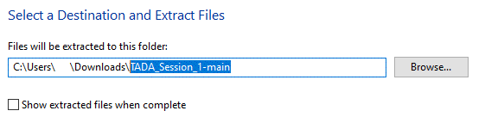
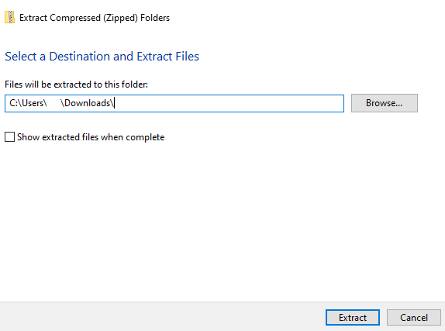
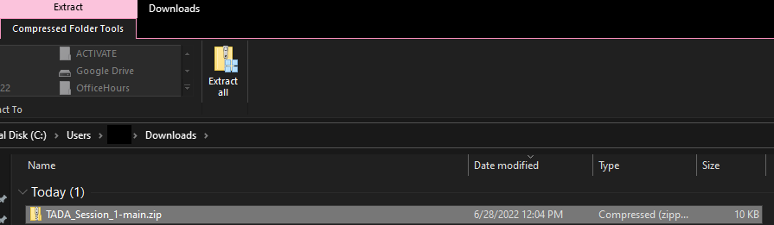
Google Colaboratory
The following steps apply to computers operating on Windows 10 and may be different for various versions of Windows and Mac operating systems
19) Highlight and delete this text from the directory
17) Navigate to the directory where you downloaded the .zip file and select it
18) Select the .zip file and then select “Extract all” at the top of the screen
20) Select “Extract”

Slide 17
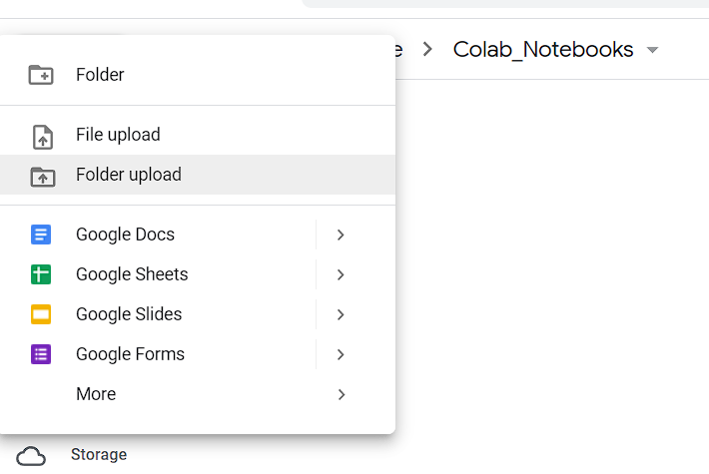
Google Colaboratory
21) Select “New” from your google drive
22) Select “folder upload” and navigate to your “TADA_Session_1-main” directory that was extracted from the .zip file.

Slide 18
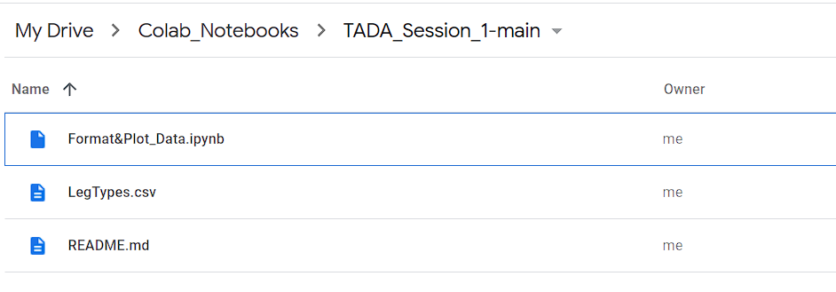
Google Colaboratory
At this point your google drive directory is ready for this session if it looks exactly like the below example

Slide 19
ACTIVITY: Google Colab and Drive
ACTIVITY: Install Google Colab and Initialize Google Drive

Slide 20
ACTIVATE Data Archive
All publicly archived ACTIVATE products can be found at https://doi.org/10.5067/SUBORBITAL/ACTIVATE/DATA001
NOTE: Ensure you have a free account registered with earthdata.nasa.gov (See SetupEarthDataLogin.pdf)
This section will walk through the downloading of in situ and remote sensing data for the ACTIVATE research flight that occurred on the 28 August 2020.

Slide 21
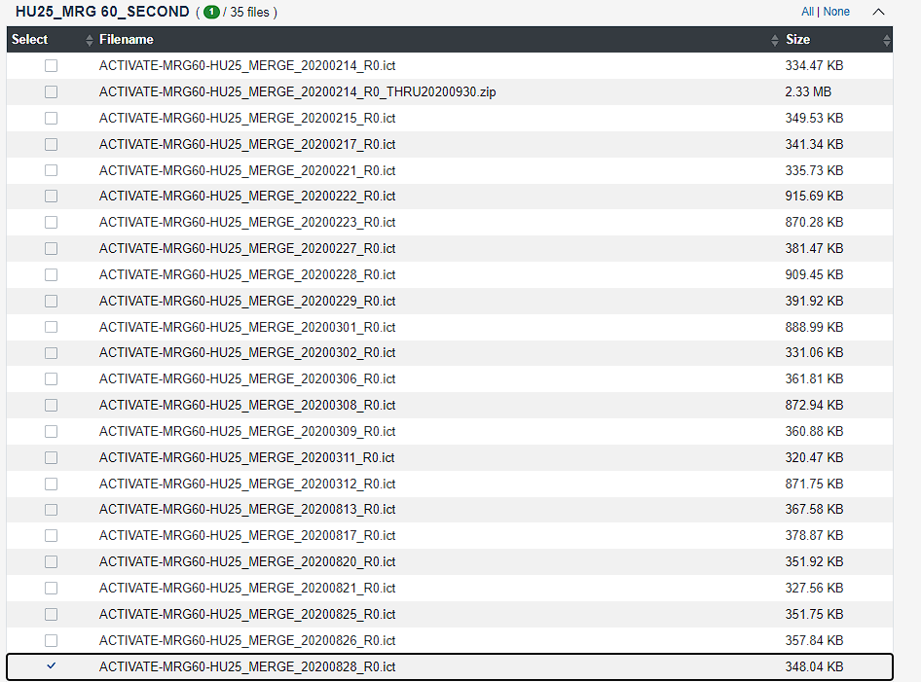
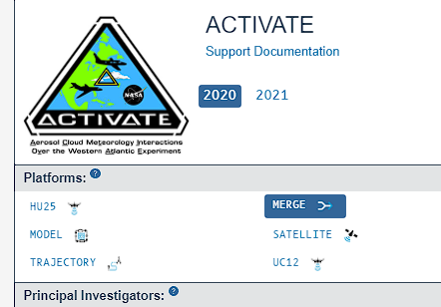
ACTIVATE Data Archive
4) Select “HU25_MRG60_SECOND”
1) Go to ASDC | SOOT Power User Interface
(https://asdc.larc.nasa.gov/soot/power-user/ACTIVATE/2020)
2) Select “2020”
5) Check the box next to “HU25_MRG60_SECOND_20200828_R0.ict”
3) Select “MERGE”

Slide 22
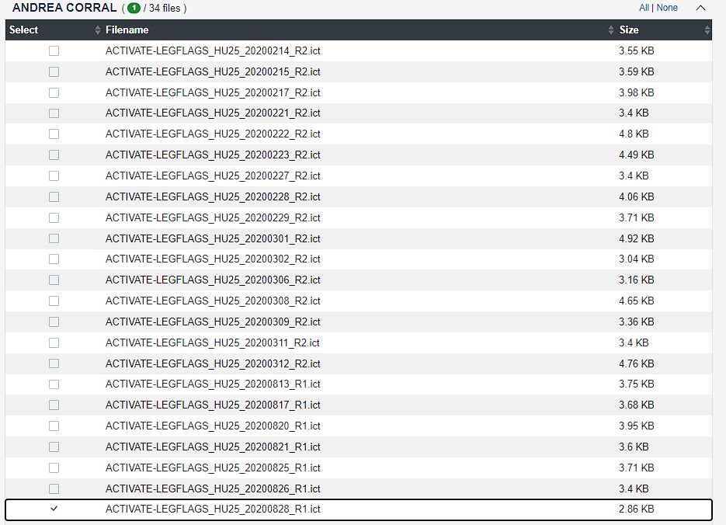
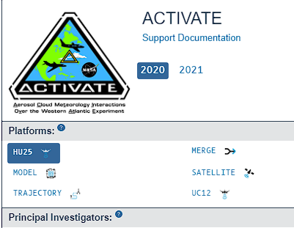
ACTIVATE Data Archive
7) Select “ANDREA CORRAL”
6) Select “HU25”
8) Check the box next to “ACTIVATE-LEGFLAGS_HU25_20200828_R1.ict”

Slide 23

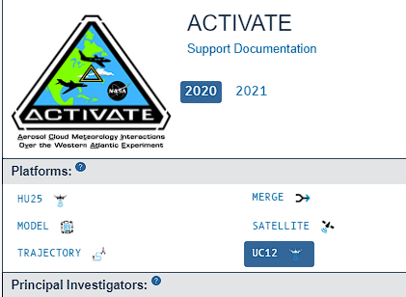
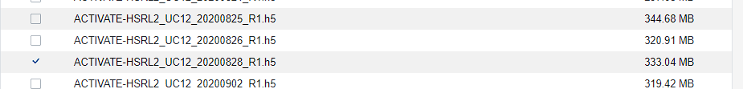


ACTIVATE Data Archive
10) Select “CHRIS HOSTETLER”
11) Check the box next to “ACTIVATE-HSRL2_UC12_20200828_R1.h5”
9) Select “UC12”
12) Select “BRIAN CAIRNS”
13) Check the box next to “ACTIVATE-RSP-AER_UC12_20200828_R1. h5”

Slide 24
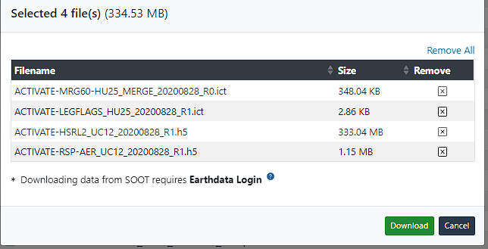
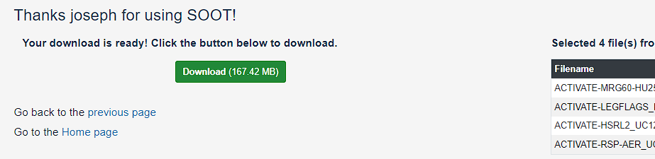
ACTIVATE Data Archive
14) Select “Review Selected Files” at the bottom of the screen
15) Select “Download” from the pop-up menu
16) After the next screen loads, Select “Download”

Slide 25
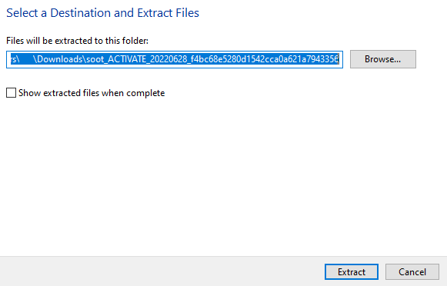
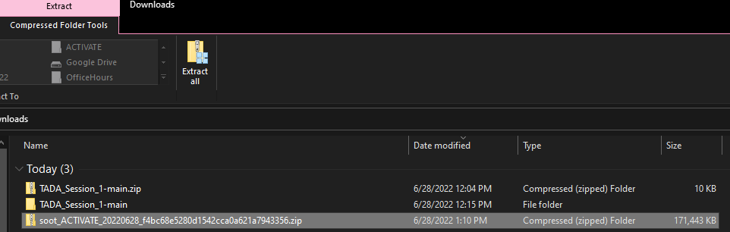
ACTIVATE Data Archive
The following steps apply to computers operating on Windows 10 and may be different for various versions of Windows and Mac operating systems
17) Navigate to the directory where you downloaded the .zip file and select it
18) Select the .zip file and then select “Extract all” at the top of the screen
19) Select “Extract”

Slide 26
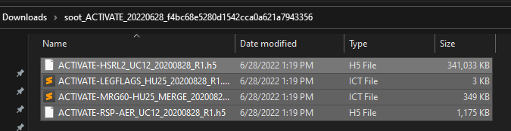
ACTIVATE Data Archive
20) Select “New” from your google drive
21) Select “file upload” and navigate to your directory that was extracted on the previous slide.
22) Select all the files and hit enter

Slide 27
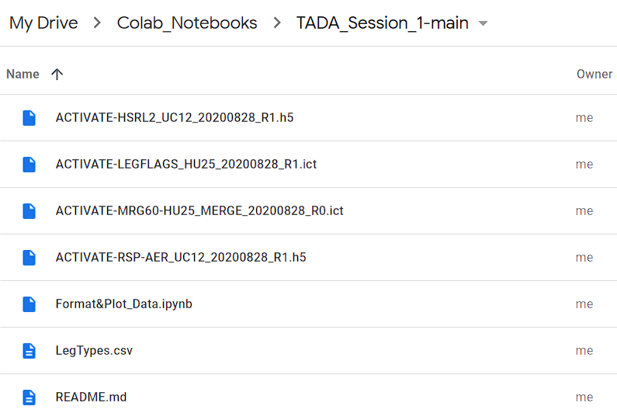
ACTIVATE Data Archive
Once the data files are uploaded, the google drive directory should look identical to the one to the right for the remaining training sessions.

Slide 28
ACTIVITY: Download the Datasets
ACTIVITY: Download the Datasets

Slide 29
Activity: Python3 Dictionaries
• This short activity was adapted from https://www.geeksforgeeks.org/python-dictionary/
• Python dictionaries are similar to Excel tables
• A dictionary in Python is an ordered collection of data values, used to store data values like a map
• A dictionary holds key:value pair. Key-value is provided in the dictionary to make it more optimized.
• The raw data files from the ACTIVATE flight will be converted to Python dictionaries as part of these activities.

Slide 30
Activity: Python3 Dictionaries
ACTIVITY: Python3 Dictionaries

Slide 31
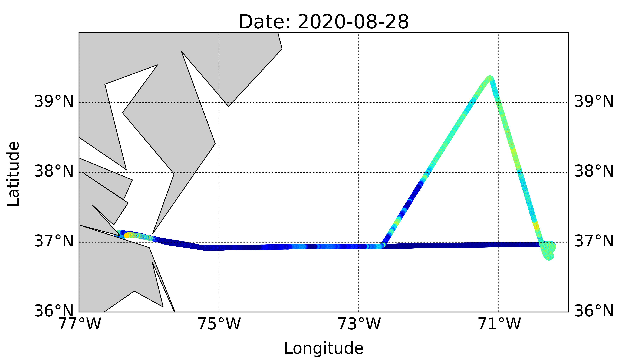
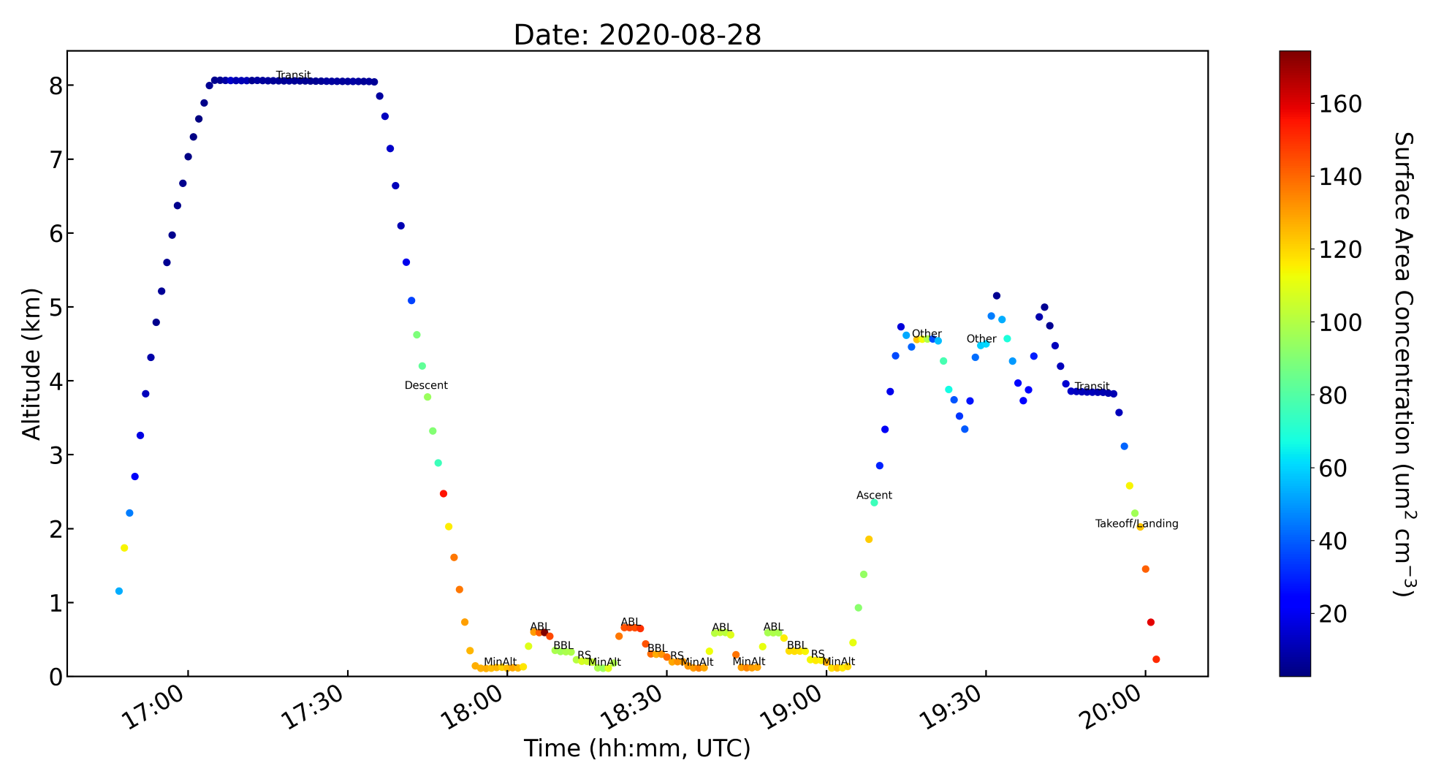
Activity: In Situ Data
Aerosol surface area will soon be related to remotely sensed data in the next activity!

Slide 32
Activity: In Situ Data
Activity:
In Situ Data

Slide 33
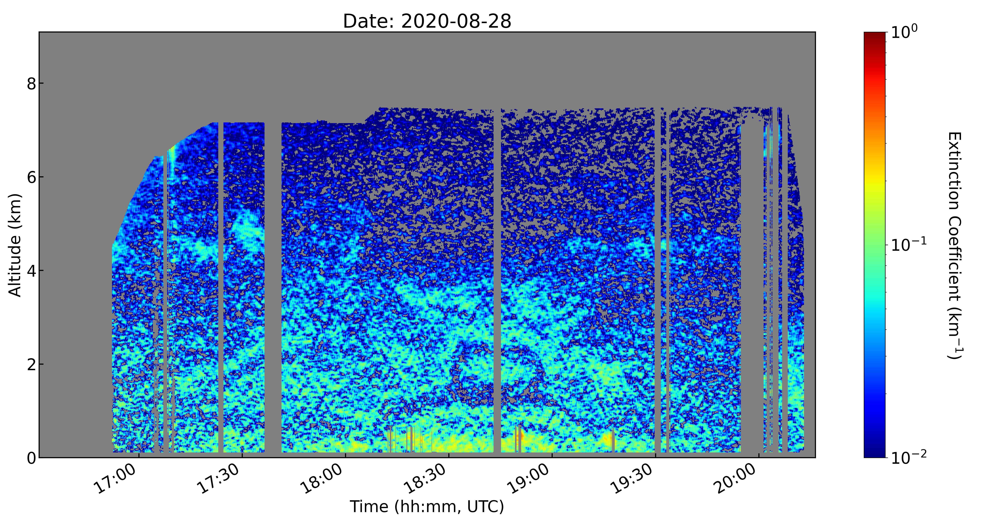
Activity: Remote Sensing Data
Here are vertical HSRL-2 data “curtains” showing where aerosol particles are concentrated.
Do you see trends that agree with the surface area data from the Falcon in the last activity?

Slide 34
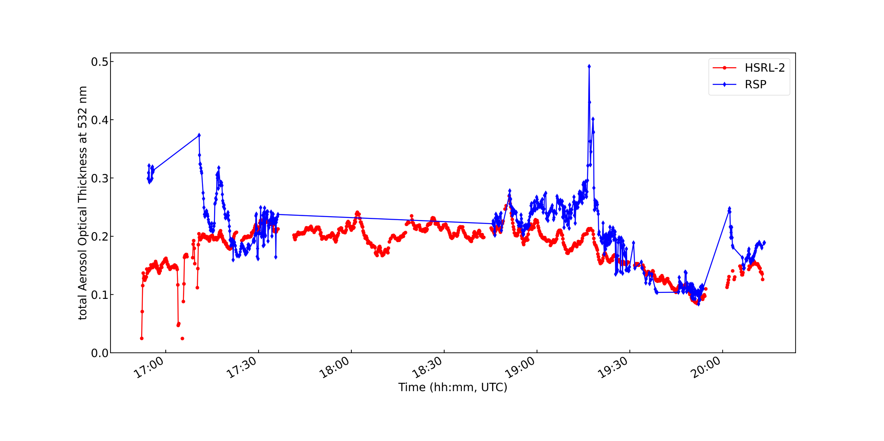
Activity: Remote Sensing Data
Instrument intercomparisons are important for research and technology development.

Slide 35
Activity: Remote Sensing Data
Activity: Remote Sensing Data

Slide 36
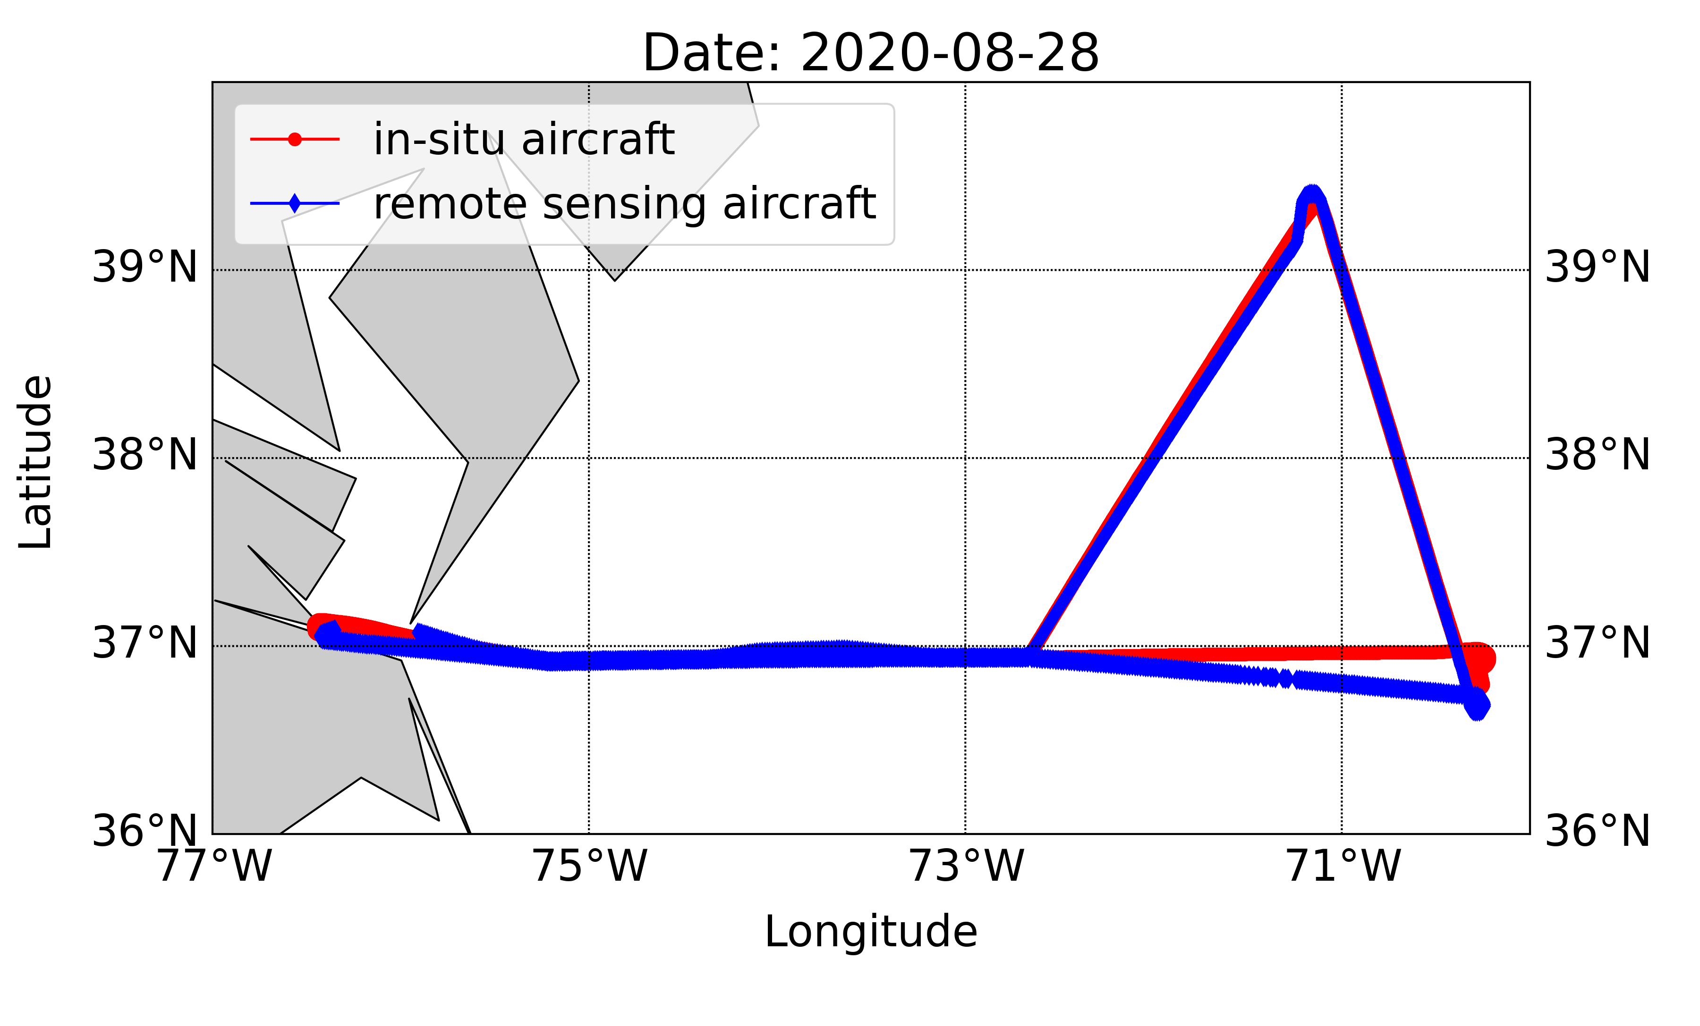
Activity: Comparing Flight Tracks
Good level of aircraft coordination during this flight!

Slide 37
Activity: Comparing Flight Tracks
Activity: Comparing Flight Tracks

Slide 38


Acknowledgements
The ACTIVATE Instrument Teams
The ACTIVATE Aircraft Pilots
The ACTIVATE Data Management and Archival Team

Slide 39
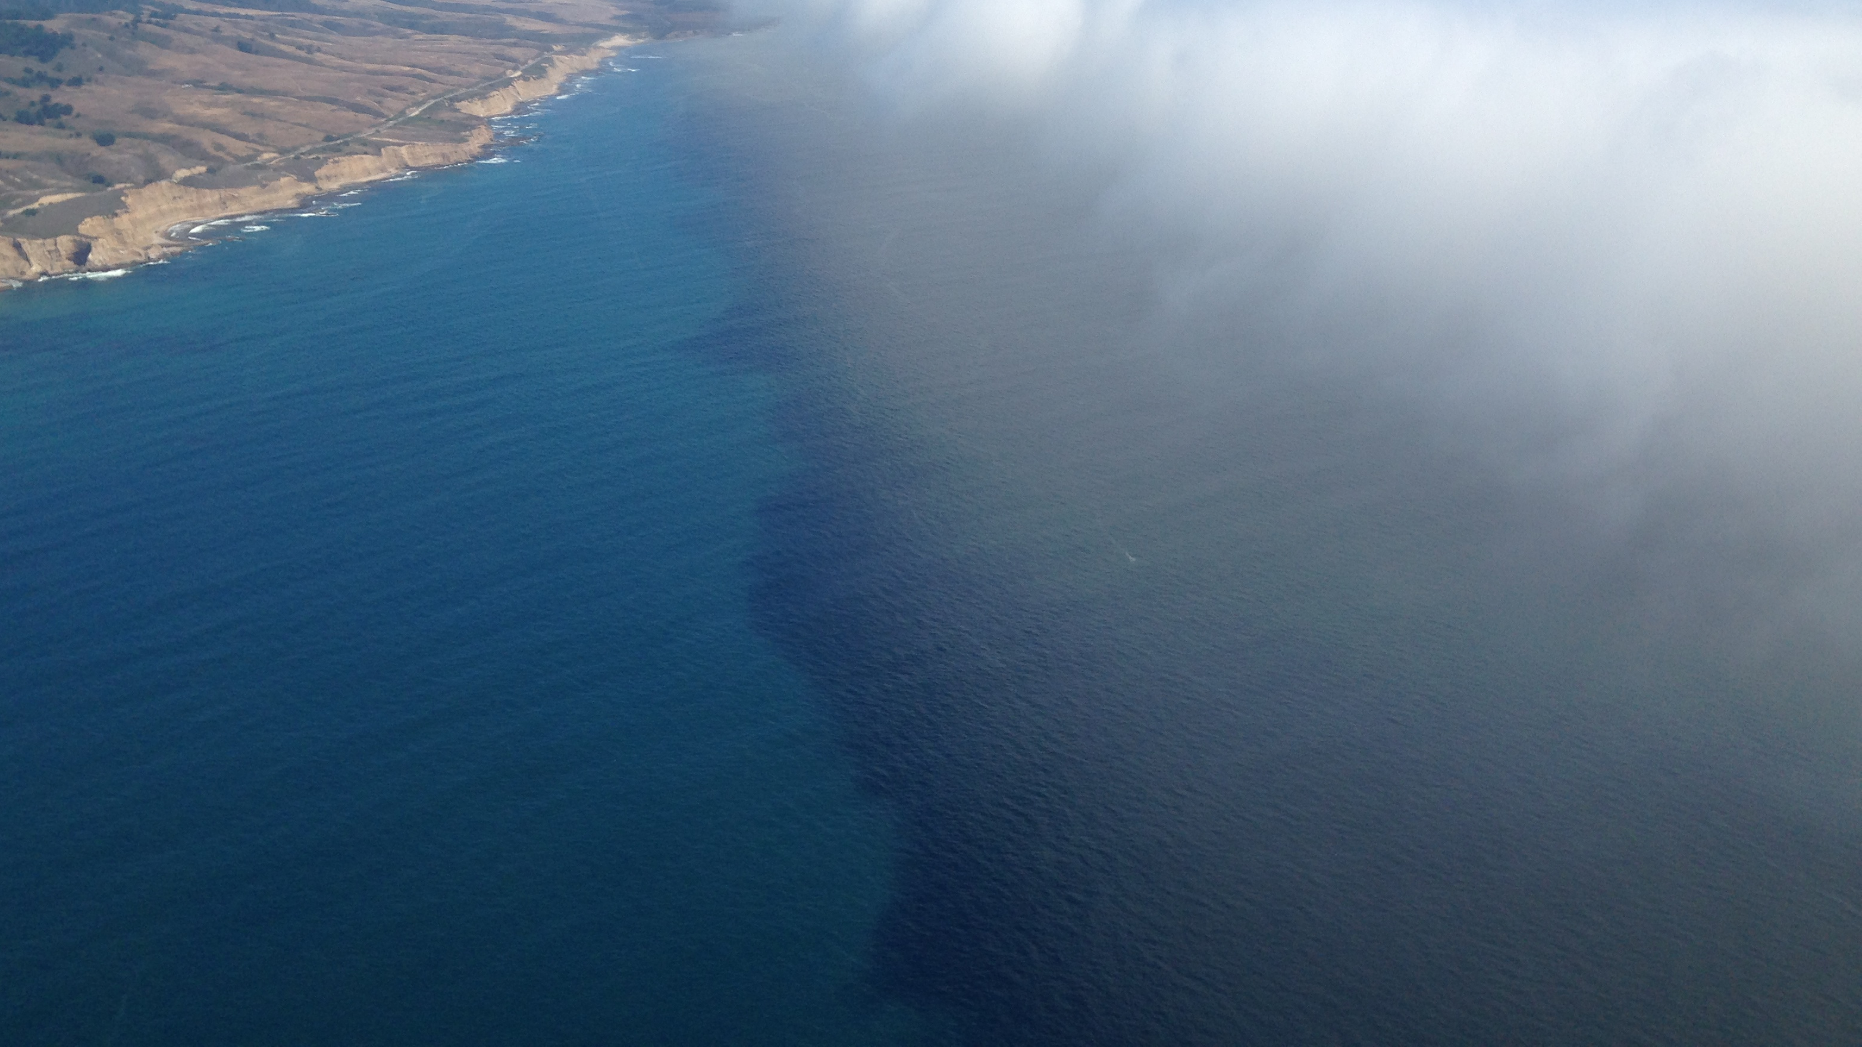
Questions?

Slide 40
Extra Slides
Science Objectives
Objective 1: Quantify relationships between aerosols, cloud condensation nuclei (CCN), and cloud drops and reduce uncertainty in model parameterizations of cloud droplet activation.
Objective 2: Improve process-level understanding and model representation of factors governing cloud micro/macro-physical properties and how they couple with cloud effects on aerosol.
Objective 3: Assess advanced remote sensing capabilities for retrieving aerosol and cloud properties related to aerosol-cloud interactions.

Slide 41
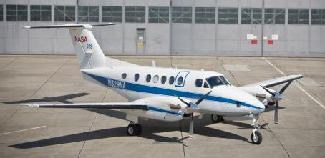
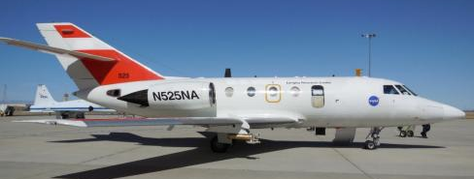
Extra Slides
Platforms
High-Altitude Remote Sensing
King Air
Range: 1,500 km
Altitude: 9 km
Airspeed: 120 m/s
Duration: ~4 hours
Low-Altitude In-situ
HU-25 Falcon
Range: 3,000 km
Altitudes: 0.15 - 3 km
Airspeed: 100-130 m/s
Duration: ~4 hours

Slide 42
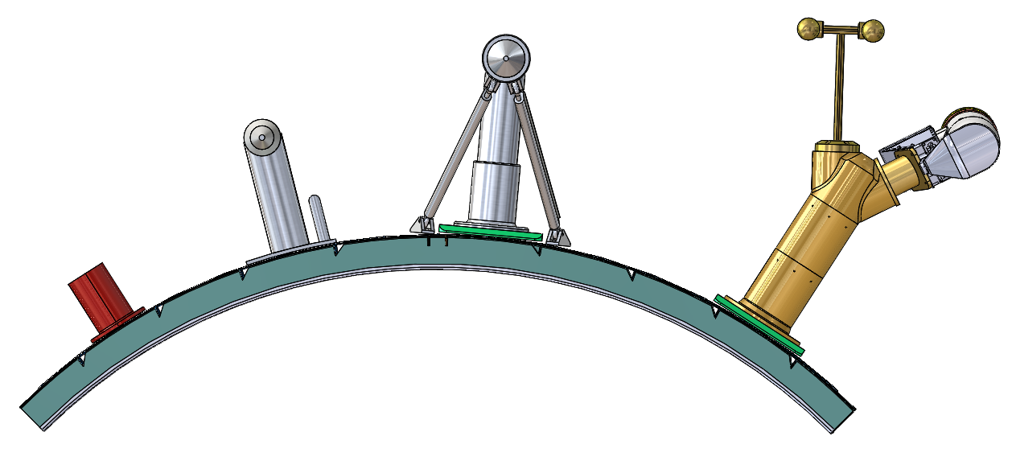
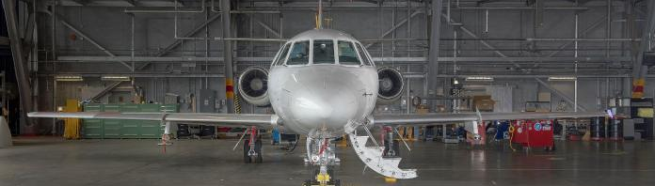
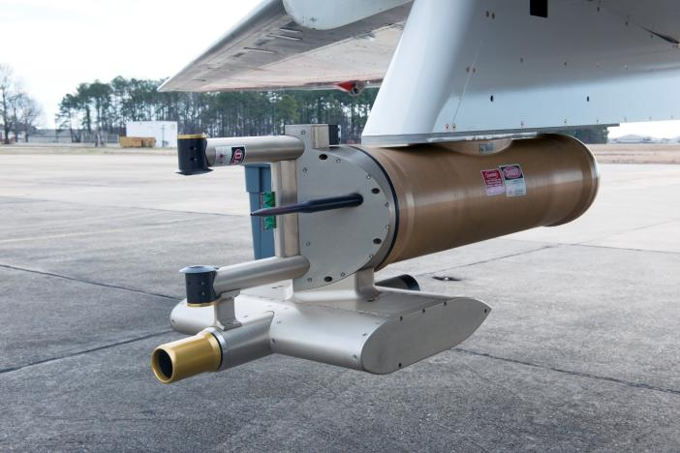
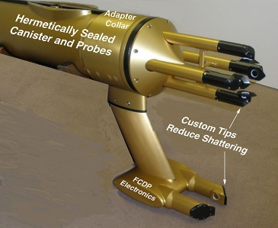
Extra Slides
Payload: Falcon External Probes
Cloud Residual Properties (CVI)
Cloud Droplet Probe
Isokinetic Aerosol Inlet
AC3 Cloud Collector
Trace Gases
Cloud Aerosol Precipitation Spectrometer (Langley)
Turbulent Air-Motion Measurement
FCDP/2D-S Cloud probe (DLR)

Slide 43
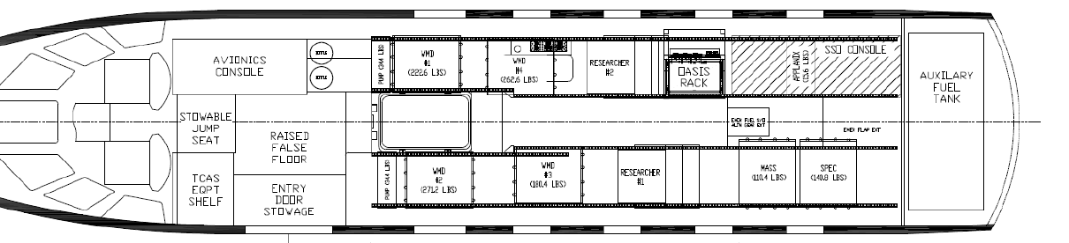
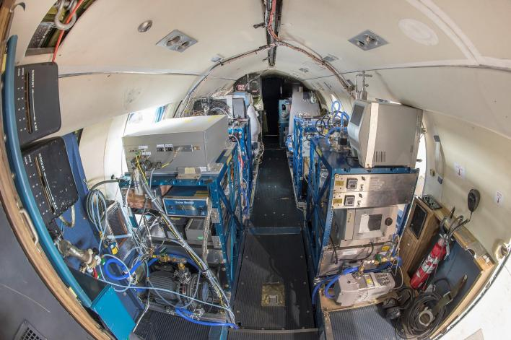
Extra Slides
Payload: Falcon In-Situ Measurements
Trace Gases
Ozone, CO, CO2, H2O
Aerosol Composition (HR-ToF-AMS)
Aerosol Composition (PILS)
Pilot
Avionics
Operator
Crown-Mounted Inlets
Maintainer
Pilot
Operator
Entry Door
Aerosol Optical
Scattering, Absorption, Hygroscopicity
Falcon Layout for ACCESS
Cloud Condensation Nuclei
Aerosol Microphysics

Slide 44
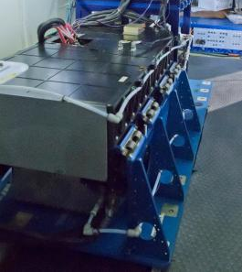
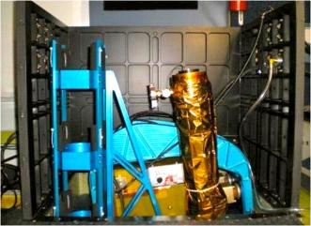
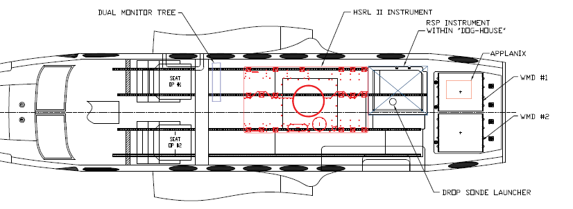
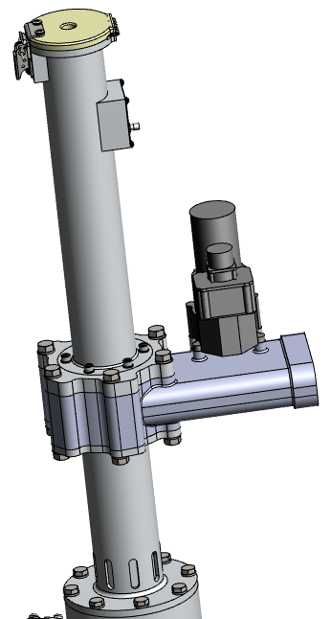
Extra Slides
Payload: King Air
High Spectral Resolution Lidar (HSRL-2)
Research Scanning Polarimeter (RSP)
Pilot
Operator
Pilot
Operator
Entry Door
Dropsonde (AVAPS) and RSP support Electronics
Dropsonde Tube Penetration
U.Wyo B-200 Launcher

