Slide 1
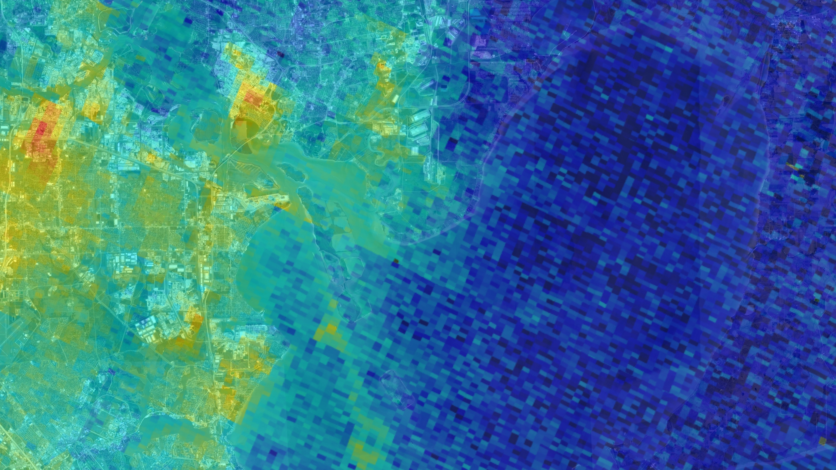

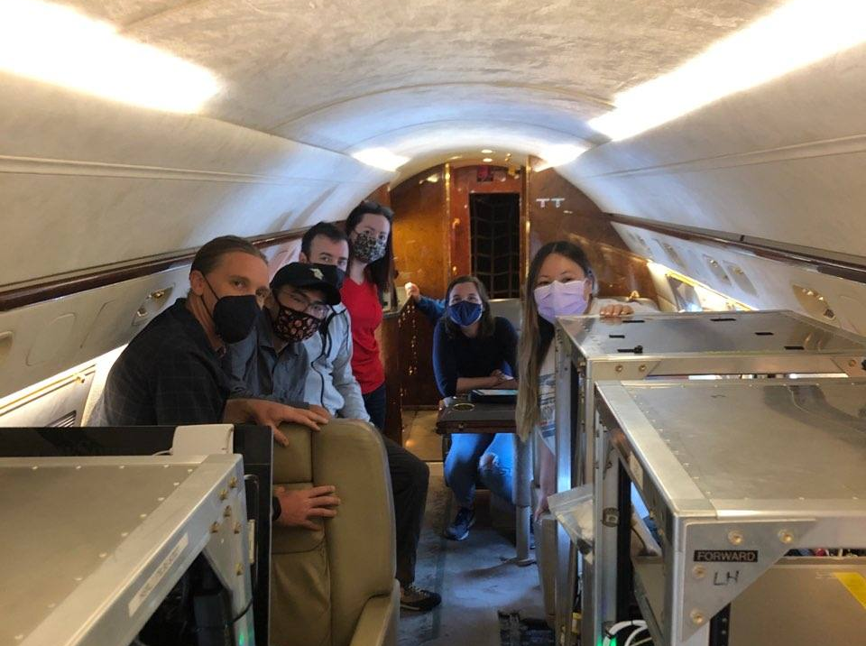
GCAS Observations on the JSC G-V
Laura Judd, NASA LaRC
Scott Janz, NASA GSFC
Jayne Boehmler and Sam Xiong, SSAI/NASA GSFC

Slide 2
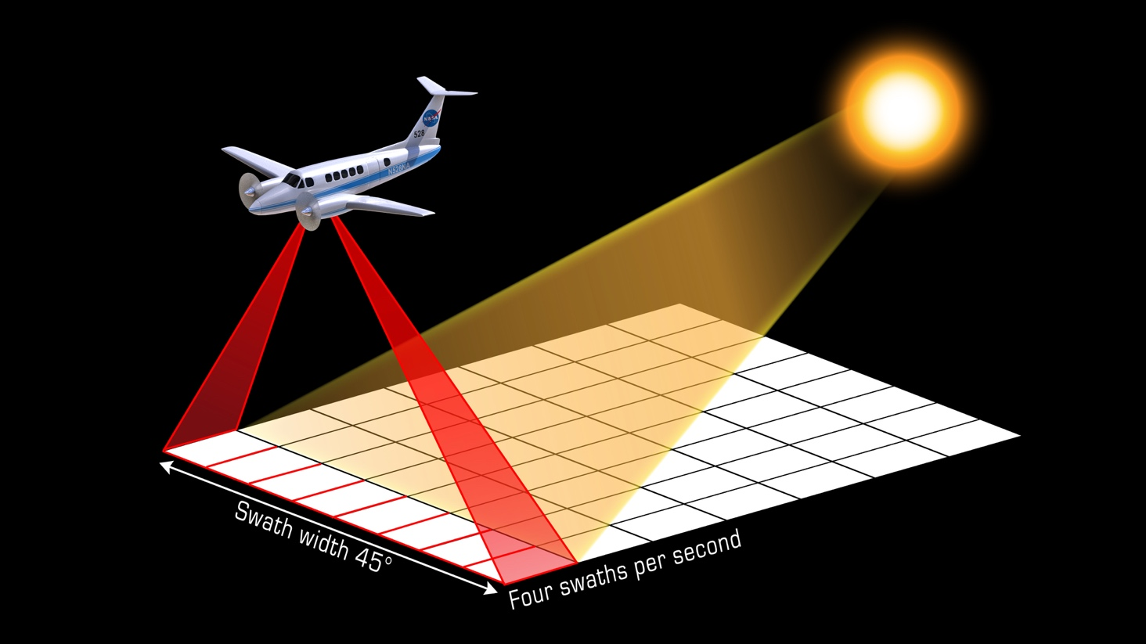
NASA GCAS Airborne Spectrometer
To be installed with HSRL2 on the JSC G-V
Primarily been used to collect preparatory measurements for geostationary air quality observations as well as emissions mapping
Observes from the bottom of an airplane with a field of view of ~7 km at a nominal altitude of 28,000 feet executing gapless mapping over areas of interest
Measures spectra in the UV-VIS-(NIR) at high spectral and spatial resolution from which trace gas columns can be remotely retrieved via Differential Optical Absorption Spectroscopy (NO₂ and HCHO at ~ 250-560 m and 750-1680 m, respectively)
Sampling strategy for the airborne spectrometers operating in a push-broom configuration (adapted from Nowlan et al., 2016)
Some References:
Kowalewski & Janz, 2014: doi:10.1117/12.2062058
Leitch et al., 2014: doi: 10.1117/12.2063763
Nowlan et al., 2016: doi:10.5194/amt-9-2647-2016
Nowlan et al., 2018: doi:10.5194/amt-2018-156
Judd et al., 2019: doi: 10.5194/amt-12-6091-2019
Judd et al., 2020: doi: 10.5194/ amt-13-6113-2020

Slide 3
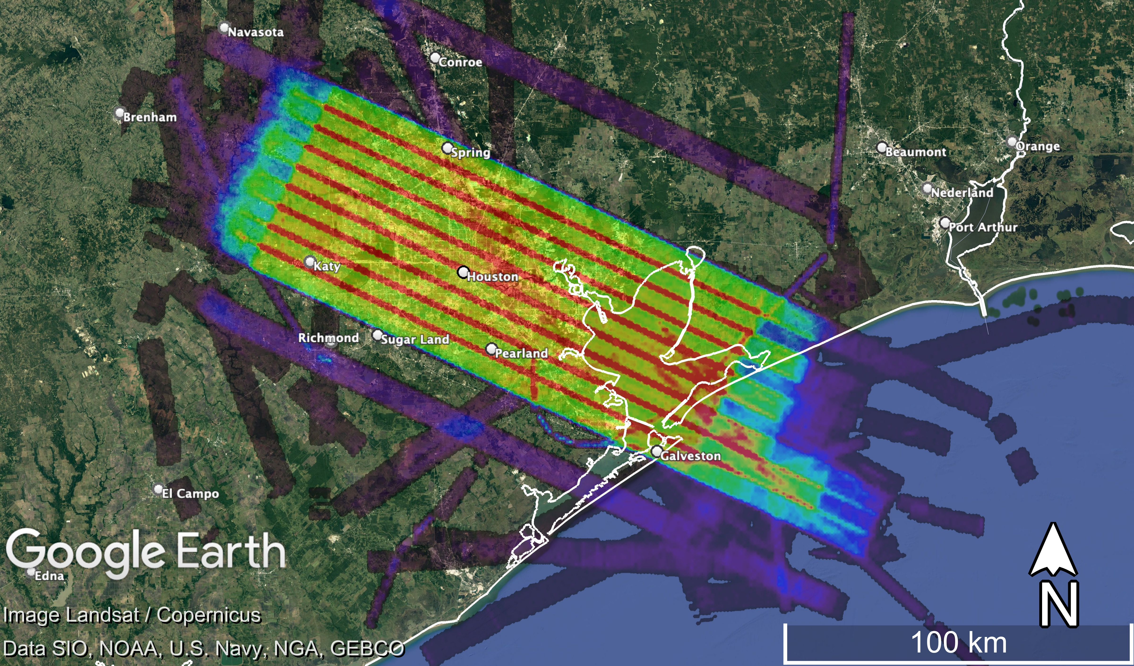
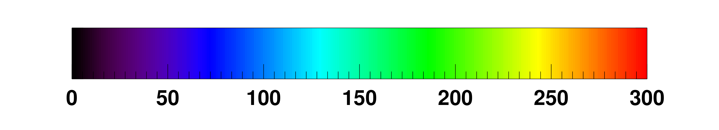
TRACER-AQ G-V Flight Strategy
Sampling Density for GCAS in Houston at 1km scale during TRACER-AQ
Repeated systematic sampling over the same area up to 3 times in a day to provide a balance of looking over a wide region but being able to better understand day-to-day and time-of-day variance in NO₂ and HCHO (mimicking geostationary)
For STAQS: similar areas will be mapped (50 x 130 km) over NYC, Chicago, and LA
2x/day expected for the G-III

Slide 4
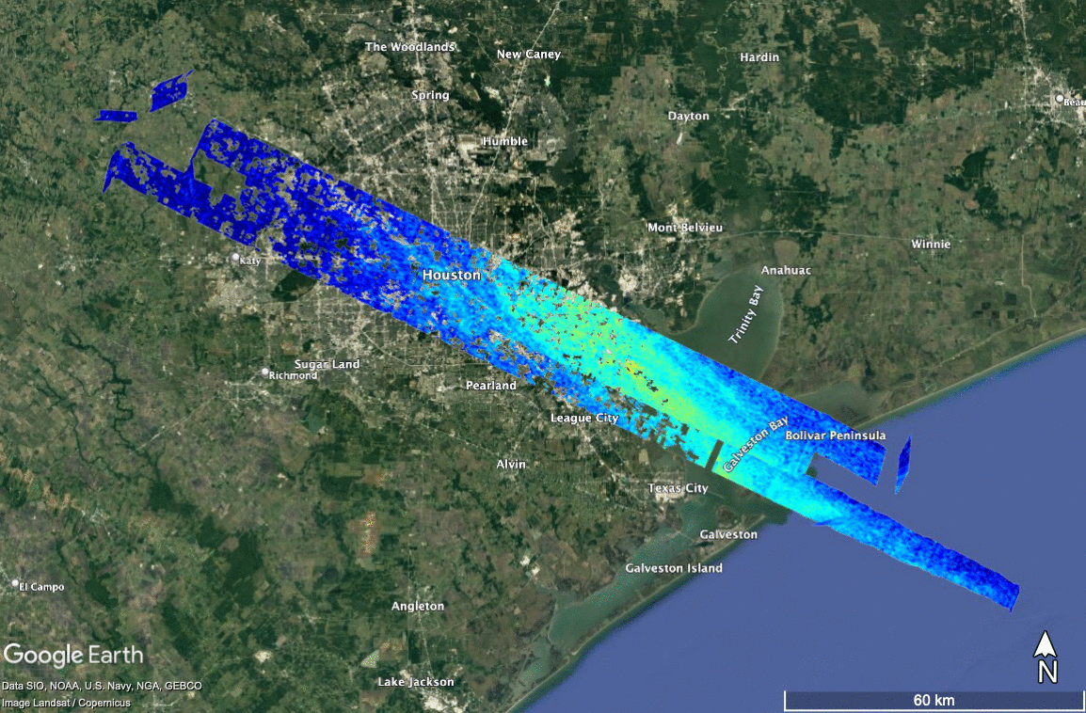
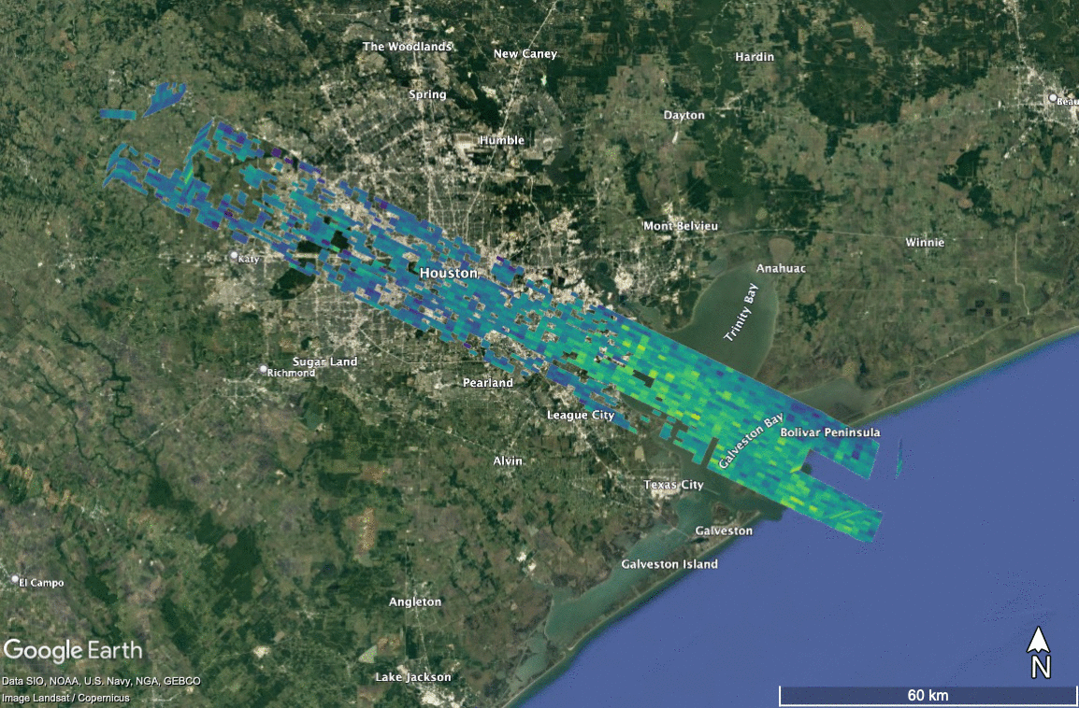
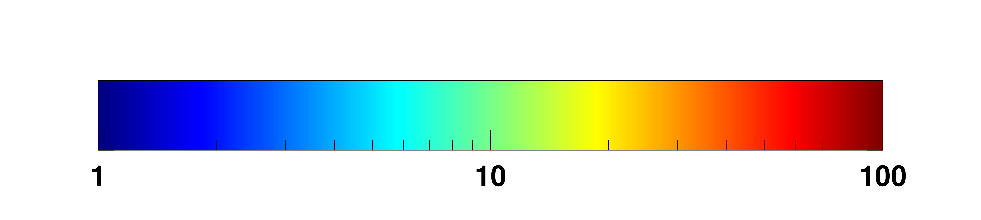
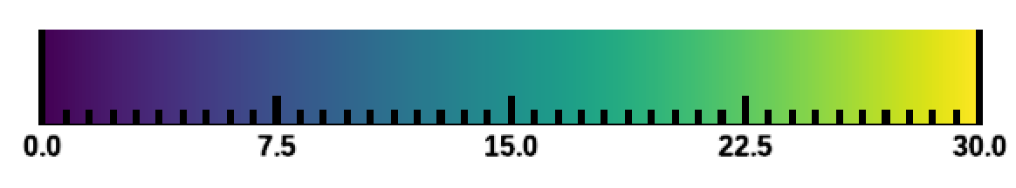
GCAS Data Status/Examples from TRACER-AQ
NO₂ and HCHO data are in the archive and publicly available.
Holes in data are clouds
NO₂ Tropospheric Vertical Column (x10¹⁵ molecules cm⁻²)
HCHO Vertical Column (x10¹⁵ molecules cm⁻²)
There are no time/date labels. But instead marked success of mapping the same areas systemically 27+ times.
Illustrating the complex variance of the spatiotemporal evolution of NO₂ and HCHO

Slide 5
GCAS v. Pandora during TRACER-AQ
NO₂ Comparisons
HCHO Comparisons
y=0.87x+1x10¹⁵
r²=0.72
y=0.50x+4e15
r²=0.29
Comparison methodology:
Pandora nearest Pandora valid data point within +/- 15 minutes of GCAS overpass
GCAS mean column within 750 (2250) m +/- stddev for NO₂ (HCHO)
Pandora QA value of 0 or 10

Slide 6
Potential research uses
TEMPO validation/evaluation – focus on the diurnal aspects
TROPOMI S5P NO₂ and HCHO evaluation along with Pandora
How does the top-down temporal evolution of NO₂, HCHO, ozone match with ground-based and modeled measurements? Especially during ozone events.
Continued evaluation on the connections of HCHO column in relation to surface ozone using Pandora and GCAS
Pollution inequality to better understand pathways for achieving environmental justice
Quantifying emissions using GCAS NO₂ observations—how can we extend toward CO2 during STAQS? At least better understanding quantitative relationship between NO2 and CO2 emissions

Slide 7
Thanks for you attention!

