Slide 1
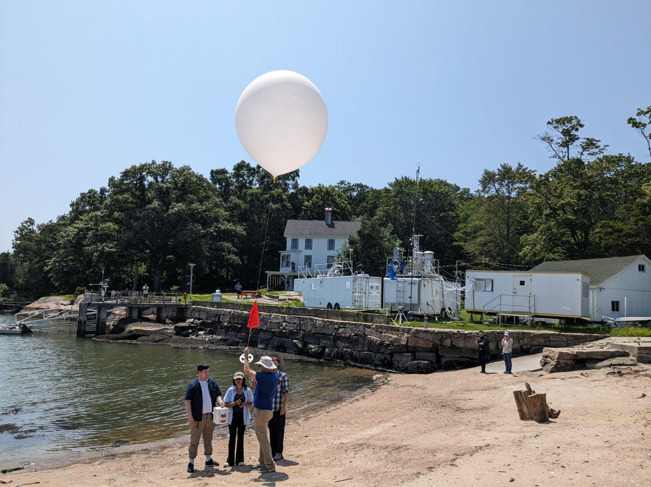
Ozonesondes during STAQS
70 ozonesondes from the three ozone lidar locations
Flax Pond Marine Site, NY
NASA LaRC ozone lidar
40 ozonesondes
Westport, CT
NASA LaRC ozone lidar
17 ozonesondes
Yale Coastal Field Station, CT
NOAA TOPAZ ozone lidar
13 ozonesondes
Left: Yale Coastal Field Station (YCFS)

Slide 2
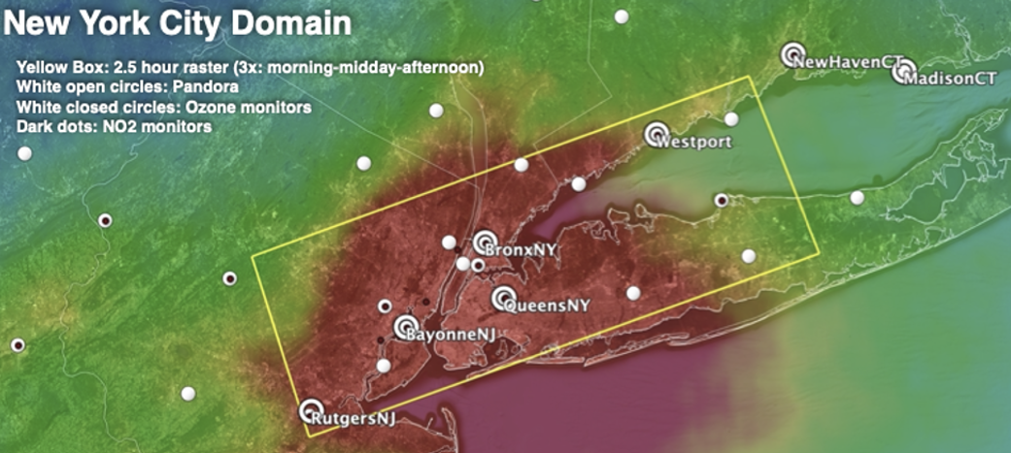
YCFS
Flax
Above: STAQS NYC domain. Image courtesy of Laura Judd

Slide 3
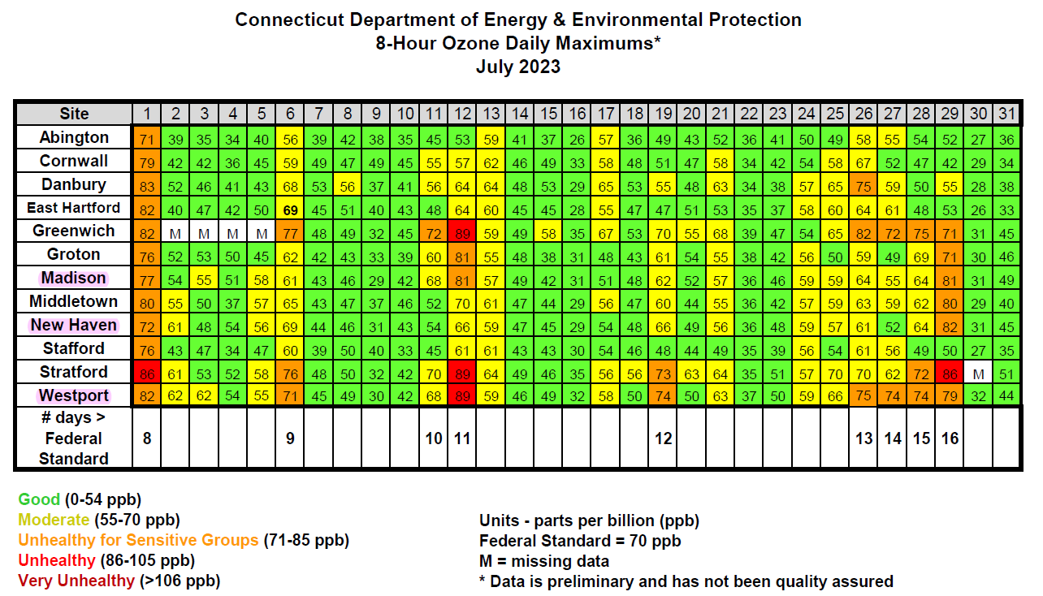

Slide 4
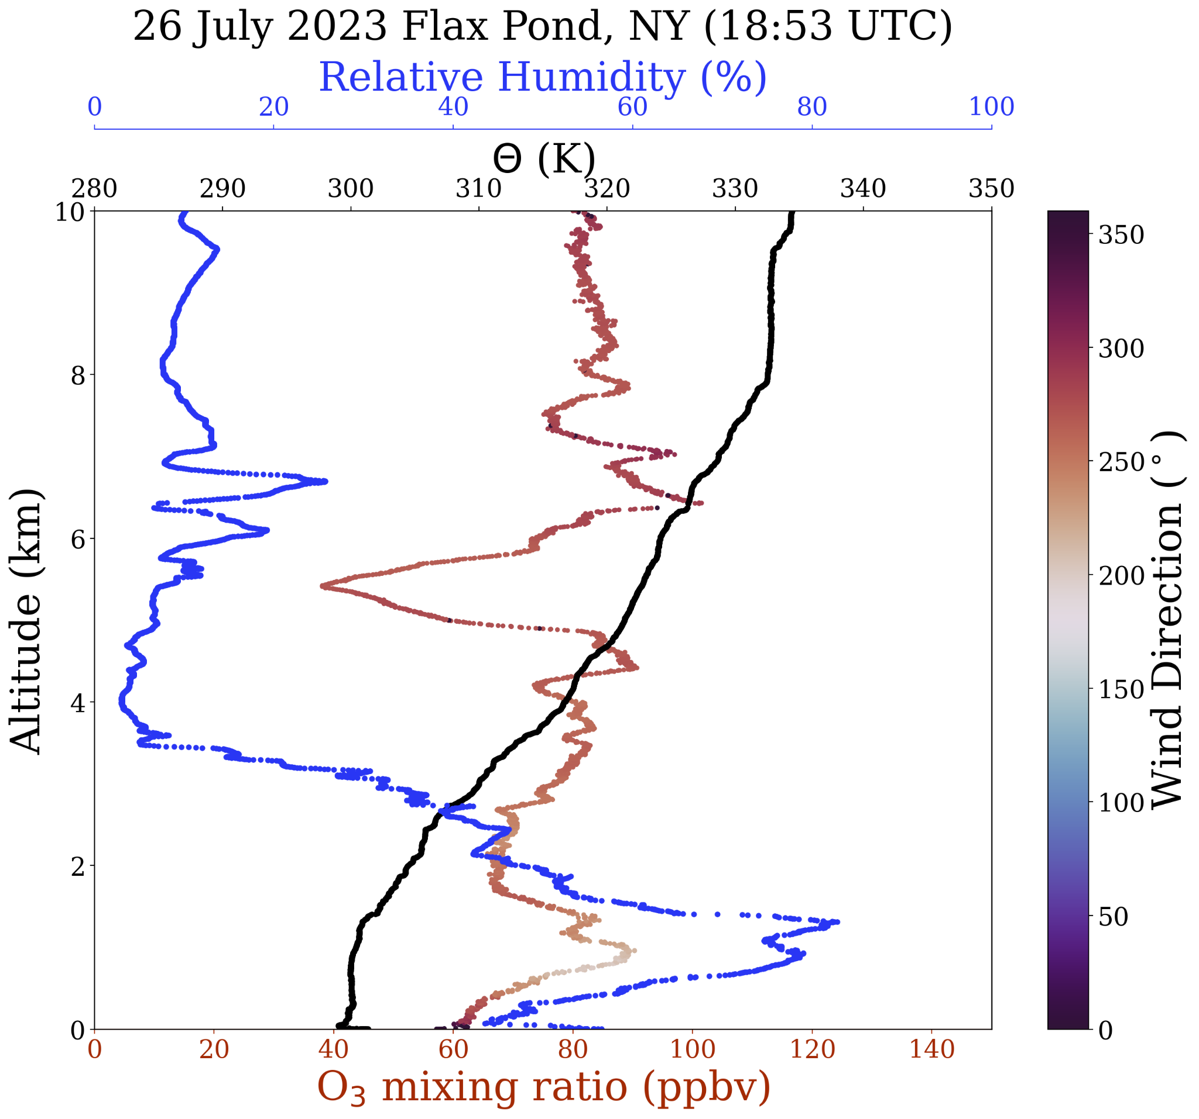
Ozonesondes during STAQS
Balloon-based Instruments: En-Sci 2Z Ozonesonde iMet-4RSB Radiosonde
Data Collected: Vertical Profiles of O₃ and meteorological data Altitude range: Surface to 24-30 km depending on balloon size Rise rate of ~5 m/s
Instrument Performance: Ozone Accuracy: 5-10% Response time: ~25 s (vertical resolution ~125 m) Time Resolution: 1 Hz

Slide 5
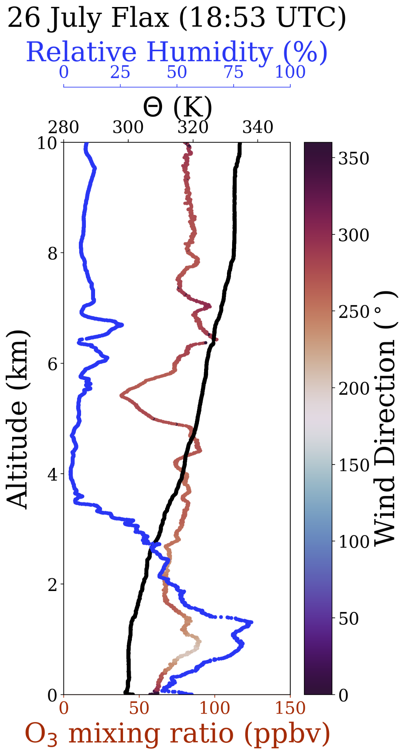
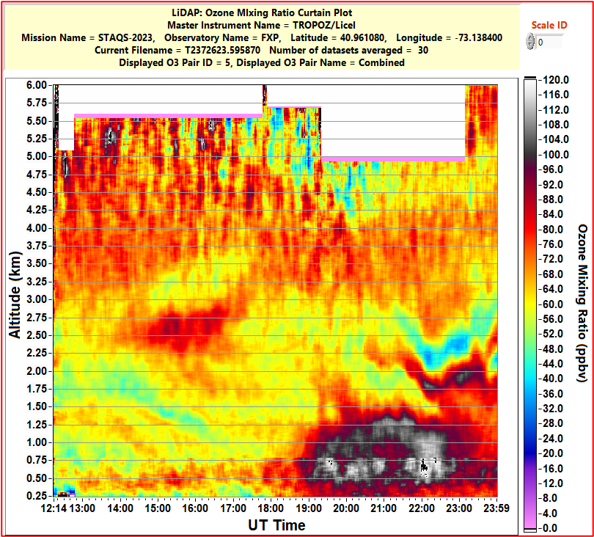
Notes:
The ozonesonde from the Flax Pond Marine Station was just at the beginning of the ozone enhancement observed by the TROPOZ ozone lidar.

Slide 6
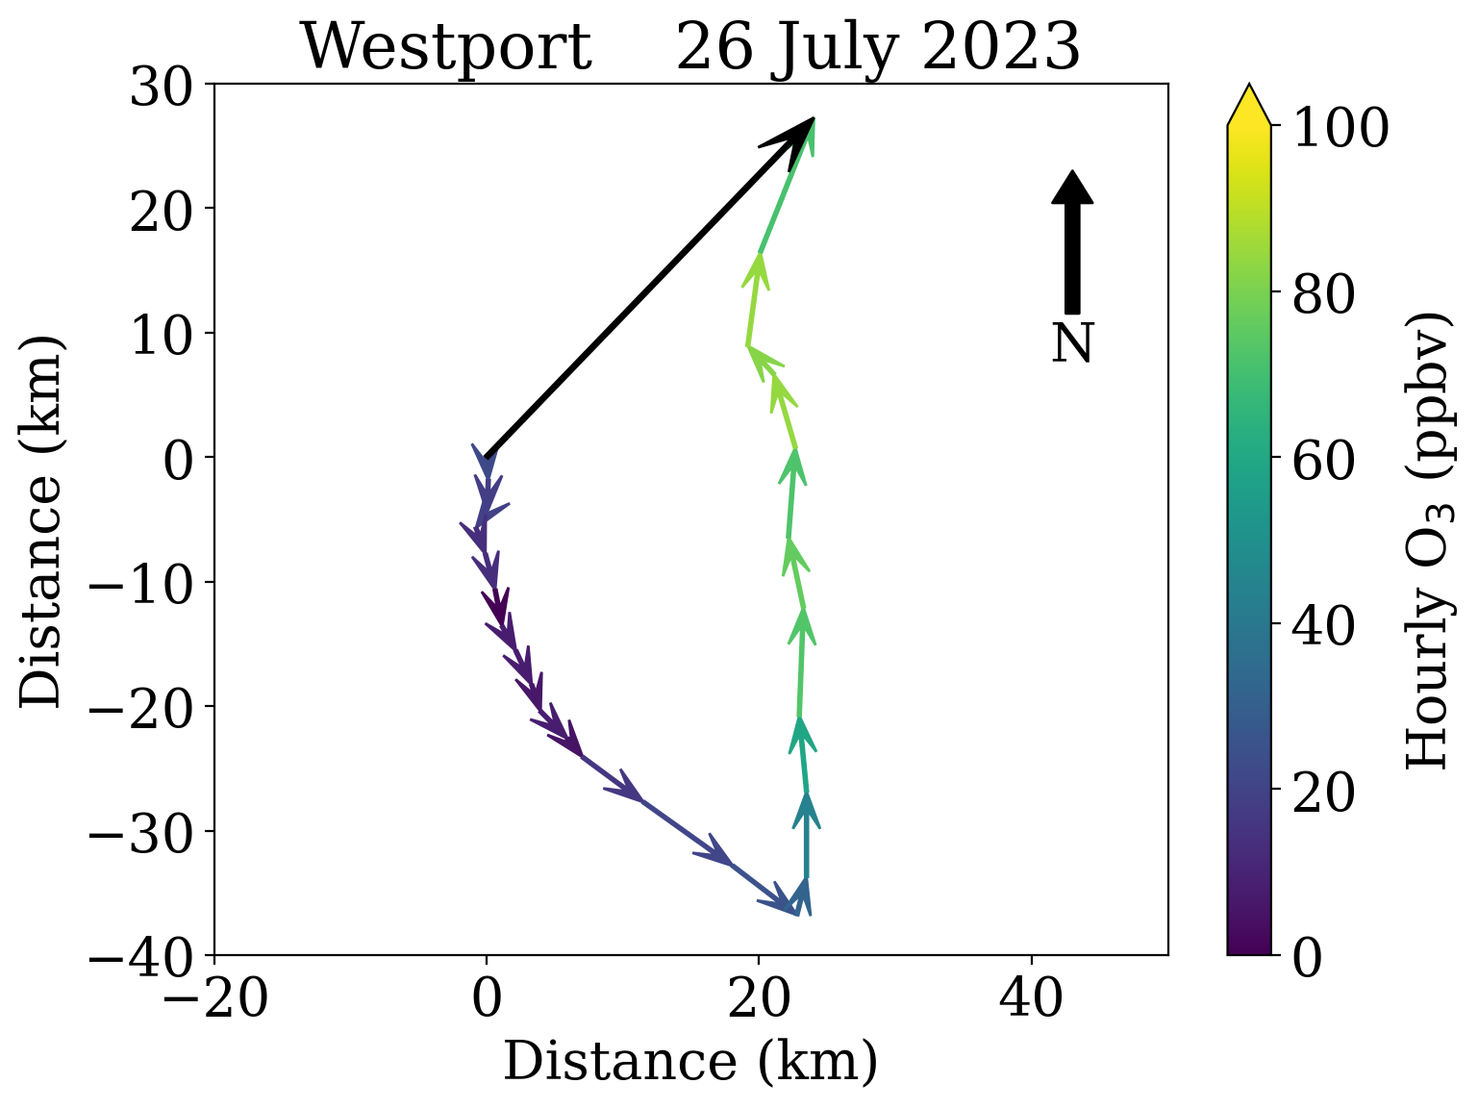
July 26
Ozone increases at Westport after the transition to southerly flow.
Hourly wind vectors starting from 00 UTC

Slide 7
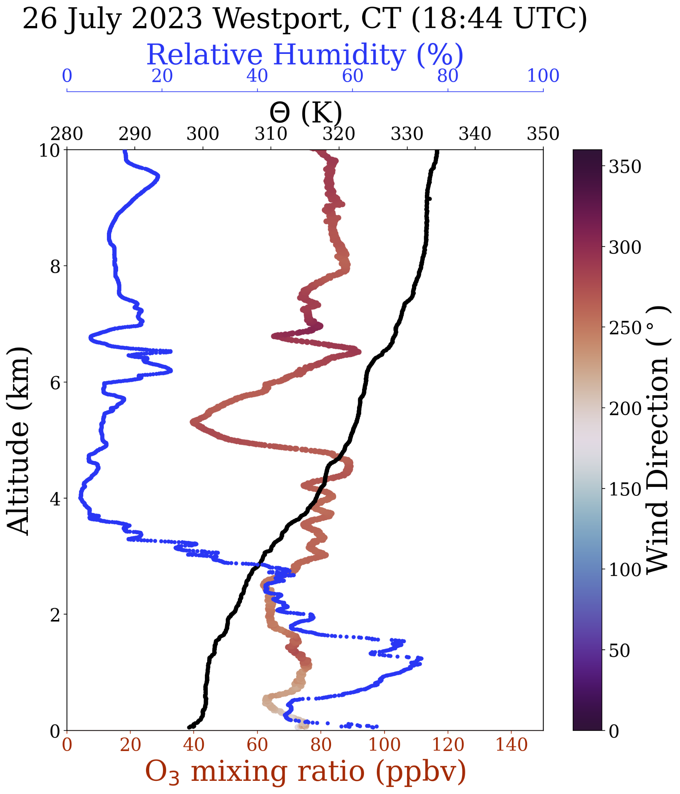
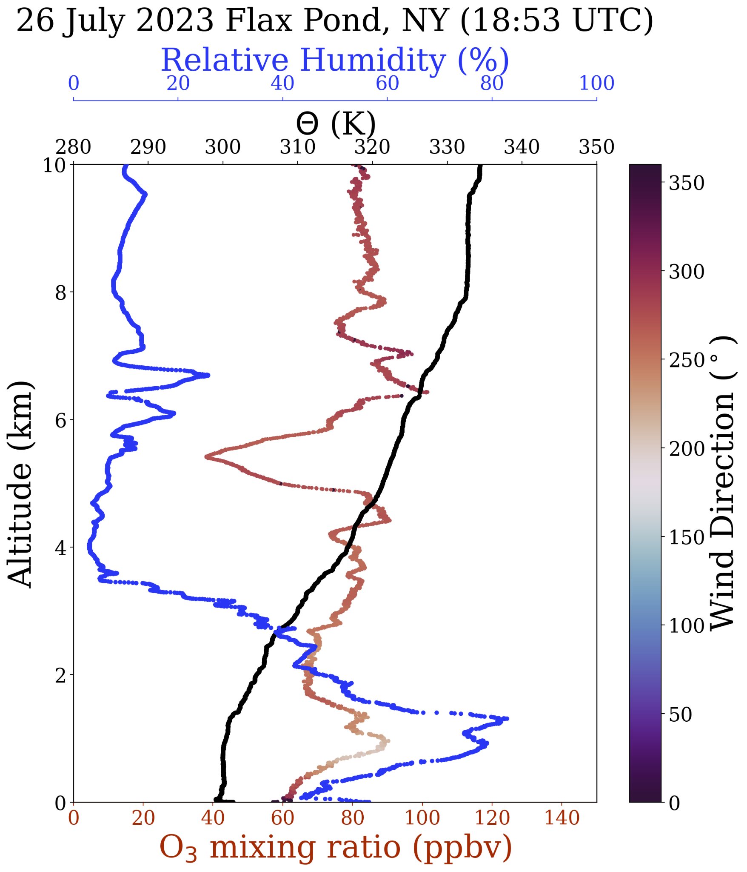
Notes:
The ozone enhancement has not reached Westport yet

Slide 8
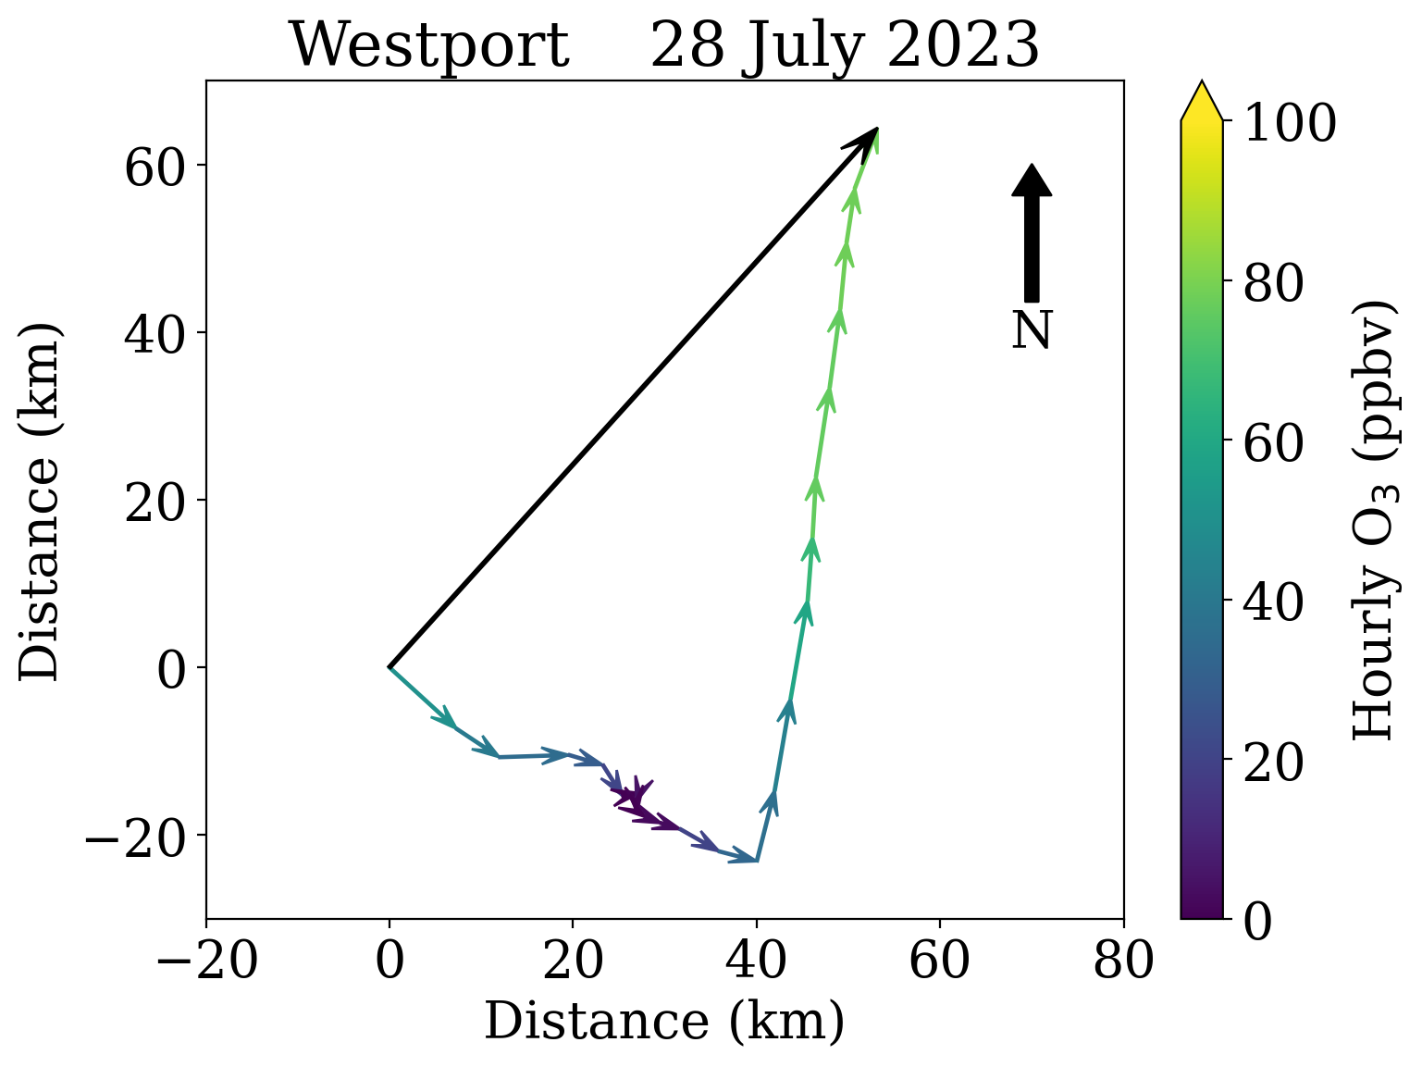
July 28
Ozone again increases at Westport after the transition to winds out of the SSW.
Hourly wind vectors starting from 00 UTC

Slide 9
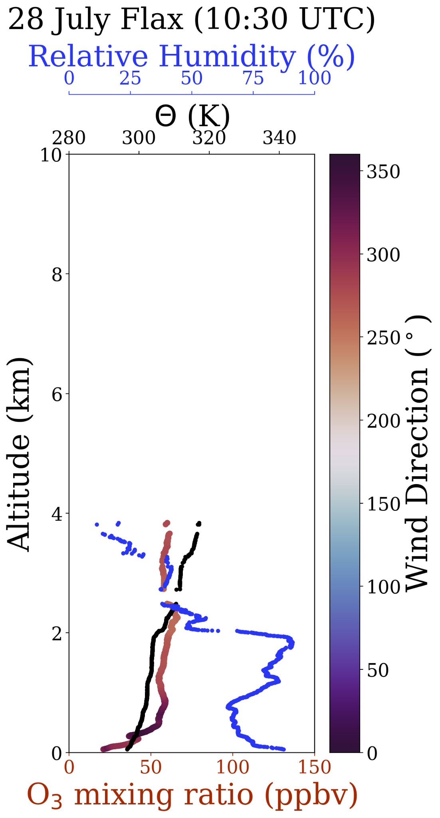
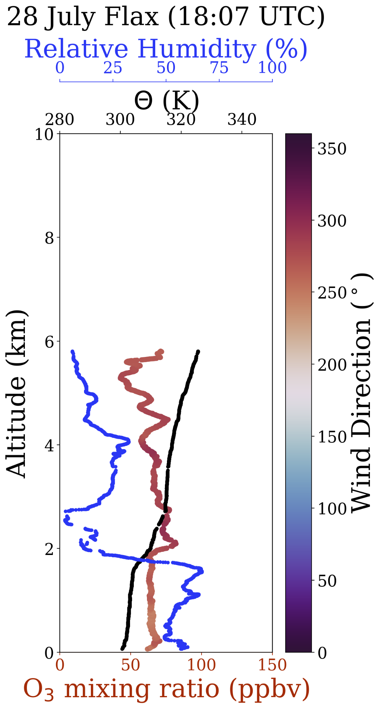
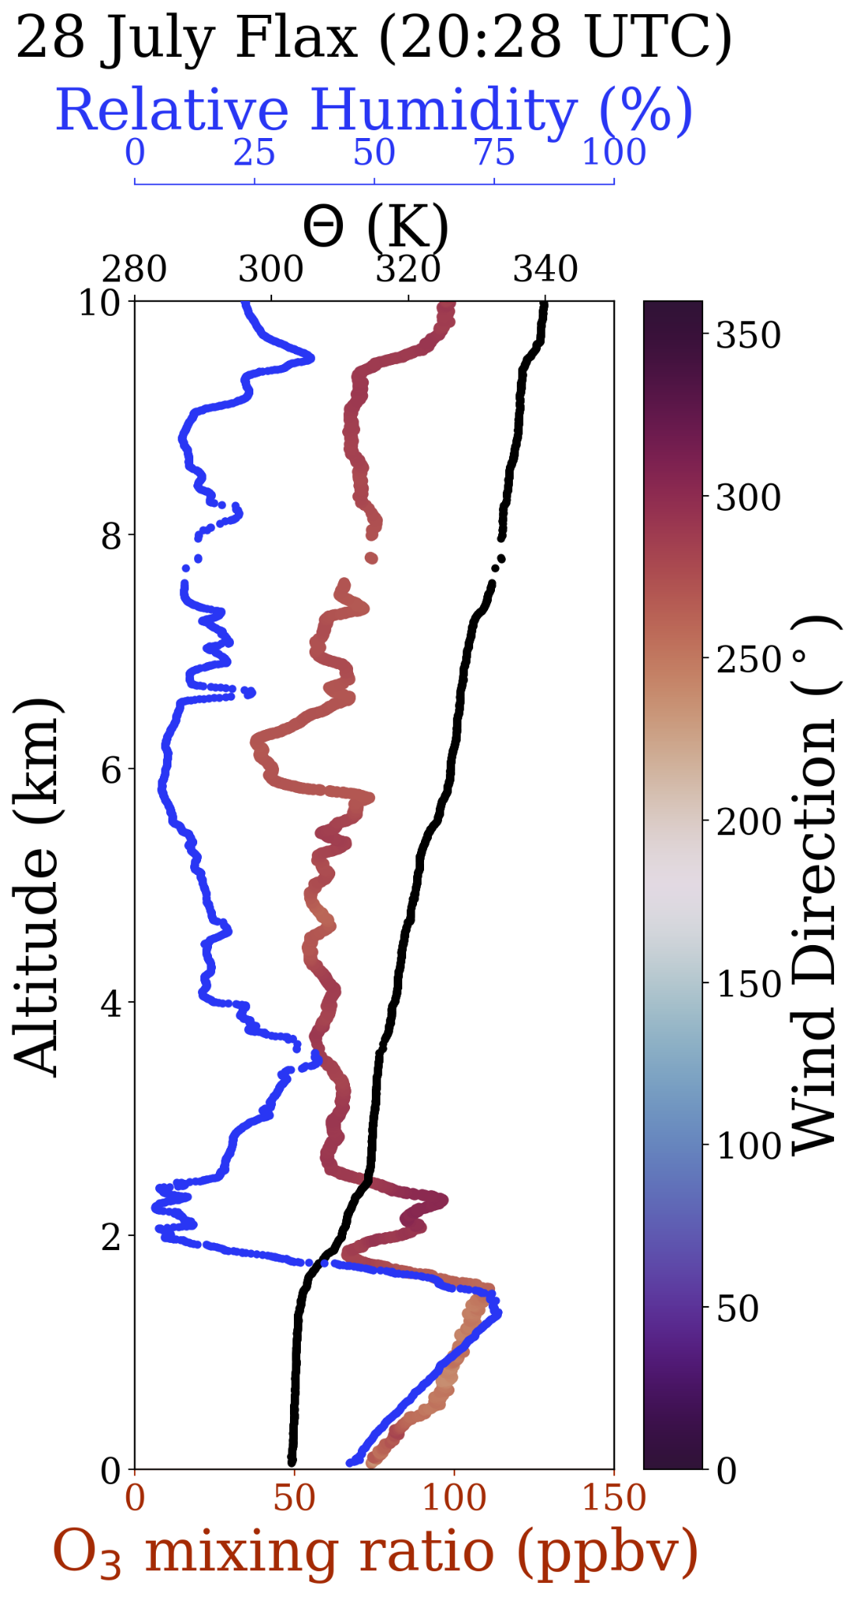

Slide 10
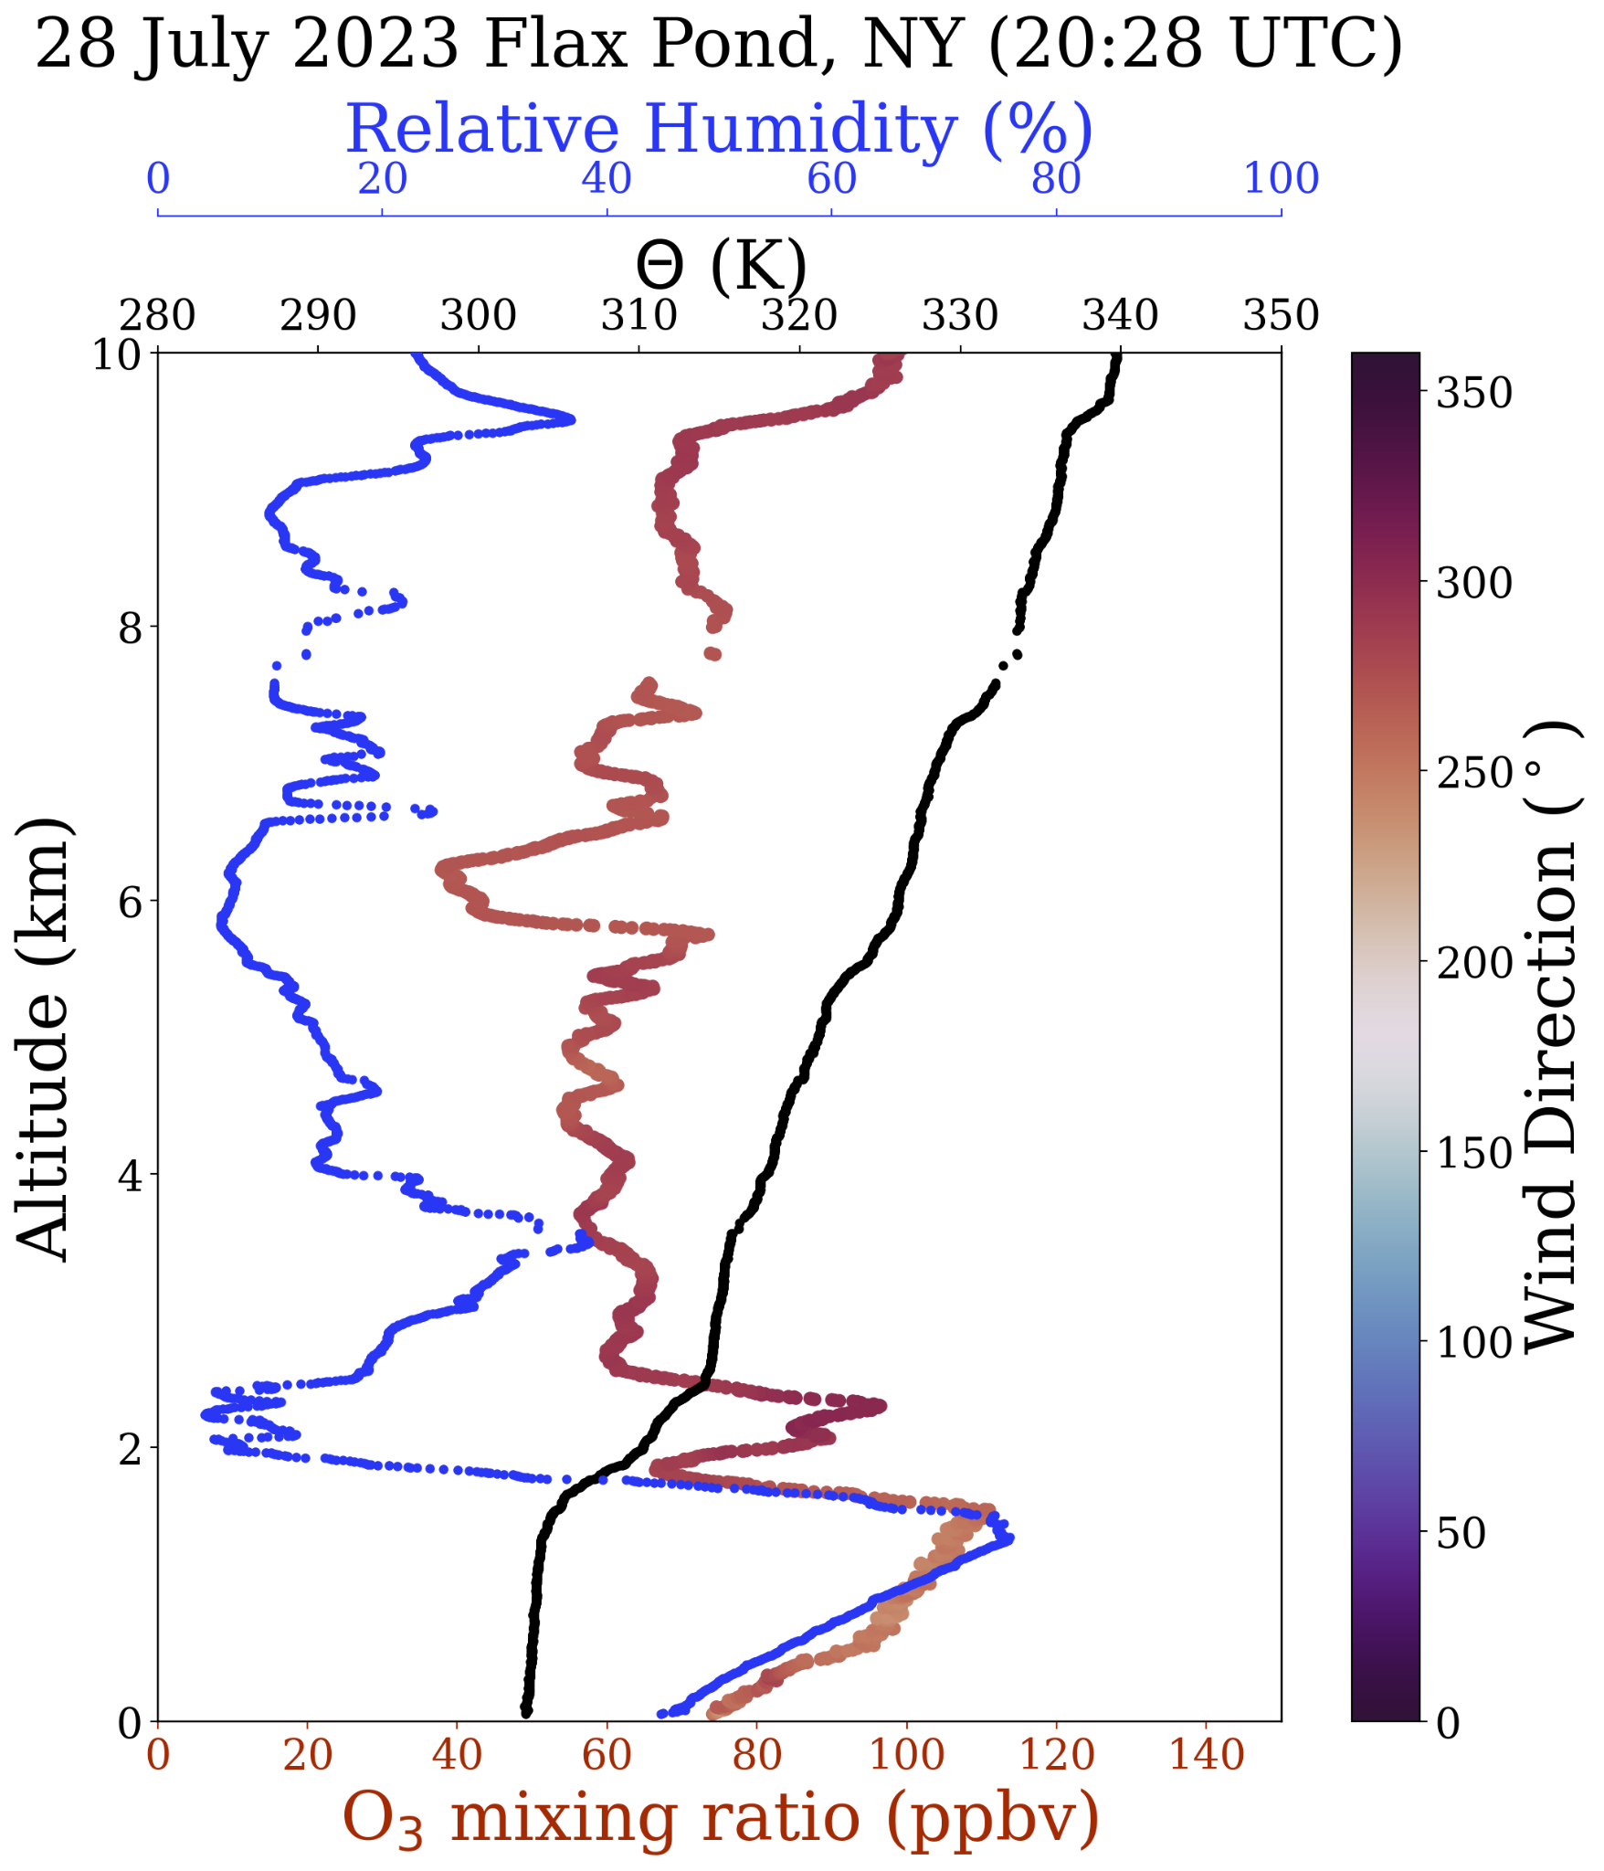
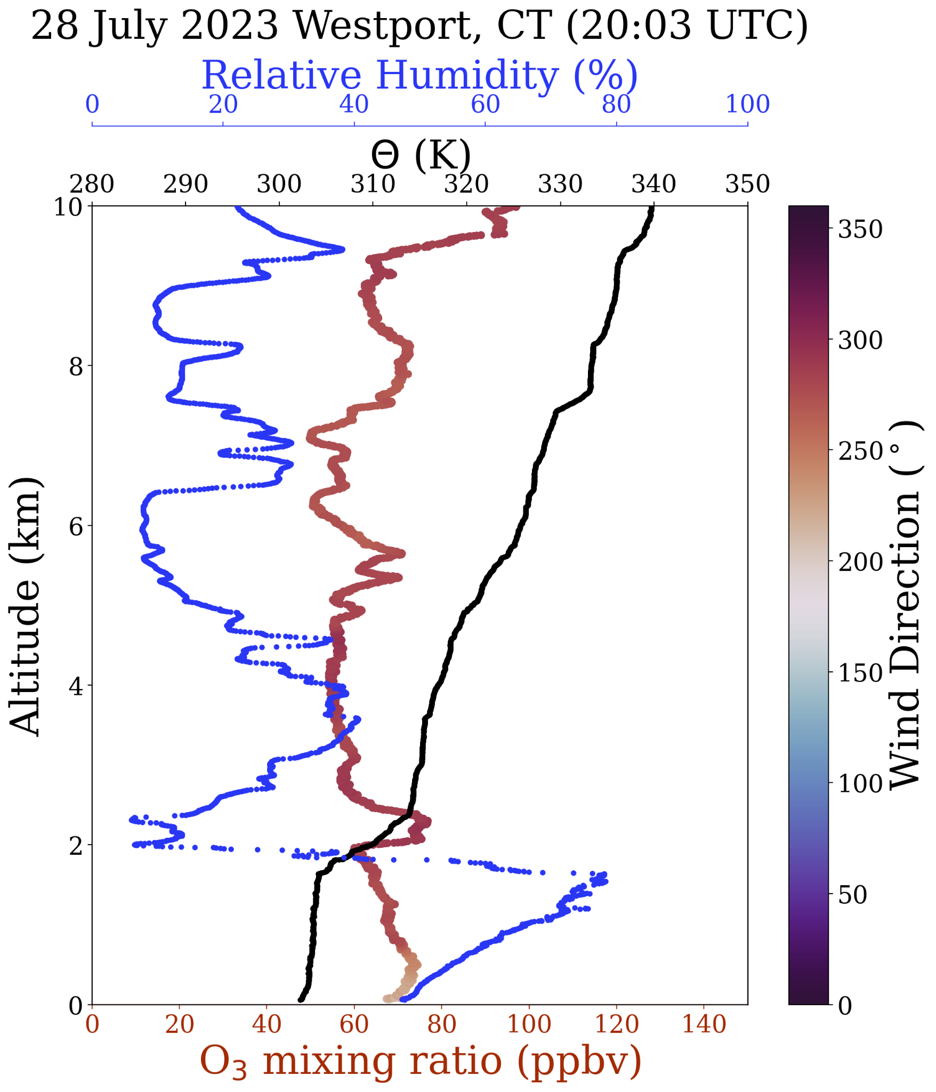

Slide 11
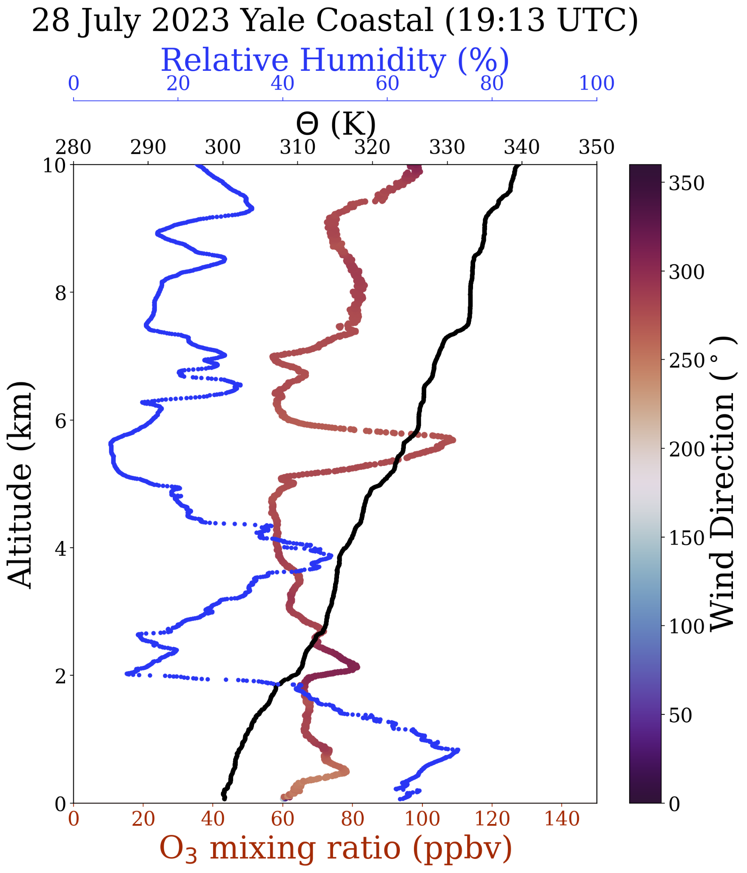
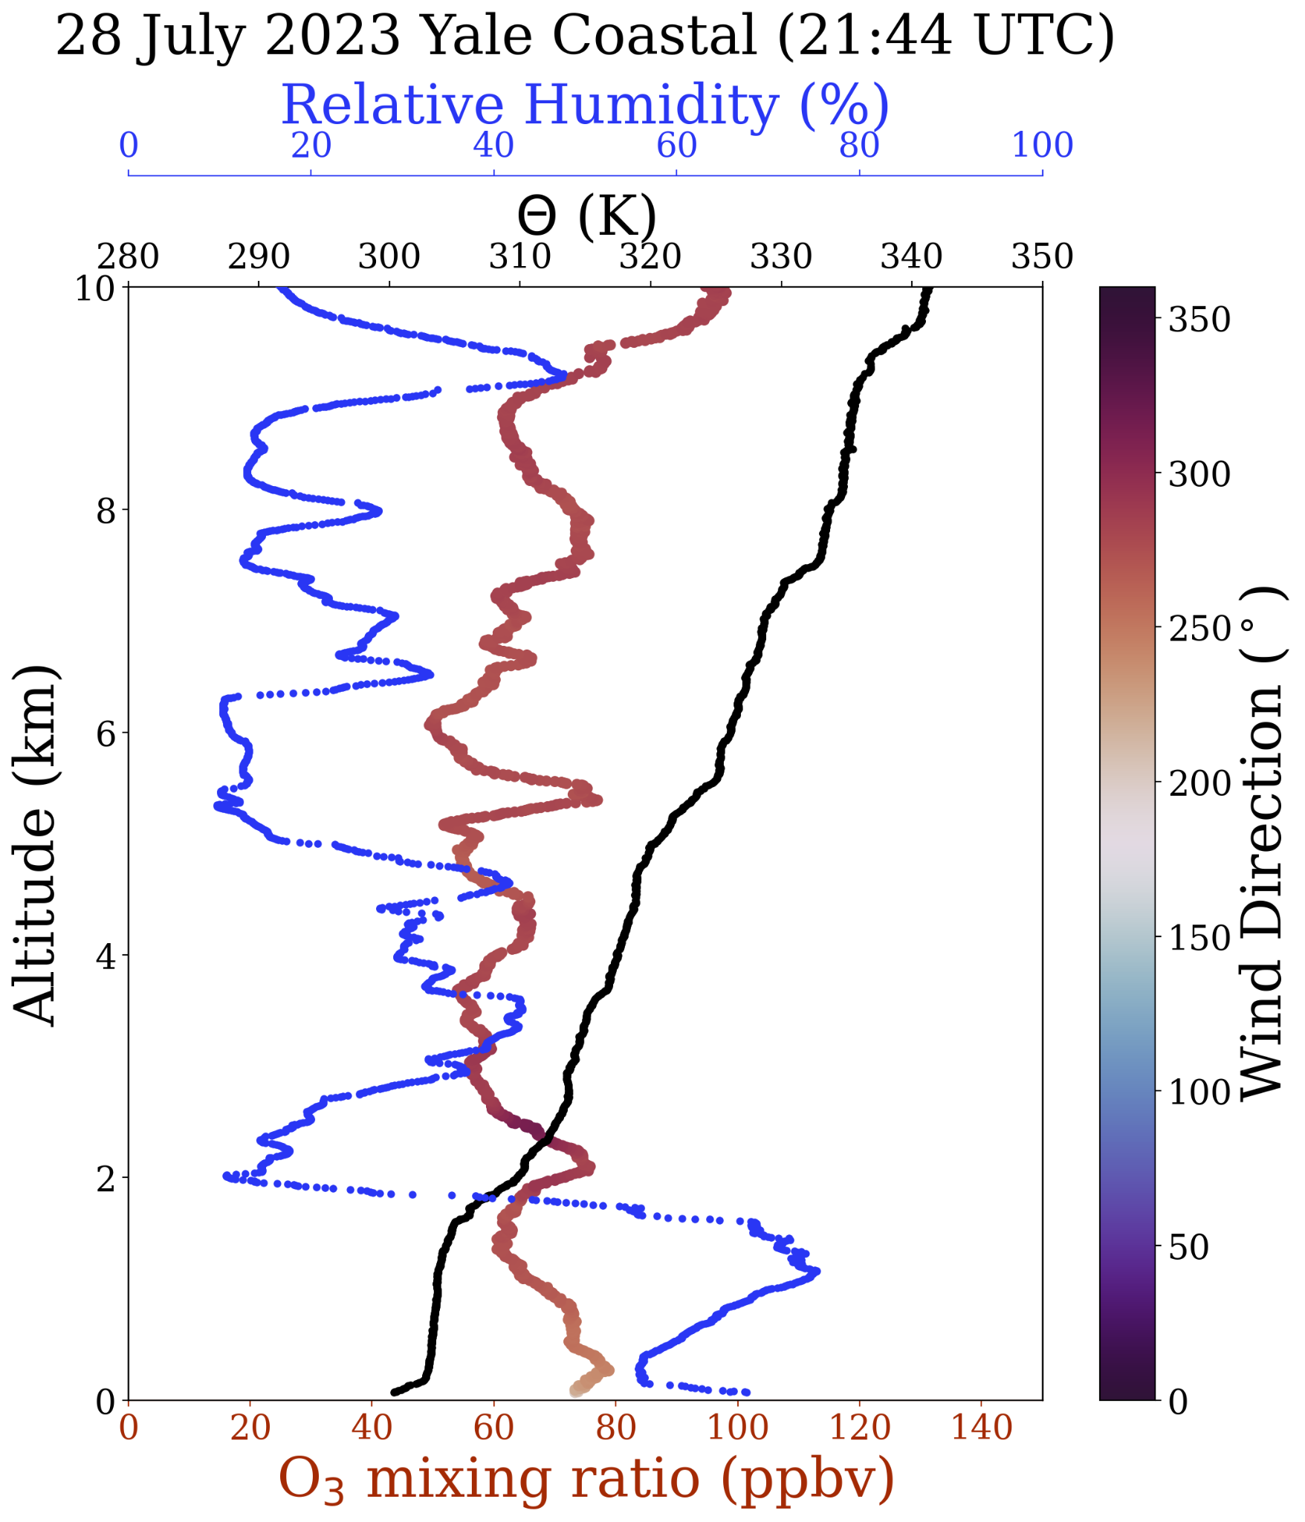

Slide 12
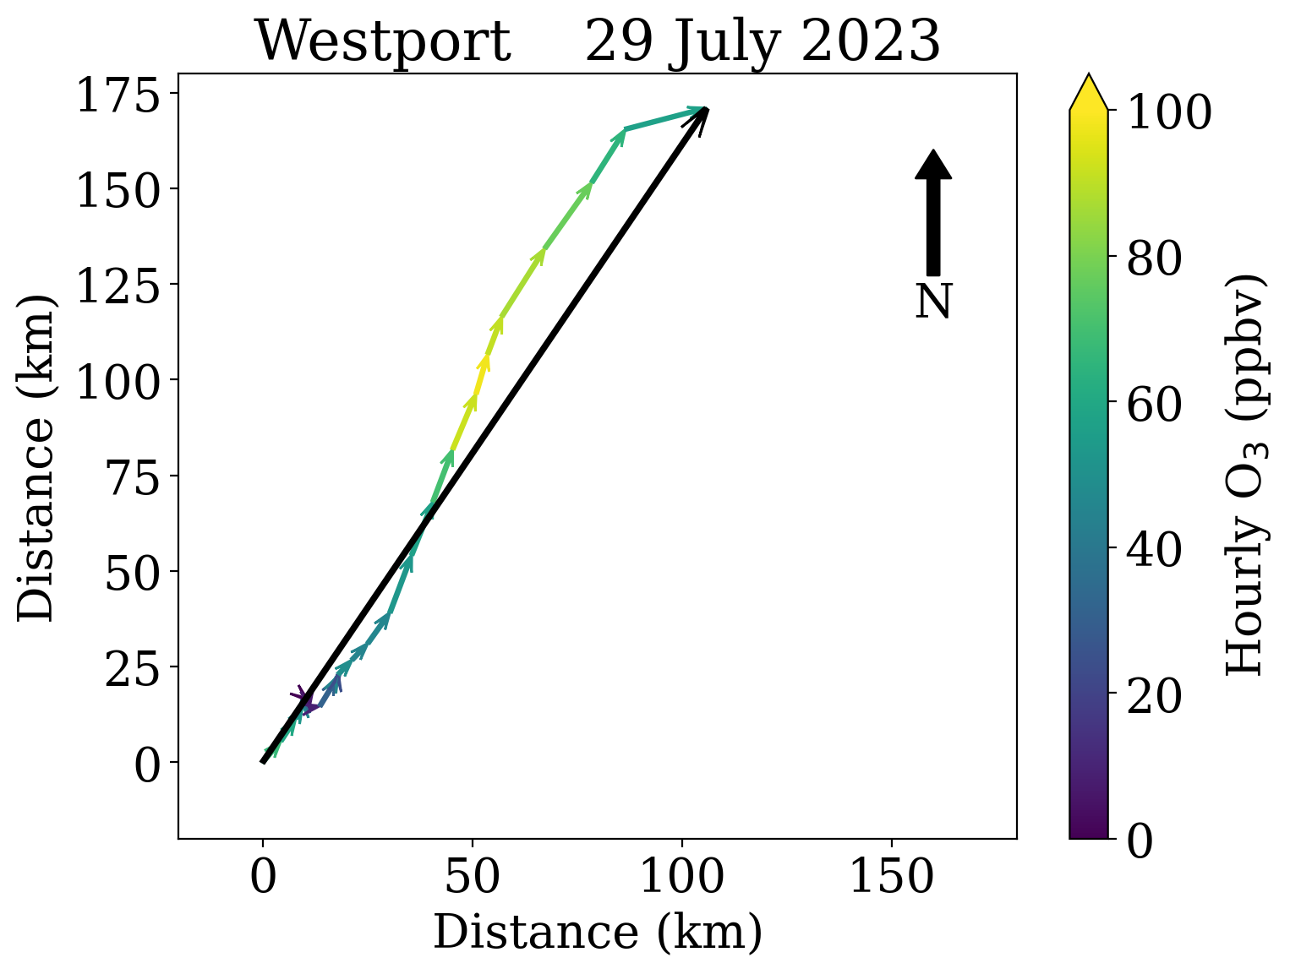
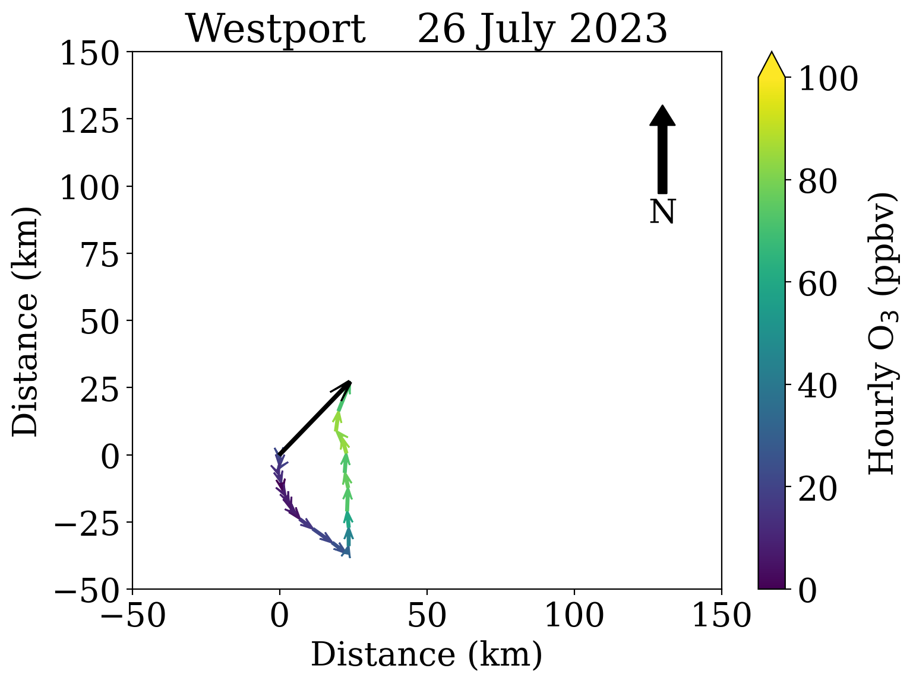
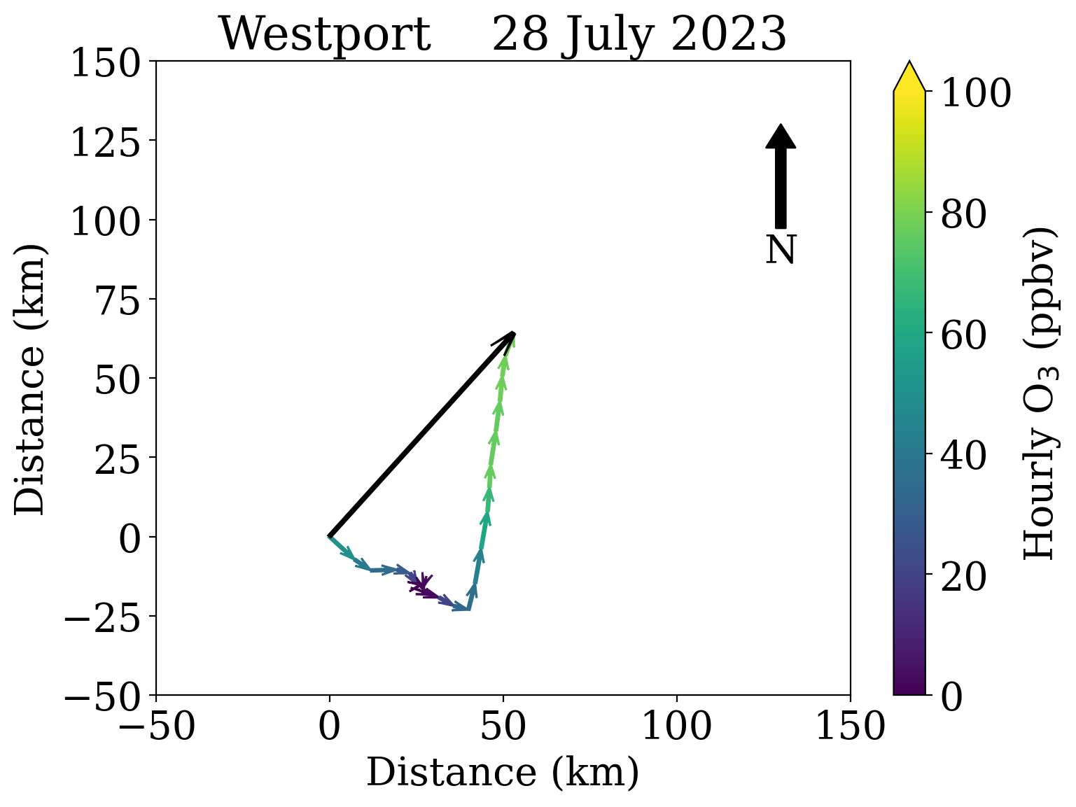
July 29
Relatively strong southwesterly winds in the afternoon
Highest ozone day of the four day (July 26-29) sequence

Slide 13
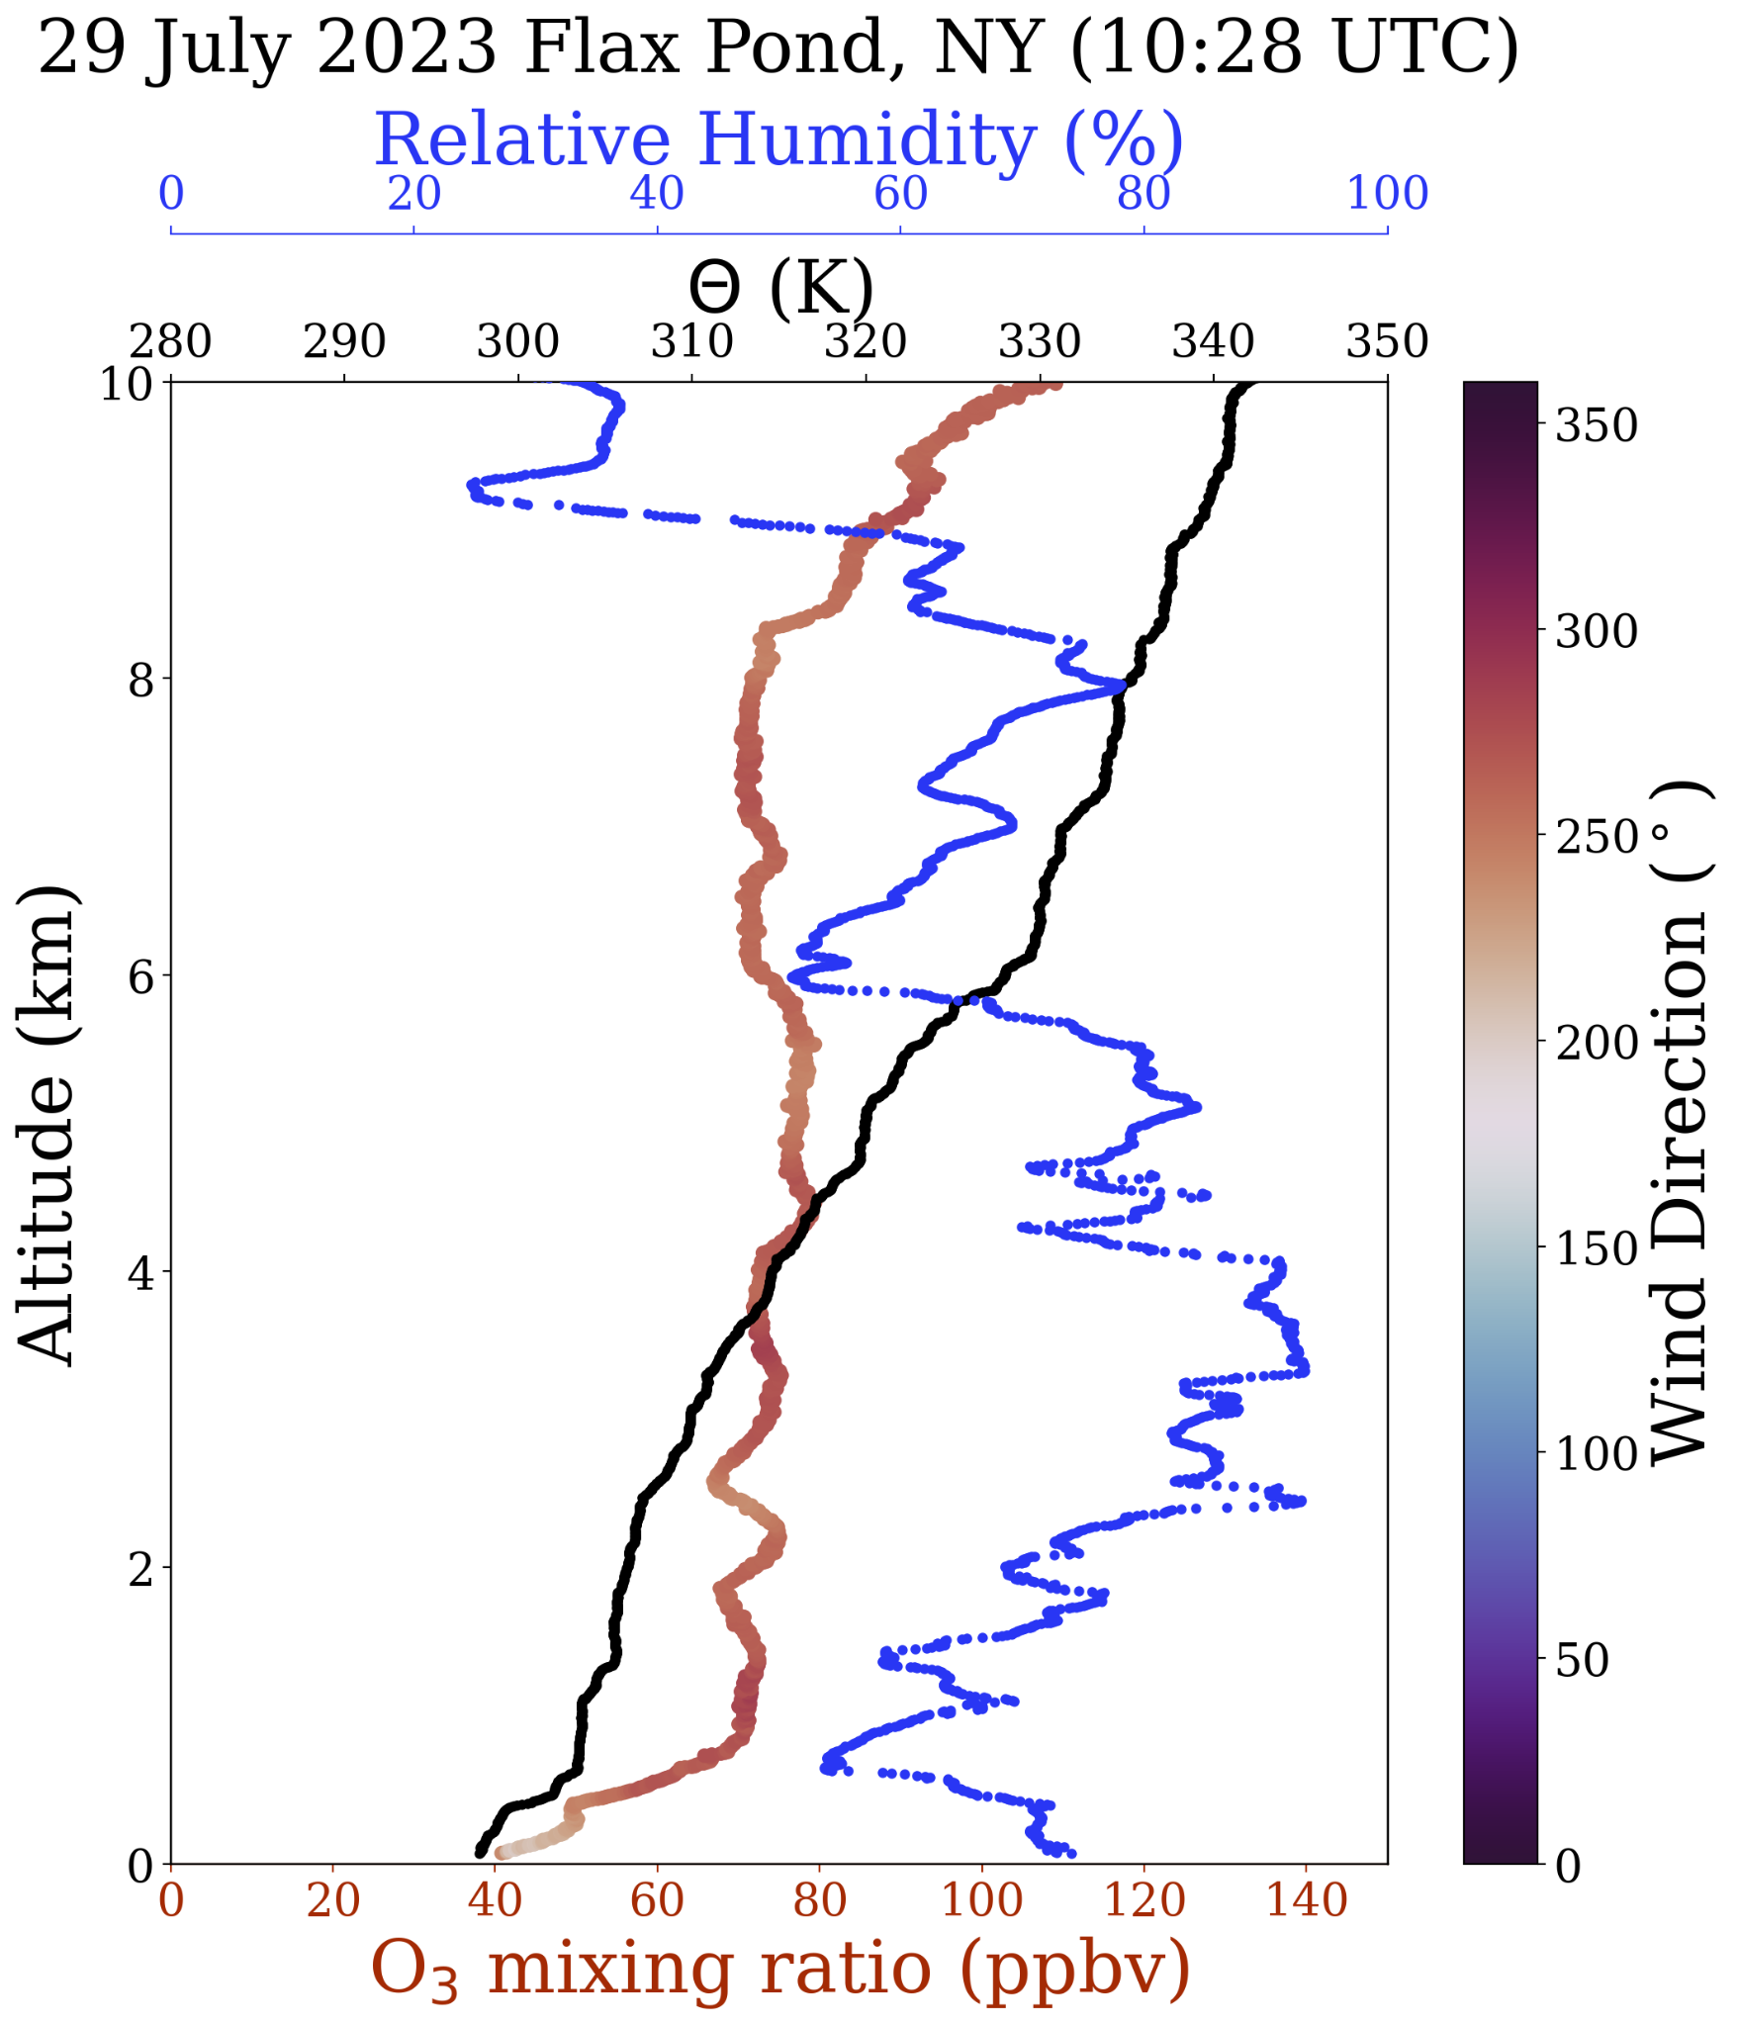
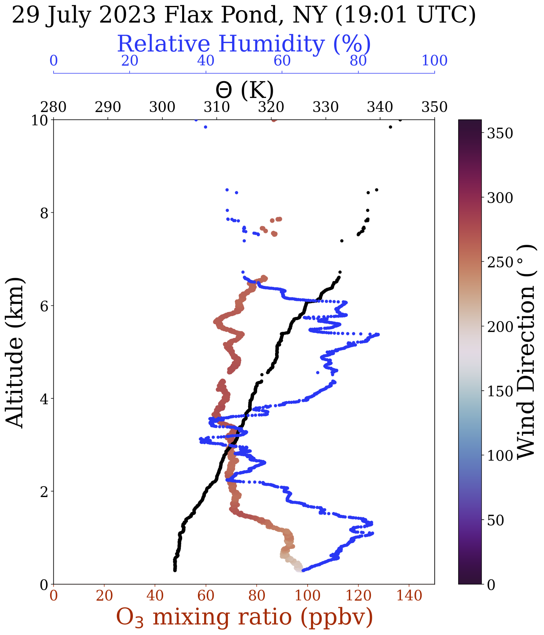

Slide 14
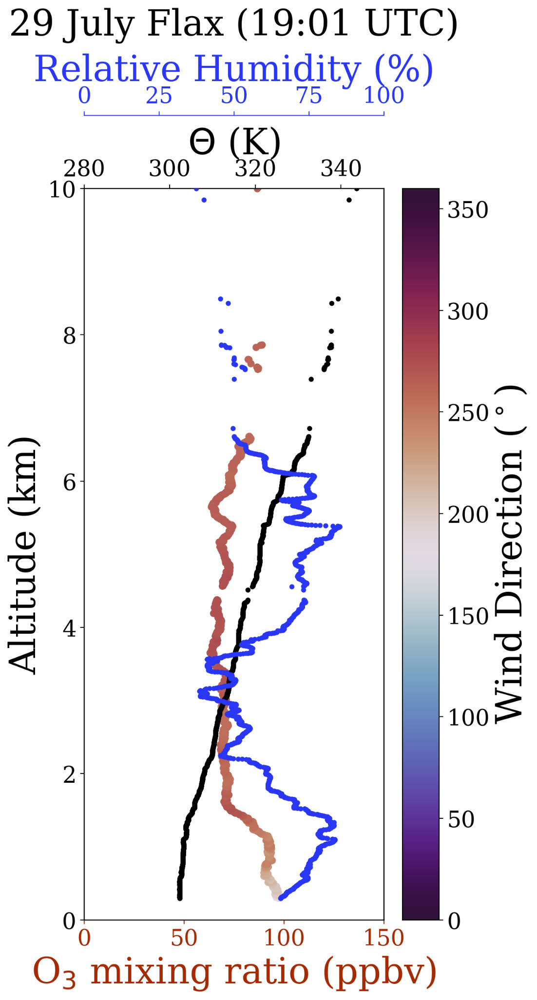
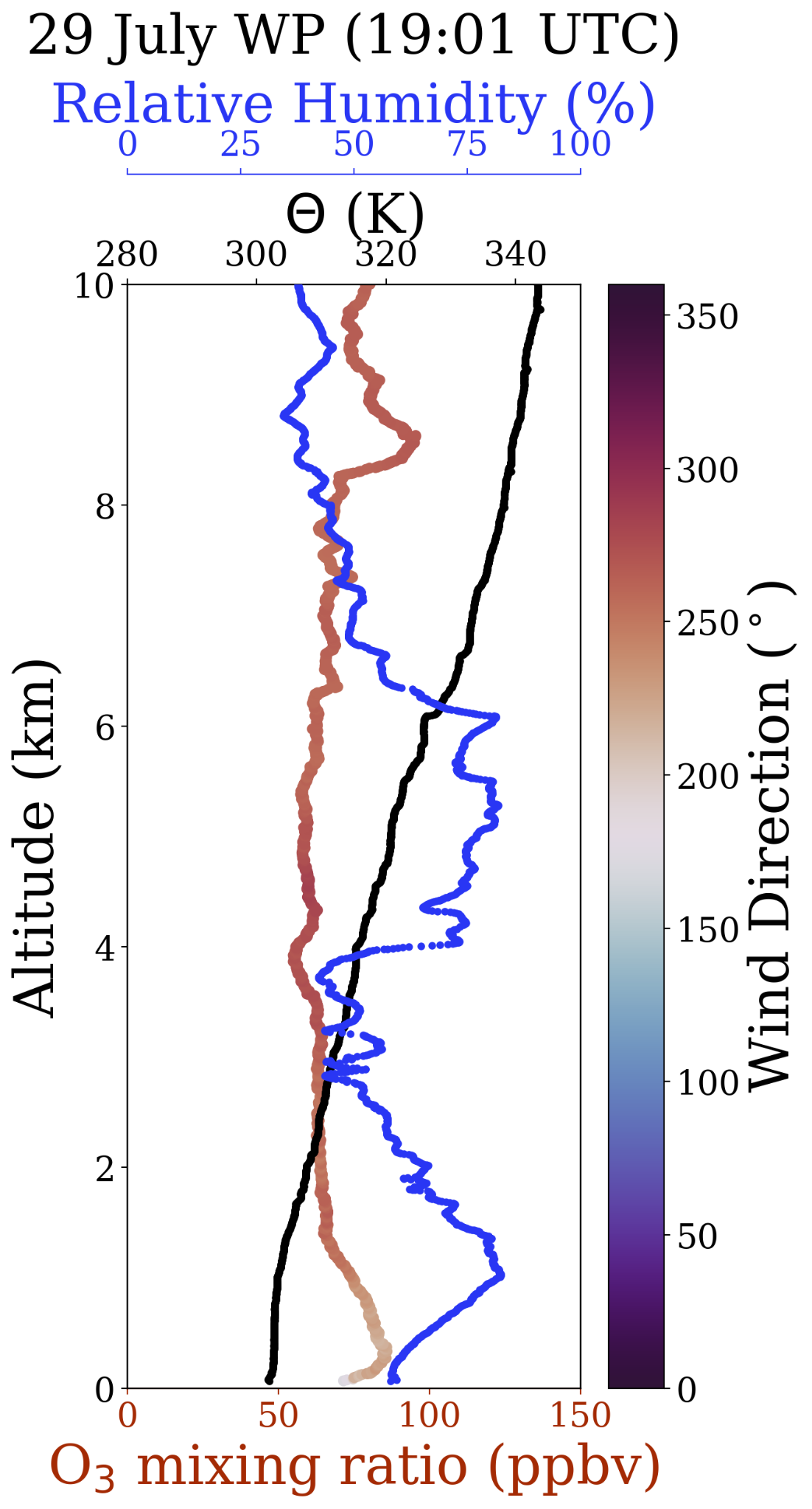
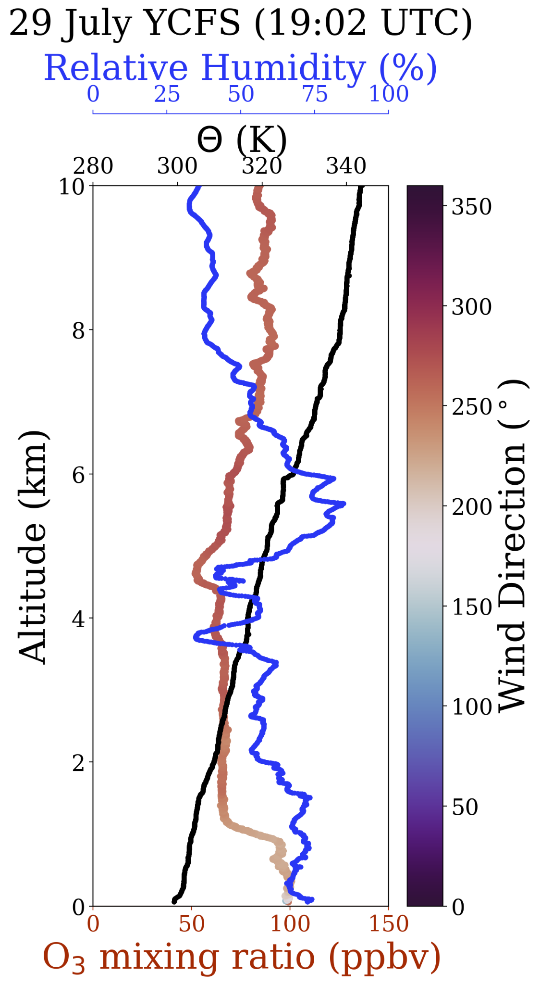

Slide 15
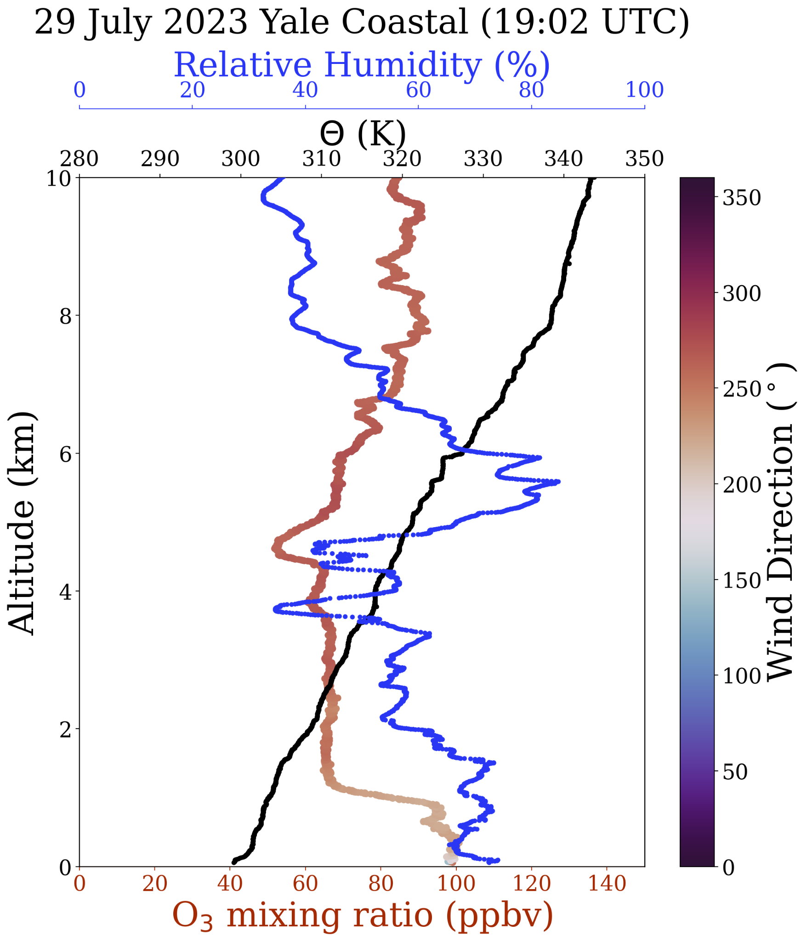
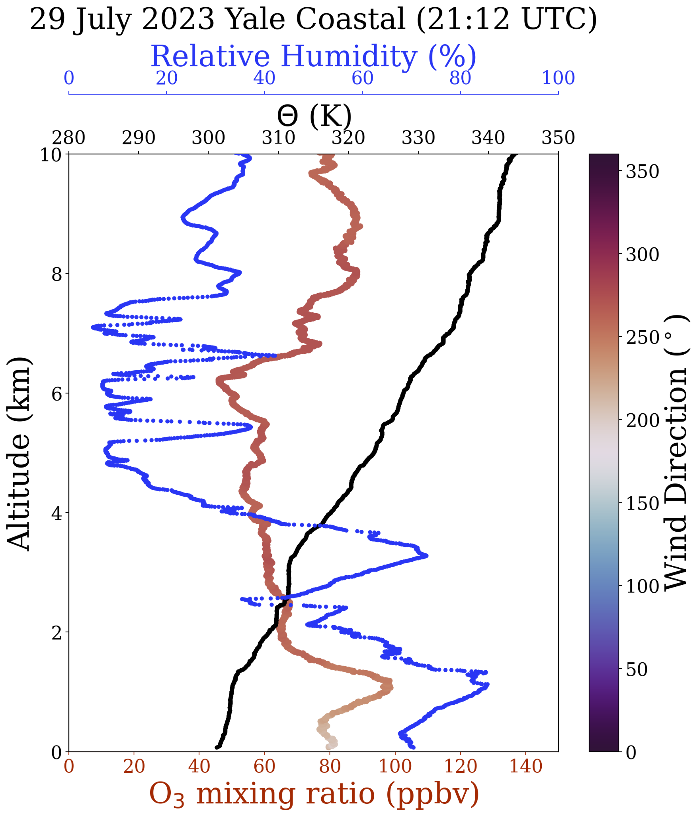

Slide 16
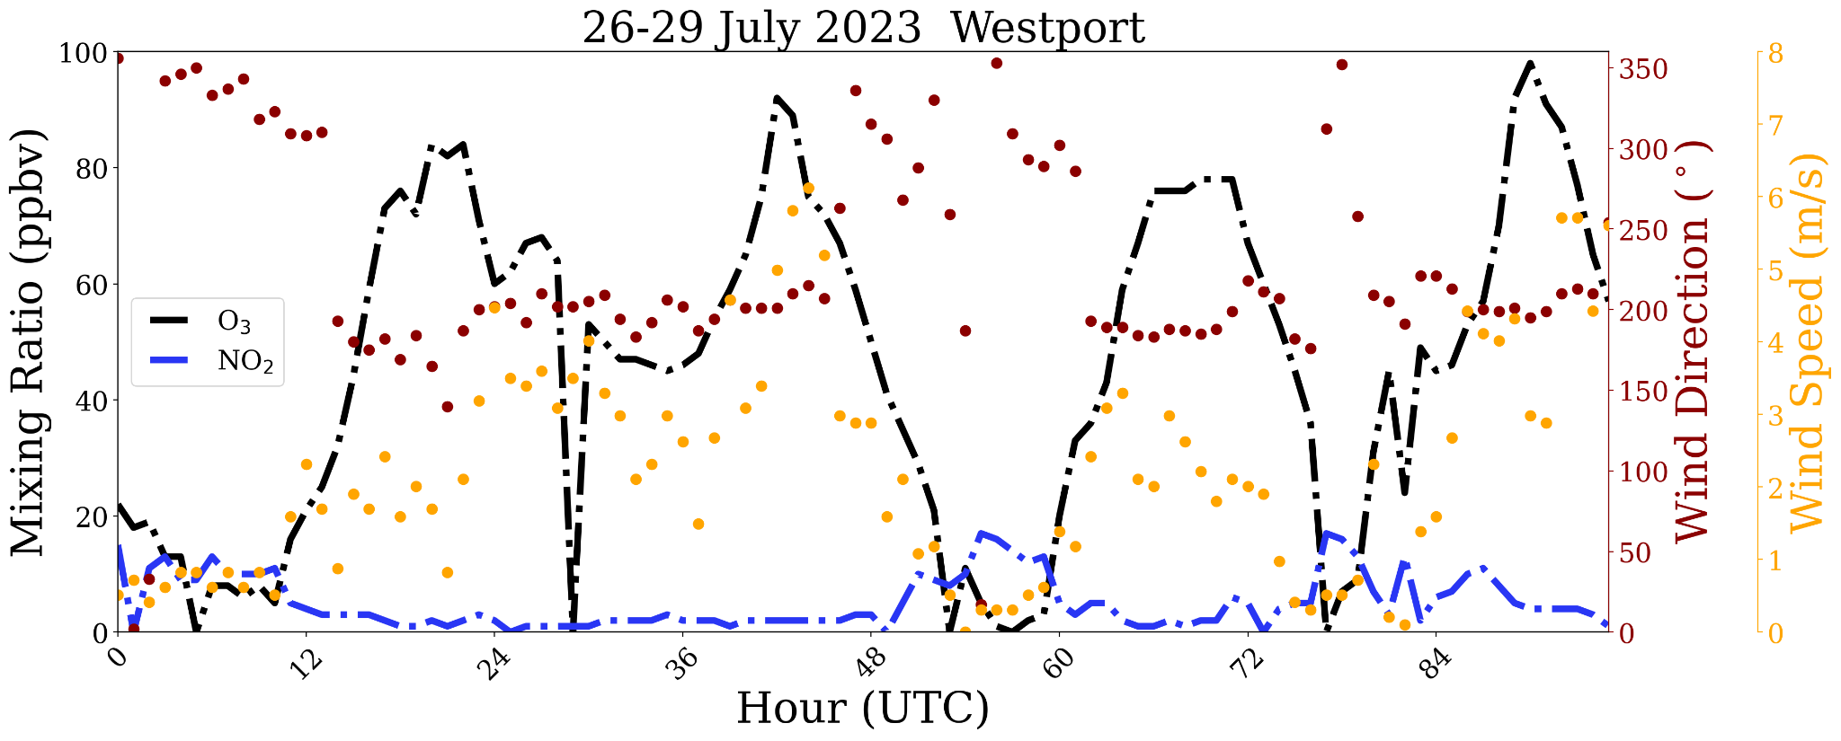
Ozone at Westport is titrated overnight when winds are northerly (I-95 influence)
7/26
7/27
7/29
7/28
Local Standard Time (LST) is UTC-5; at midnight LST there the ozone is zeroed
Notes:
Thanks to Guillaume Gronoff

Slide 17
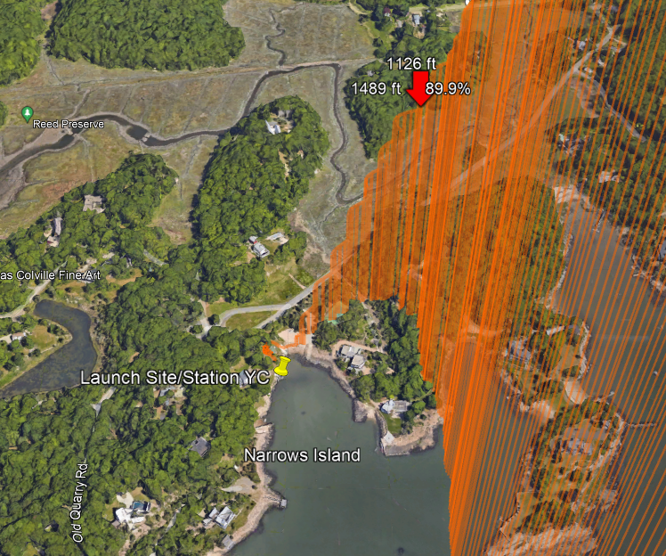
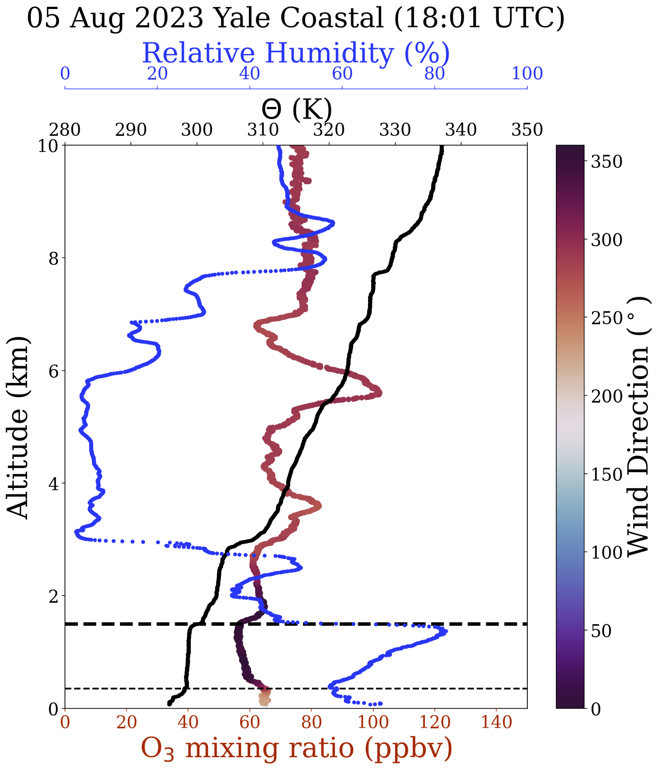
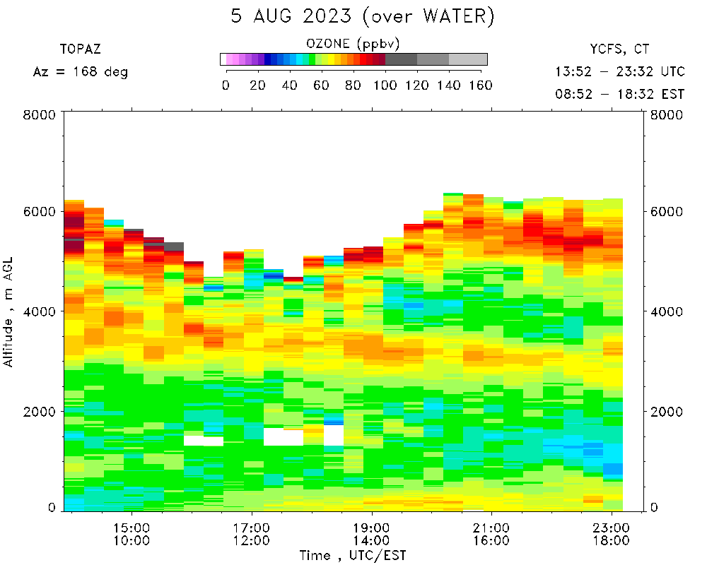
Wind shift above the marine layer
August 5
Right: Balloon path
Example of how a shift in winds above the marine layer with lower ozone throughout the rest of the boundary layer.
Nice agreement with TOPAZ lidar of features in first 6 km of the profile

Slide 18
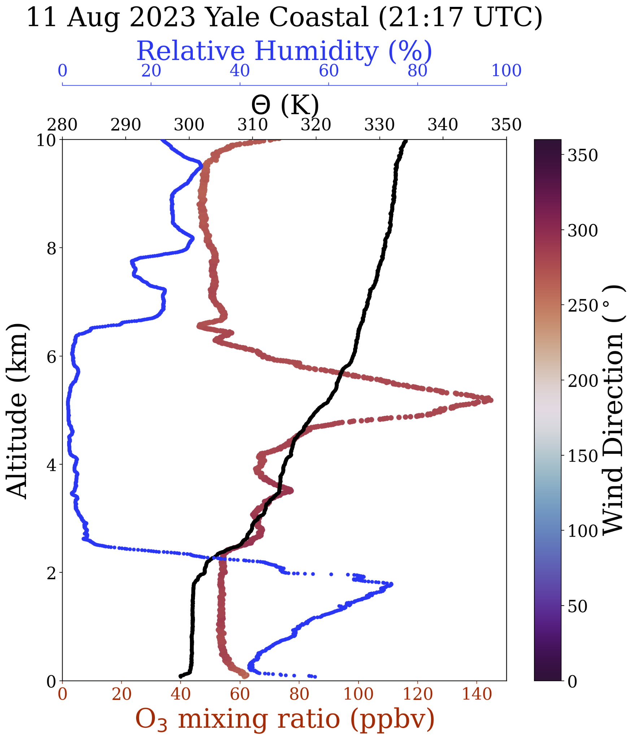
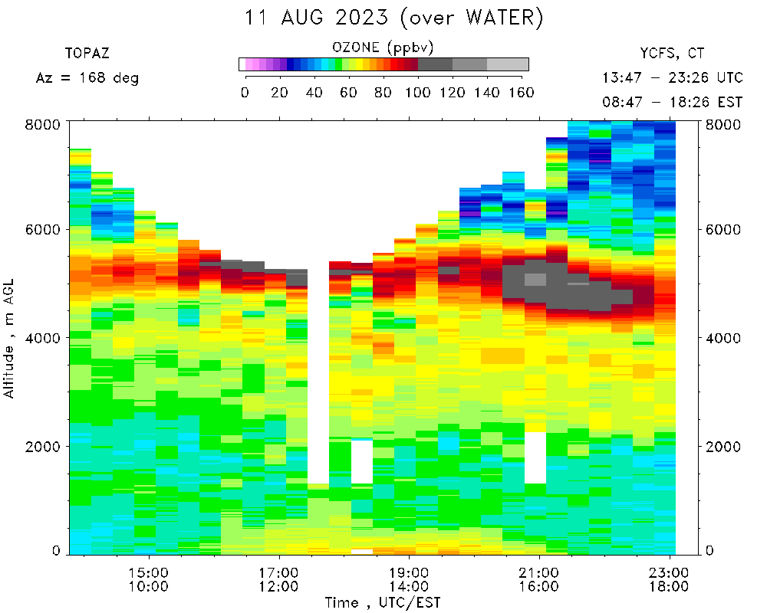
TOPAZ lidar comparison on August 11
Notes:
Based on plot made by Andy Langford

Slide 19
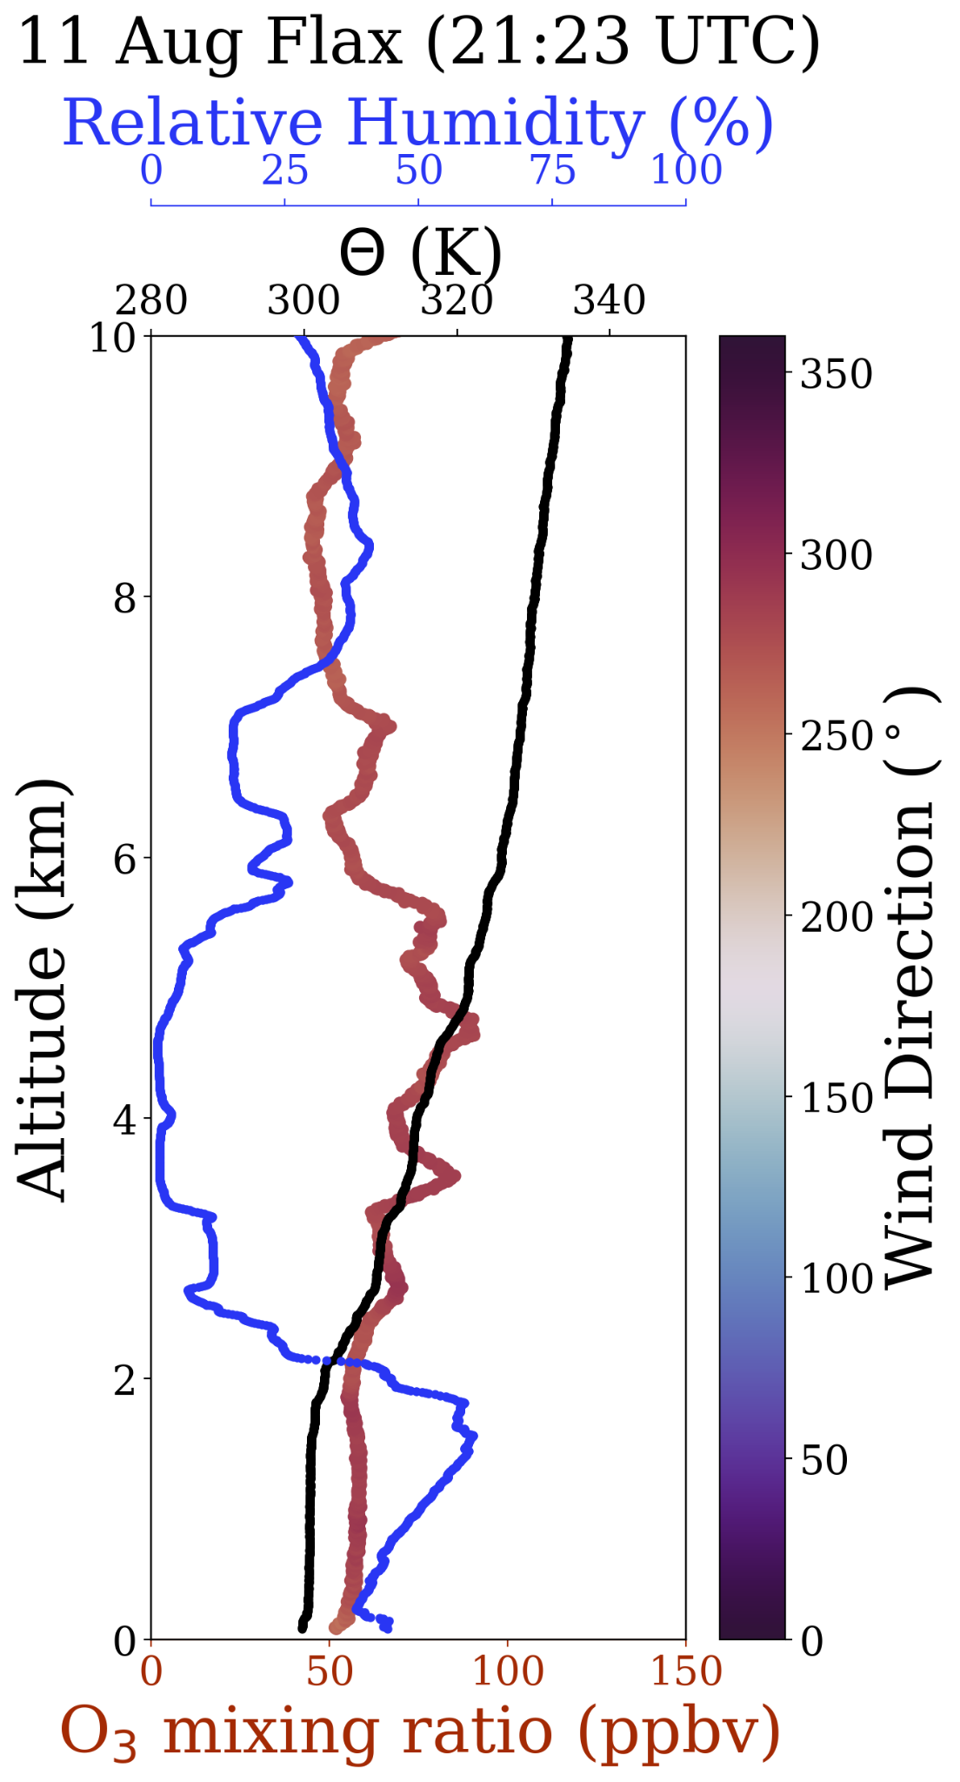
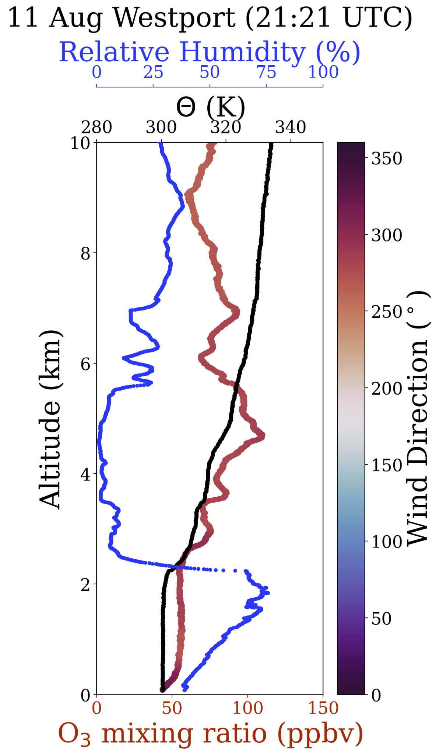
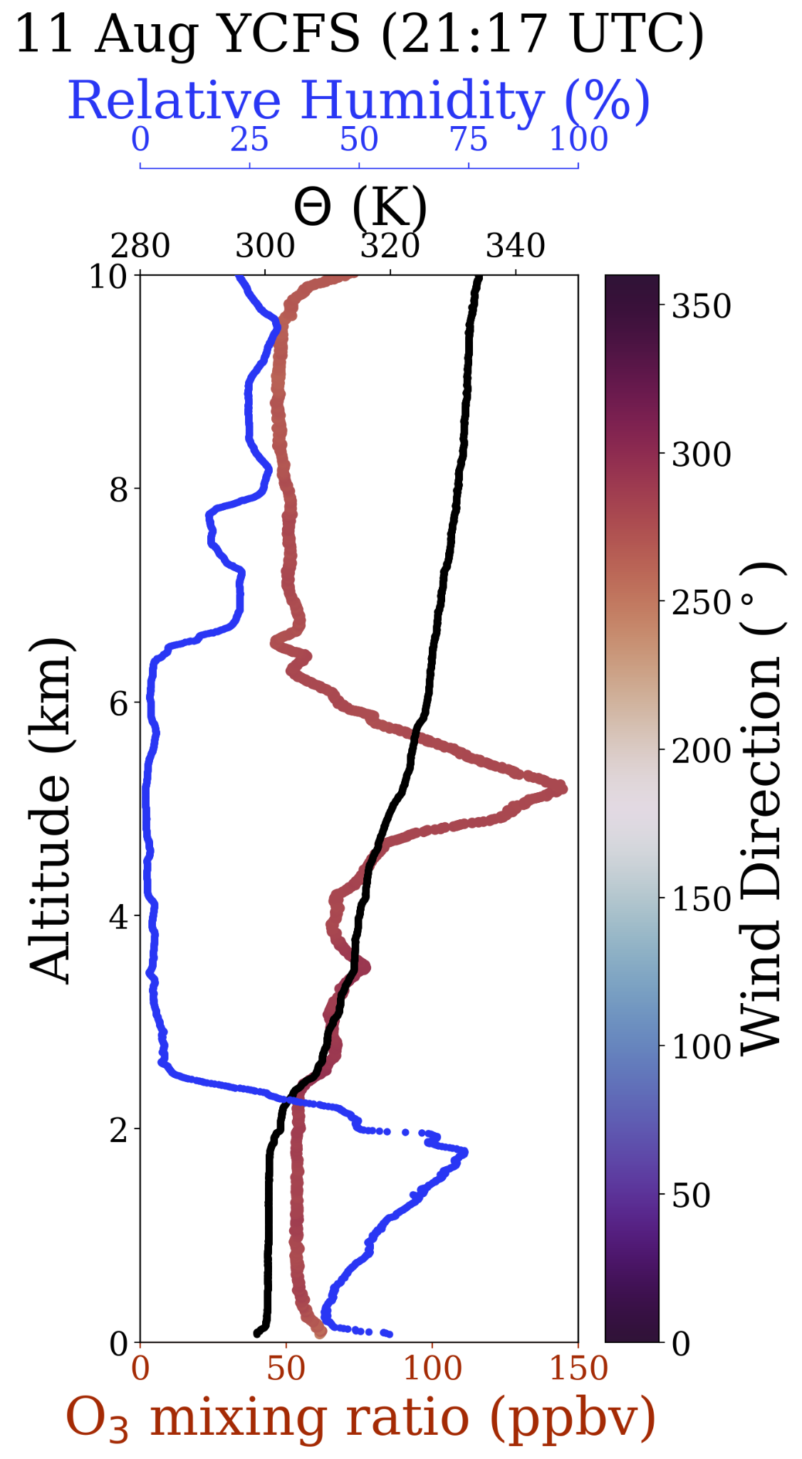

Slide 20
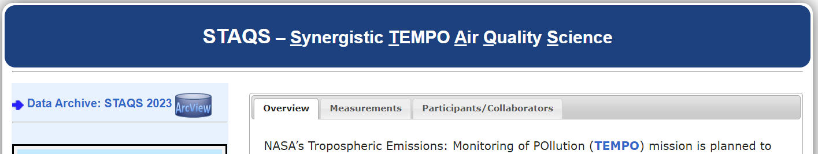
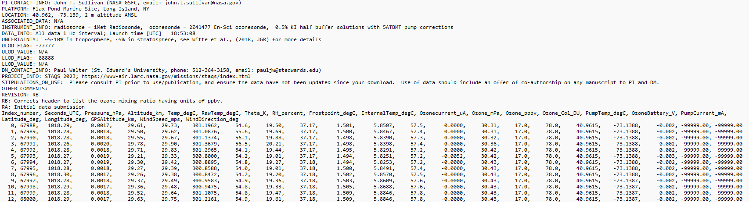
STAQS: https://www-air.larc.nasa.gov/missions/staqs/index.html Click on “STAQS Data Archive” and then “Sondes”
Data is in ICARTT format (text file with a header followed by data that is comma delimited)

Slide 21
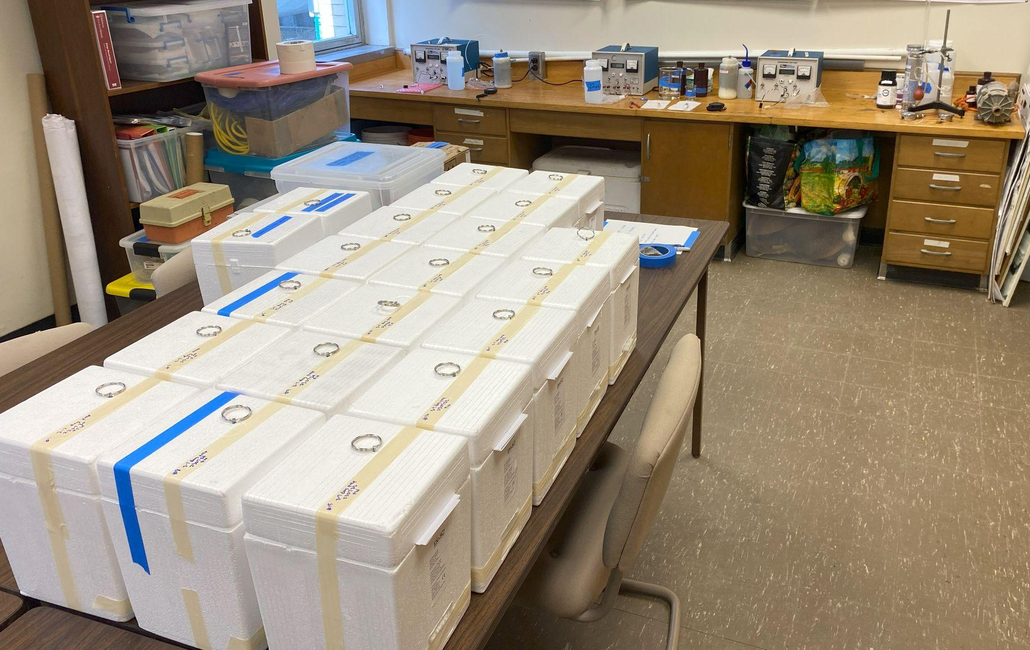
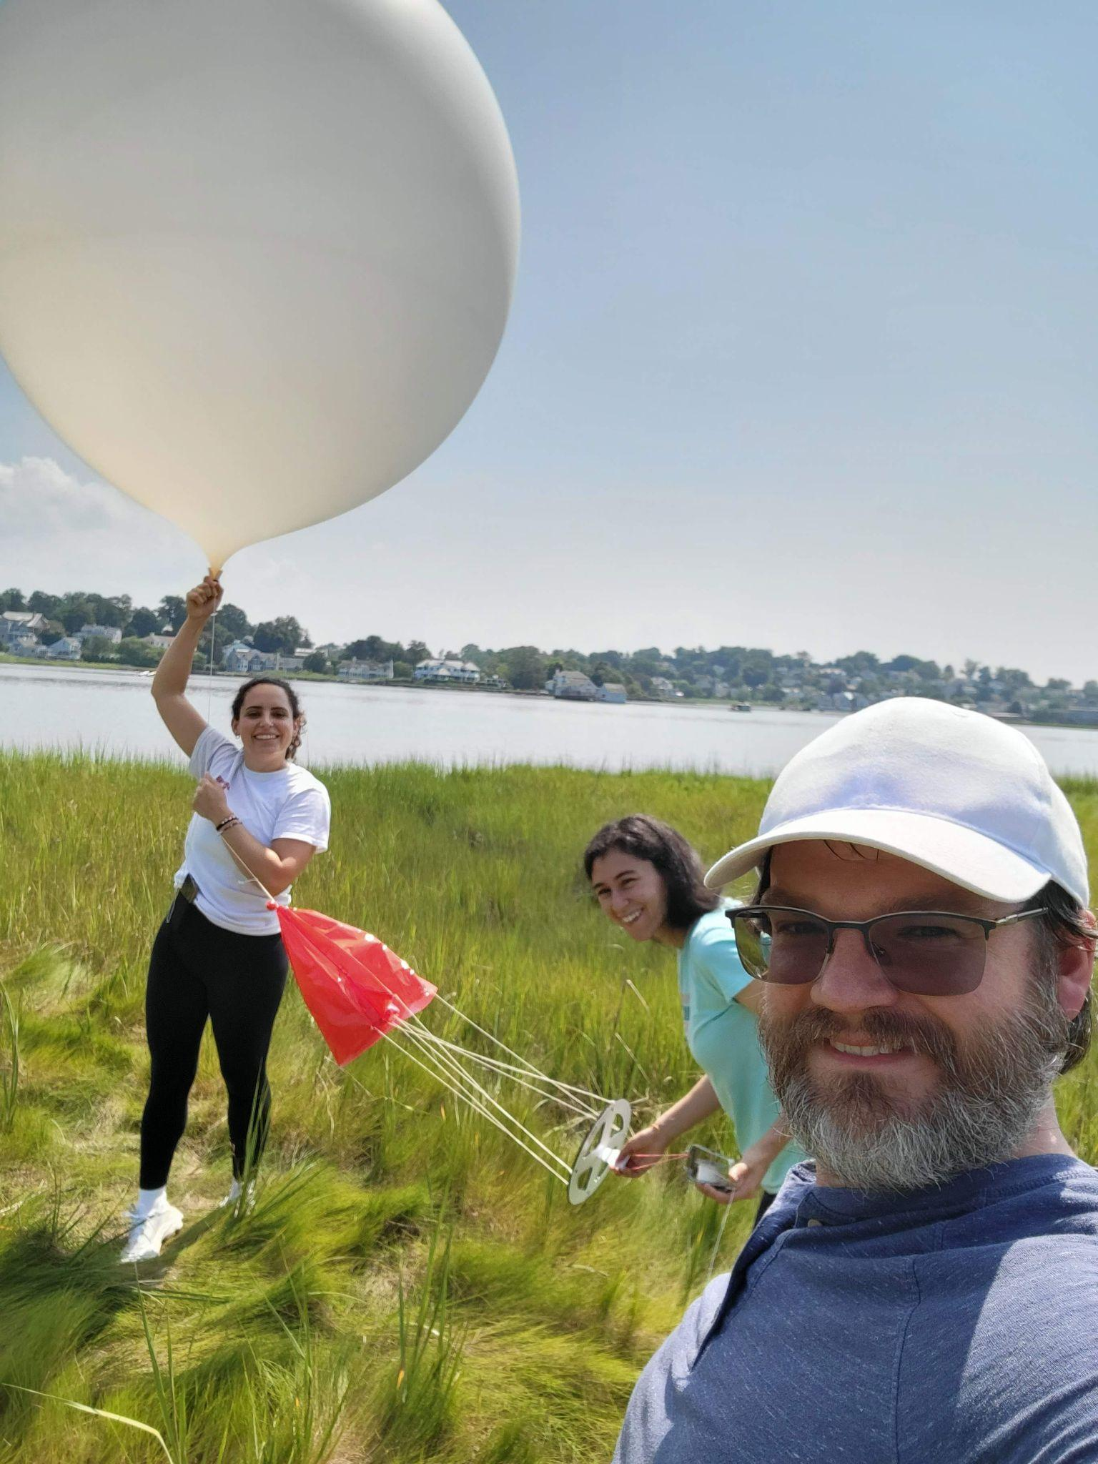
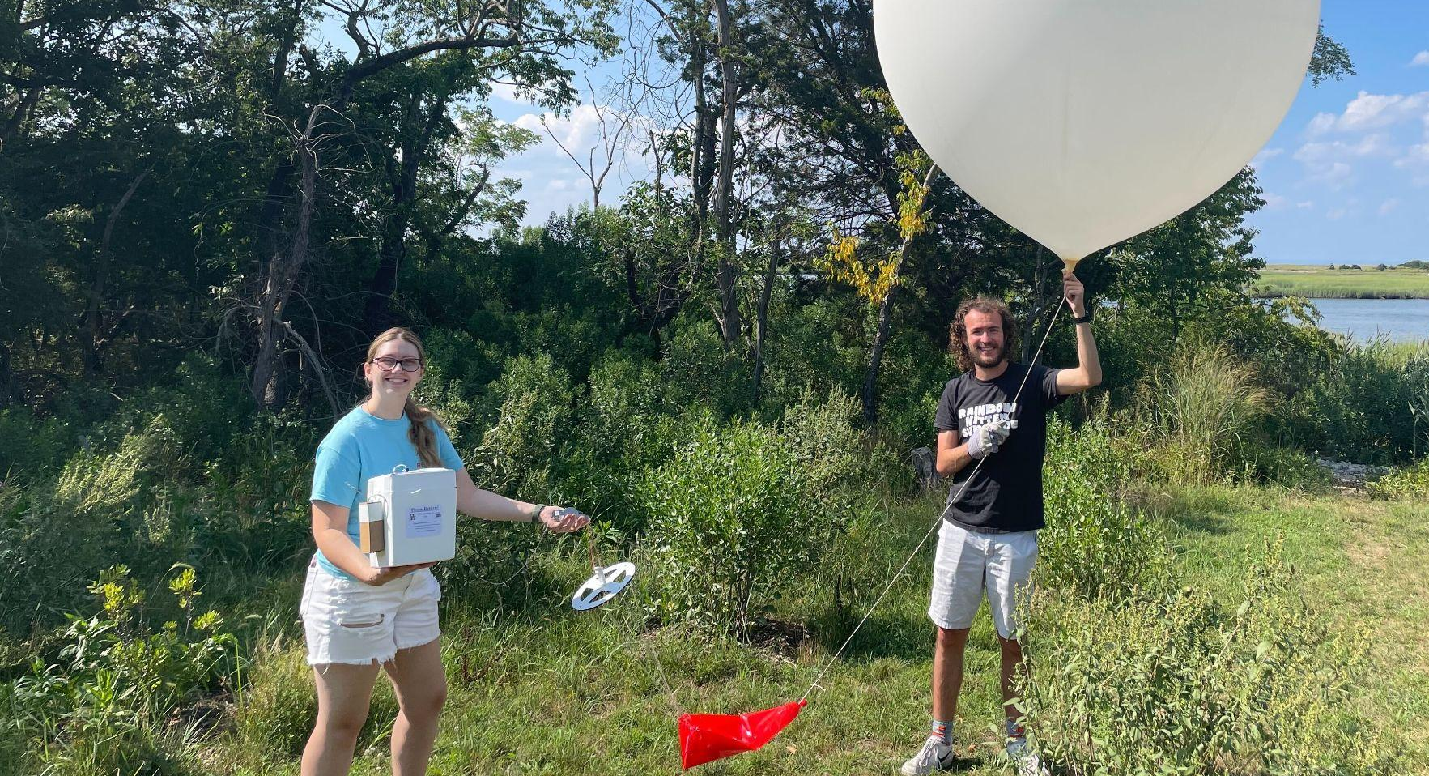
Thanks to Steve Abrams and Stony Brook University for hosting us at the Flax Pond Marine Laboratory
Flax Pond Marine Laboratory
Westport

