Slide 1
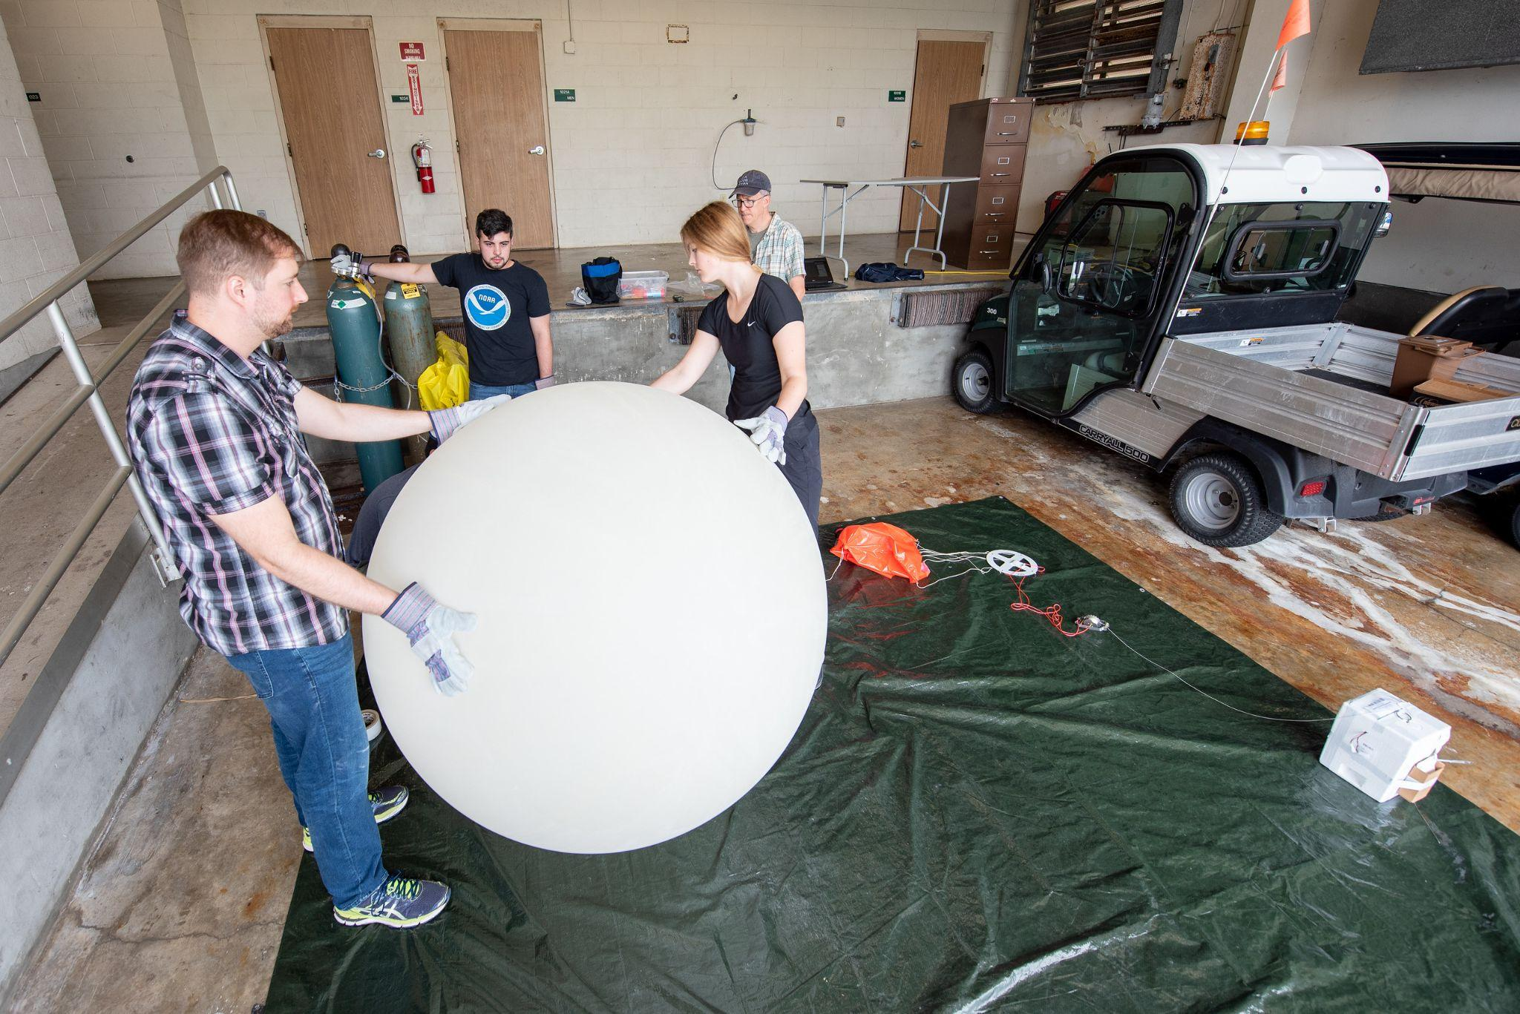
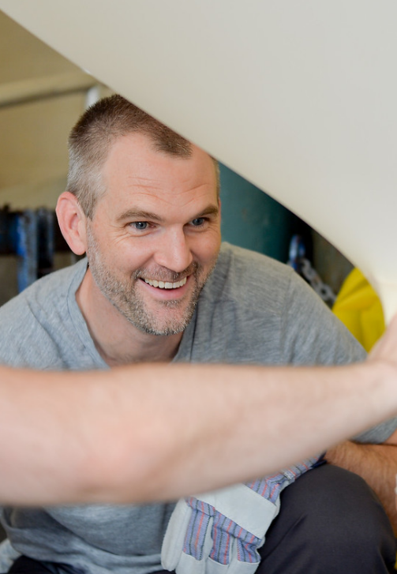
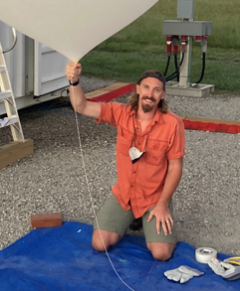


Ozondesondes during STAQS
Paul Walter
St. Edward’s University
John Sullivan
NASA Goddard

Slide 2
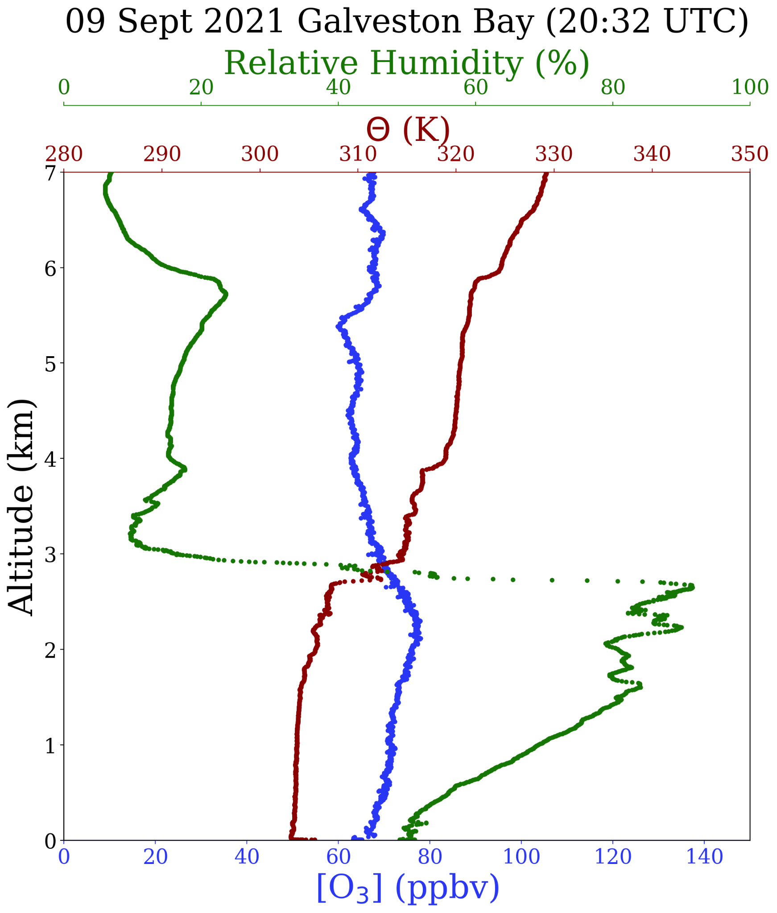
Ozonesondes during STAQS
Balloon-based Instruments:
En-Sci 2Z Ozonesonde
iMet-4RSB Radiosonde
Data Collected:
Vertical Profiles of O₃ and meteorological data
Altitude range:
Surface to 24-30 km depending on balloon size
Rise rate of ~5 m/s
Instrument Performance:
Ozone
Accuracy: 5-10%
Response time: 25 s
(vertical resolution ~125 m)
Time Resolution: 1 Hz

Slide 3
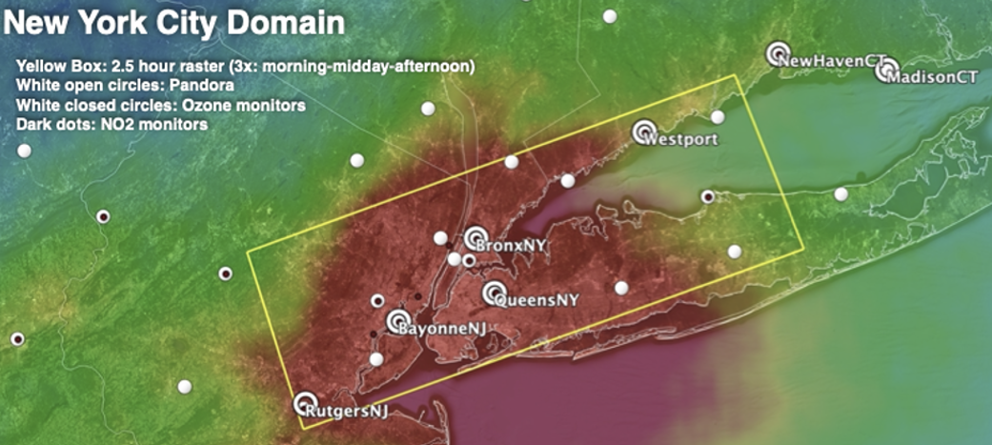
Ozonesondes during STAQS
50-60 ozonesondes near Long Island Sound
~20 collocated at each TOLNet ground-based ozone lidar site
  NASA GSFC ozone lidar (Flax Pond, NY)
  NASA LaRC ozone lidar (Westport, CT)
10-20 from other locations
Validation of
ground-based & airborne ozone lidars
TEMPO
Pandoras
Characterize ozone episodes
Boundary layer and residual layer ozone
Identification of possible ozone transport
Boundary Layer heights
Vertical profiles of U and V winds
Ground-based ozone lidar locations shown in pink. Image courtesy of Laura Judd.

