Slide 1
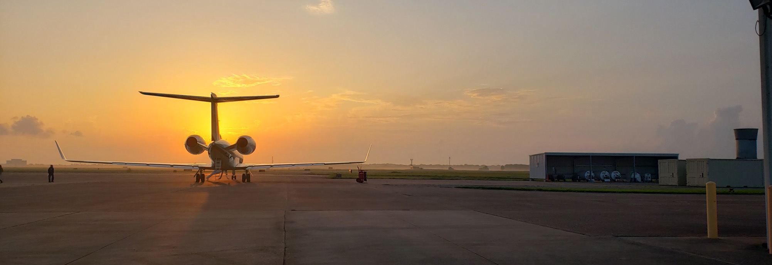
TRACER-AQ Science Flight #1
1 September 2021 13:00-18:00 UTC

Slide 2
