Slide 1
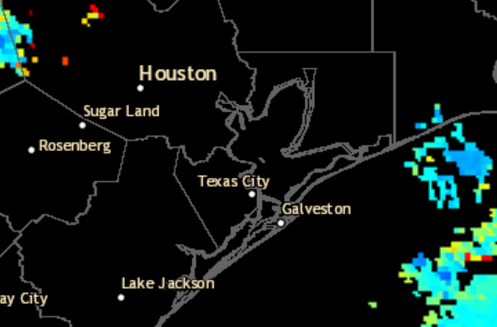
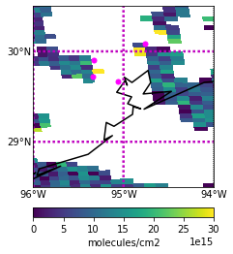
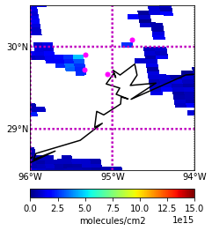
GOES 16 True Color Imagery 09/01/2021 11:36-19:51 UTC
AOD Composite 09/01/2021 20:11 UTC
Source: https://weather.cod.edu/satrad/
Source:https://www.star.nesdis.noaa.gov/smcd/spb/aq/AerosolWatch/?product_date=20210919&zoom=8&lat0=29.66467011272428&lon0=-94.83121297319396&layers=67108865&region=conus
HCHO 09/01/2021 from 20:15 UTC TROPOMI (v. 2.02.01) Overpass
NO2 09/01/2021 from 20:15 UTC TROPOMI (v. 2.2.0) Overpass
Liberty
Liberty
Aldine
Note: Few valid
measurements from TROPOMI due to clouds.
Aldine
La Porte
La Porte
UH
UH
Qa value:
>0.5
Qa value: >0.75

