Slide 1
Forecast Discussion
TRACER AQ IOP 1
3 September 2021
Forecast Coordinator: Alex Kotsakis
Forecasters: Mike Jensen, Doug Boyer, Amber Schlessiger
Interns/Assistants:

Slide 2
Forecast verification
Forecast | Fri 9/2 AM | Fri 9/2 PM
Low-level Cloudiness | Few | Broken
Mid-level Cloudiness | Clear | Broken
Upper level Cloudiness | Clear | Broken
Convection | Scattered Near coast to SW | Scattered
Seabreeze | Later | Yes
Ozone | Low | Moderate (North of Houston)
PM2.5 | Moderate | Moderate

Slide 3
Forecast summary
Forecast | Fri 9/4 AM | Fri 9/4 PM | Sat 9/5 AM | Sat 9/5 PM | Long Term Outlook (Sun - Tues)
Low-level Cloudiness | Few | Few | Few | Few | Mostly clear on Monday, building cloudiness into Tuesday
Mid-level Cloudiness | Few | Few | Few | Few
Upper level Cloudiness | Few | Few | Few | Few
Convection | Unlikely | Few near coast | Unlikely | Unlikely | More likely Tues.
Seabreeze | Unlikely | Yes | Unlikely | Yes (Weaker) | Unlikely
Ozone | Low | Moderate (N. of Houston) | Low | Moderate | Moderate
PM2.5 | Moderate | Moderate | Moderate | Moderate | Moderate
Notes:
This is not updated yet

Slide 4
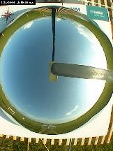
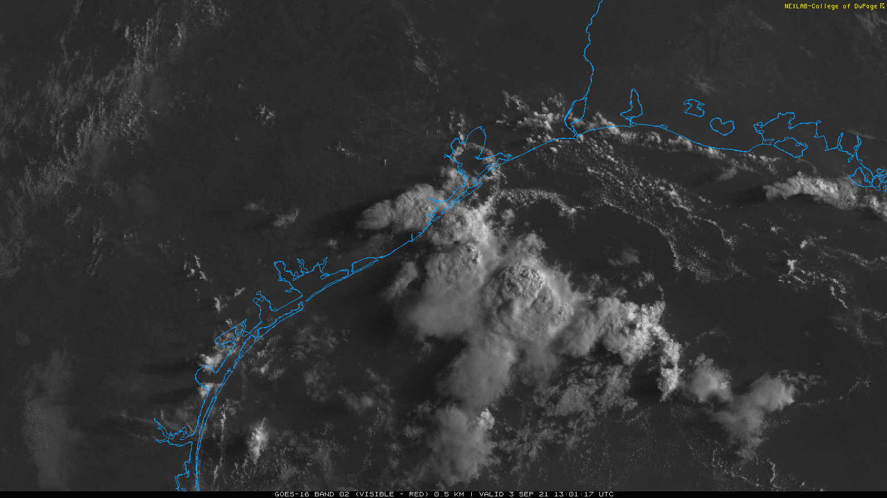
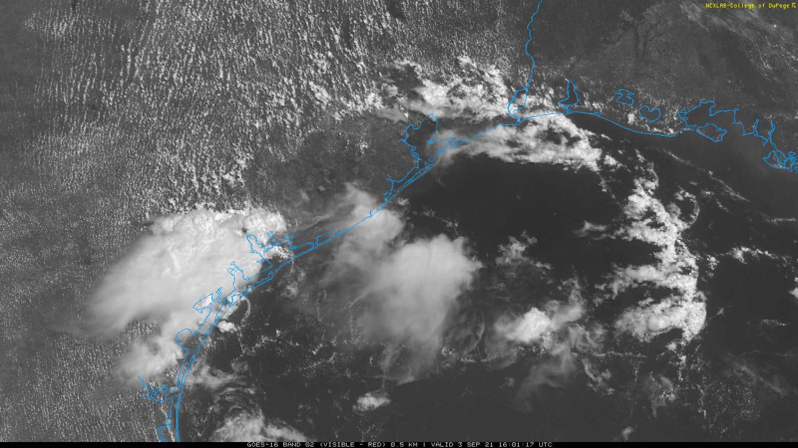
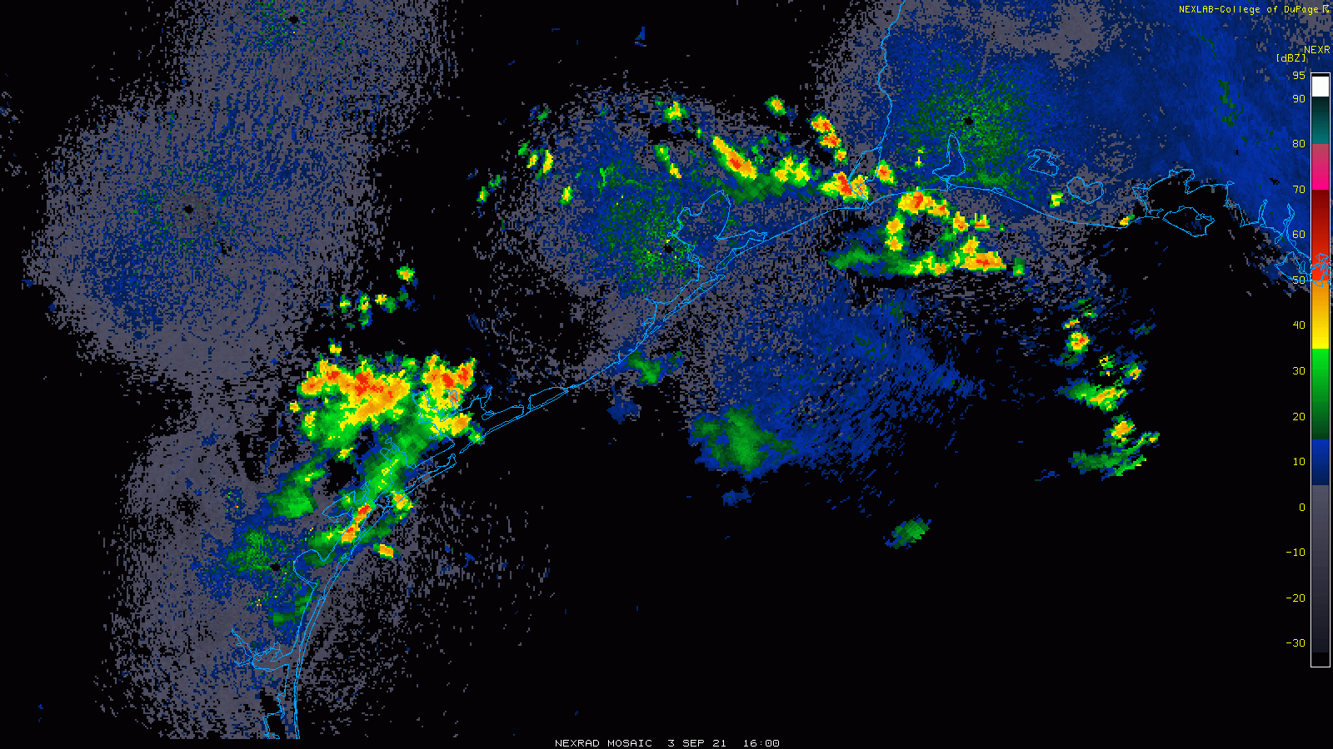
Today’s Weather
13 UTC
13:59 UTC
16 UTC
Slide author: M. Jensen

Slide 5
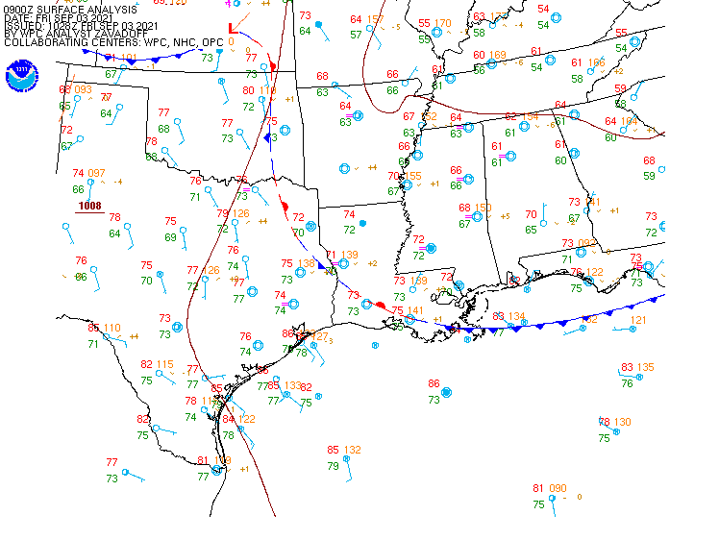
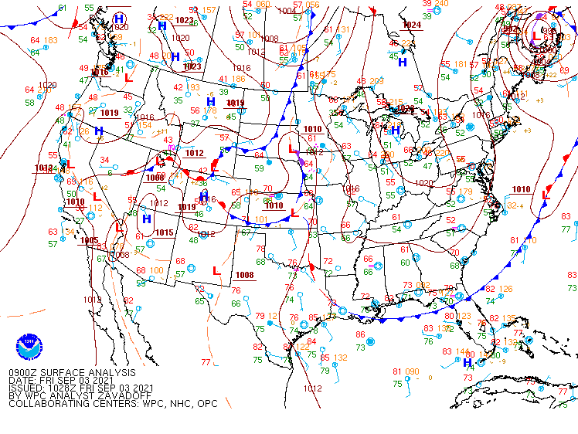
Surface Obs, 0900Z September 3 2021
Slide author: M. Jensen

Slide 6
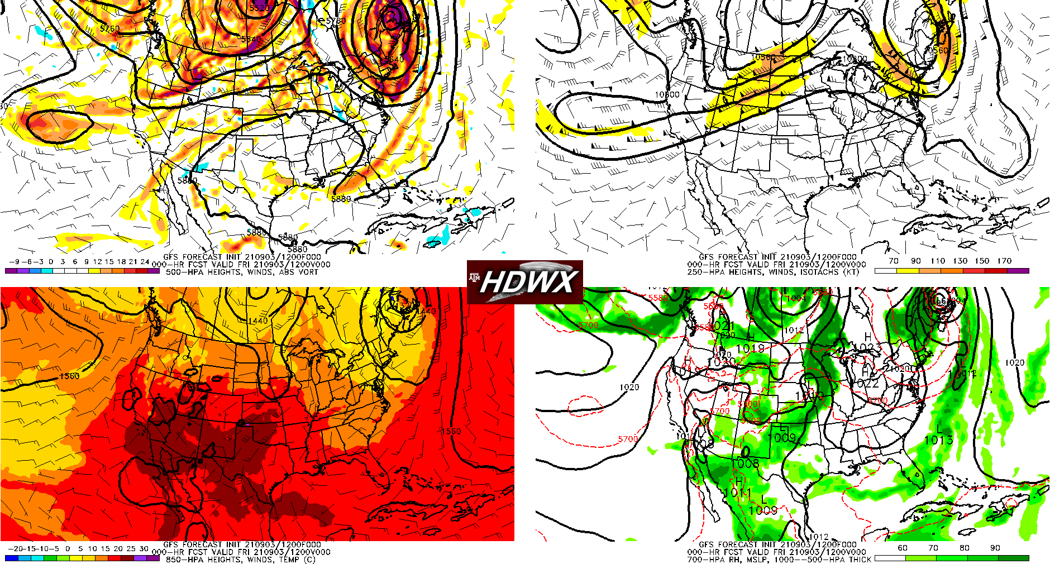
9/03 12Z Situation
Slide author: M. Jensen

Slide 7
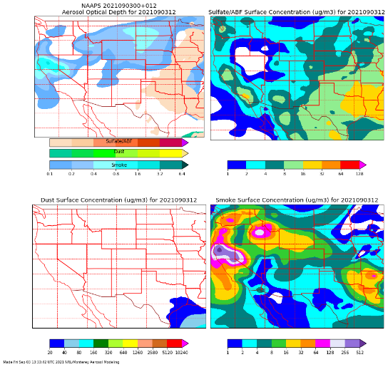
NAVY 12Z Aerosol and Smoke Forecast
Slide author: Amber Schlessiger

Slide 8
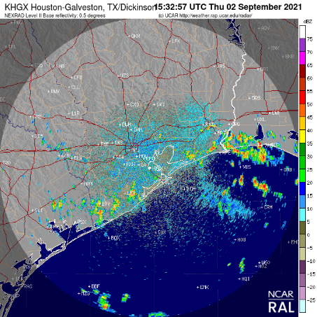
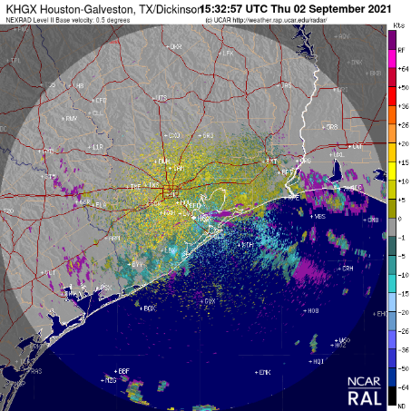
Thursday Morning

Slide 9
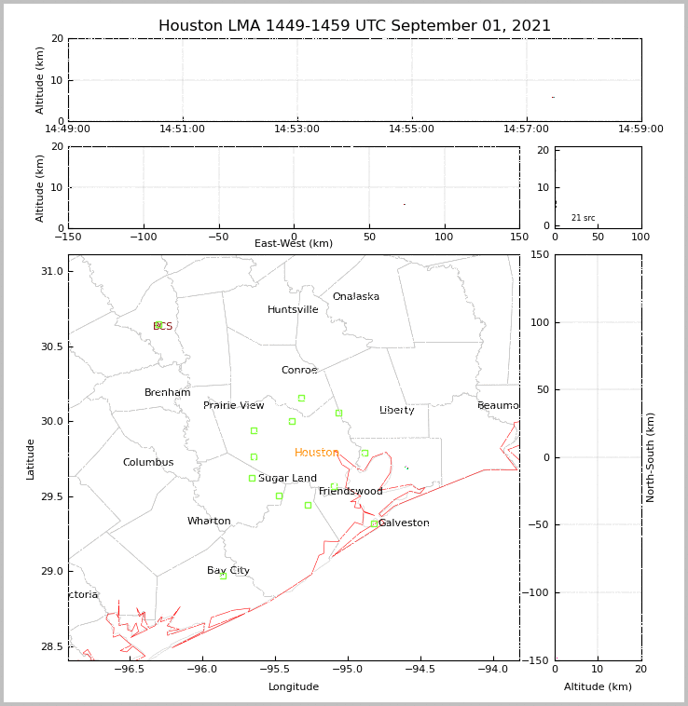
Houston LMA

Slide 10
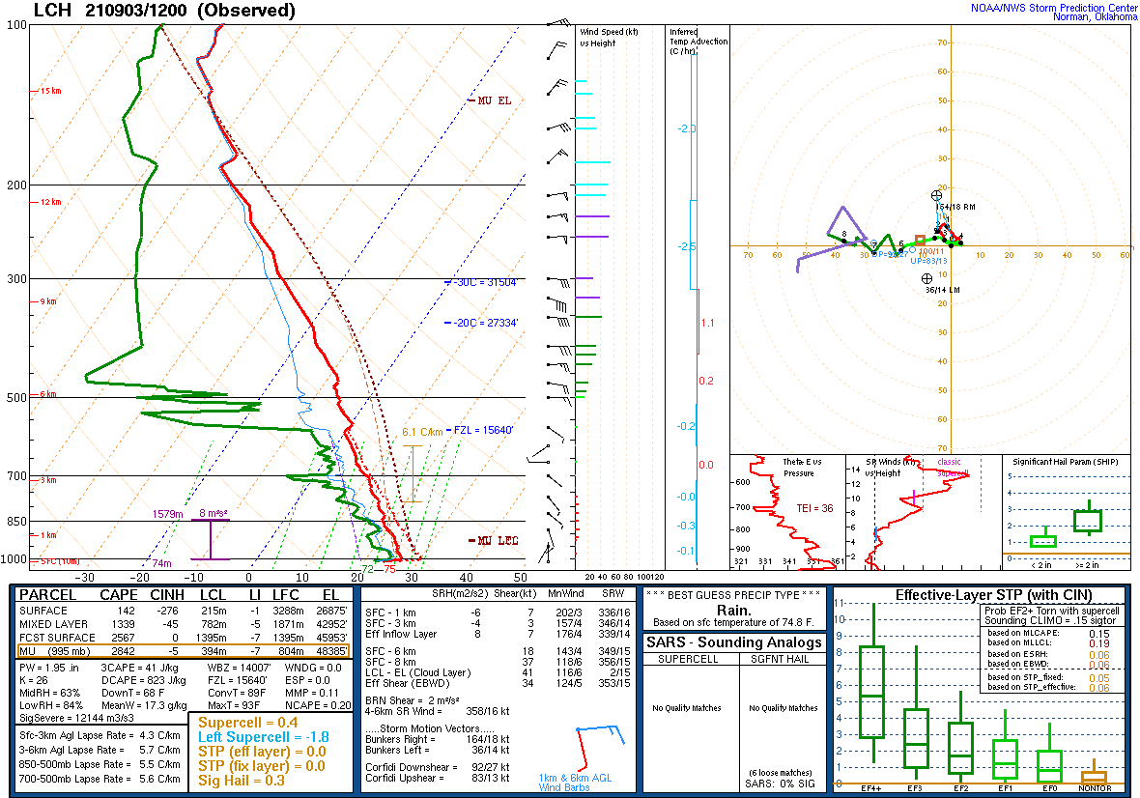
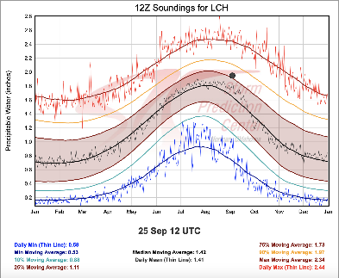
Slide author: M. Jensen
Notes:
https://www.spc.noaa.gov/exper/soundingclimo/

Slide 11
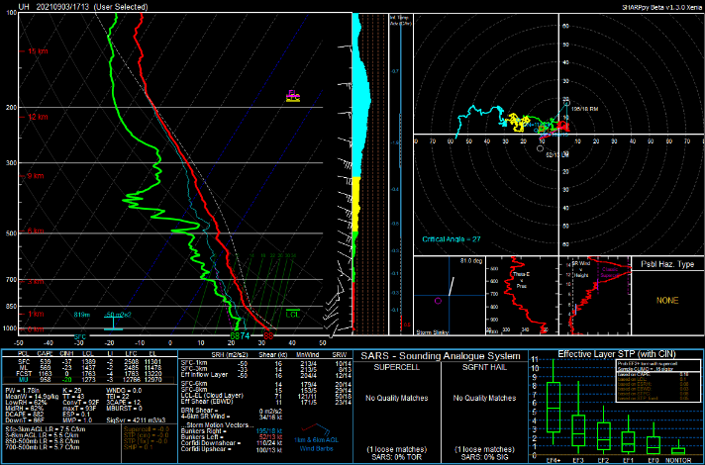
Slide author: A. Kotsakis
Notes:
https://www.spc.noaa.gov/exper/soundingclimo/

Slide 12
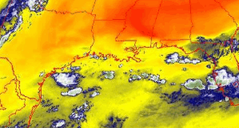
GOES-16 Band 10 (lower level water vapor)
Valid 1 Sep 1500--1600 Z

Slide 13
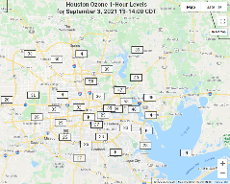
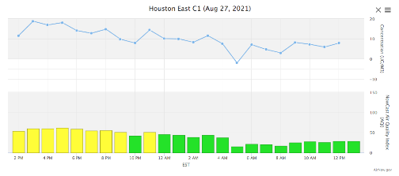
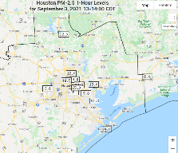
Air Quality Verification
Ozone
Thurs
Fri
PM2.5
Thurs
Fri

Slide 14
Forecast Discussion
TRACER AQ spin up week
3 September 2021
Forecast Coordinator: Alex Kotsakis
Forecasters: Mike Jensen, Doug Boyer, Amber Schlessiger
Interns/Assistants:

Slide 15
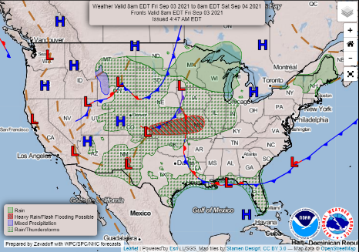
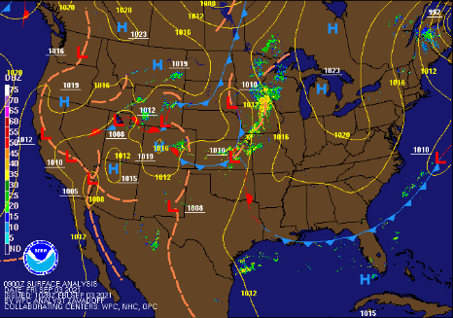
Slide Author: Amber Schlessiger

Slide 16
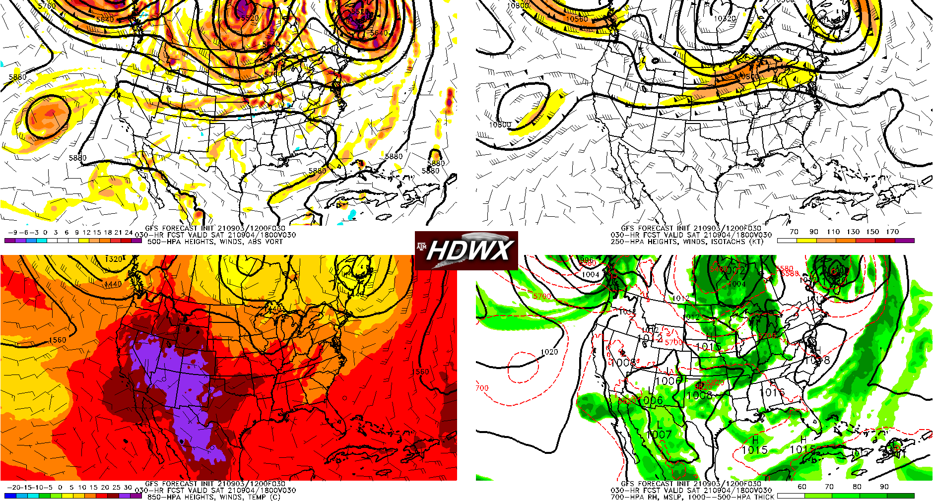
Valid Friday 12 Z
Slide author: M. Jensen

Slide 17
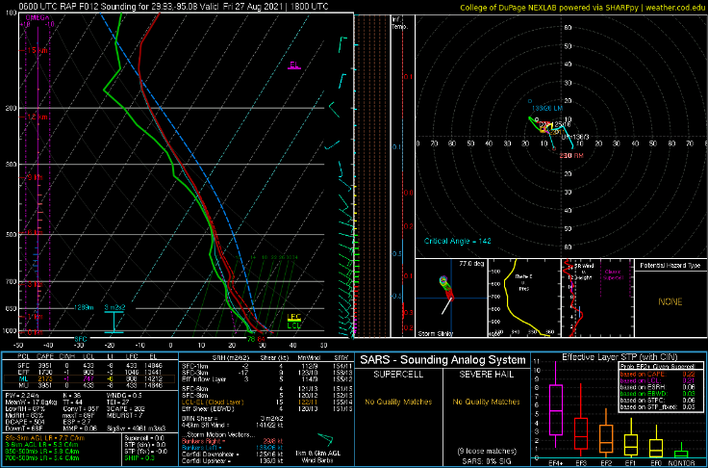
RAP Friday 18Z Sounding, Houston

Slide 18
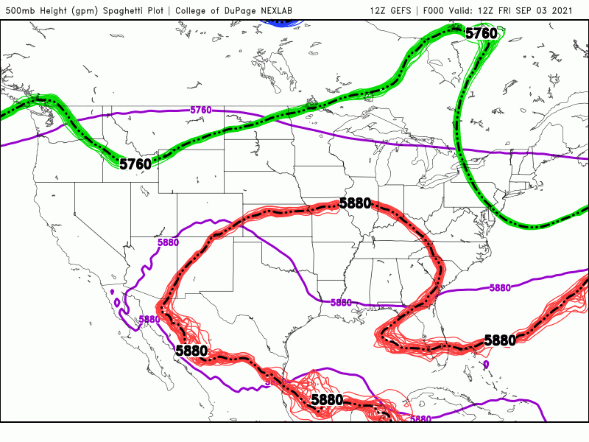
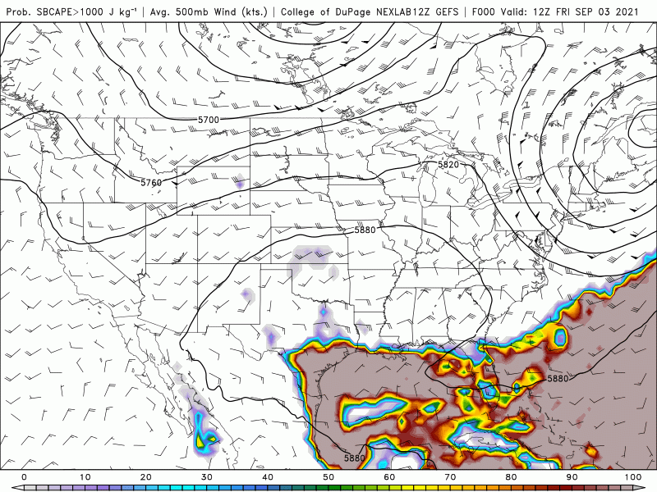
GEFS forecasting: 500 hPa pattern and Probability of CAPE > 1000 J·kg⁻¹
Slide author: M. Jensen

Slide 19
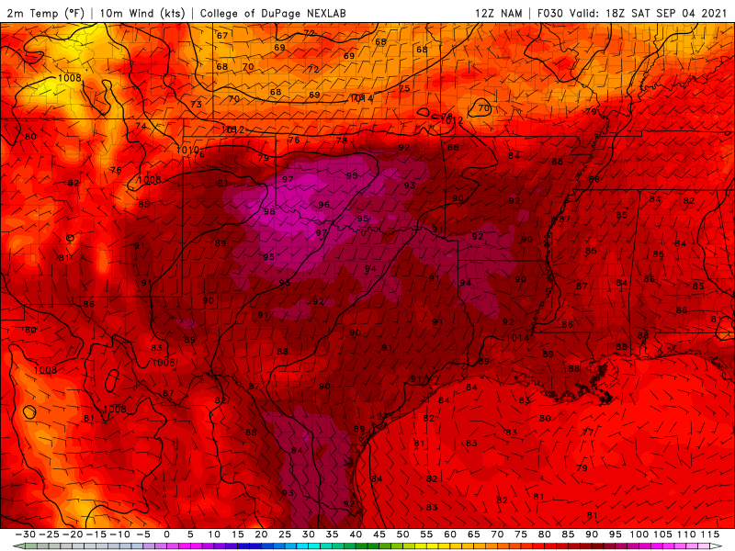
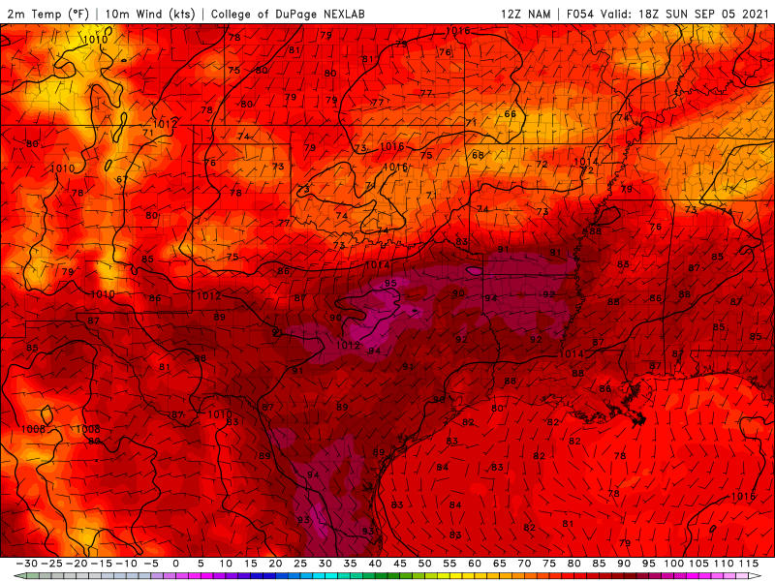
Surface T and wind NAM
Sun. 1800 UTC
Sat. 1800 UTC
Slide author: M. Jensen

Slide 20
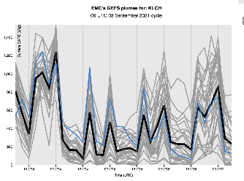
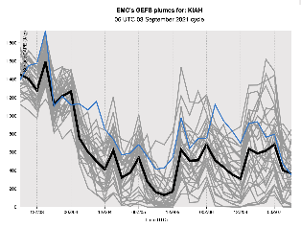
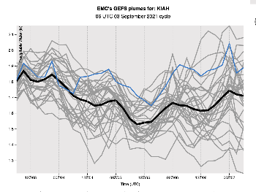
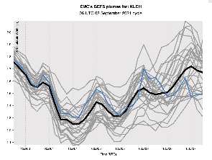
GEFS Plumes at KLCH and KIAH
CAPE
PWV
Slide author: M. Jensen

Slide 21
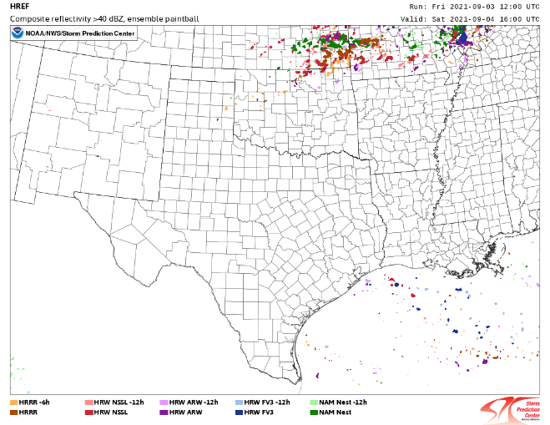
Saturday Morning
Slide author: M. Jensen

Slide 22
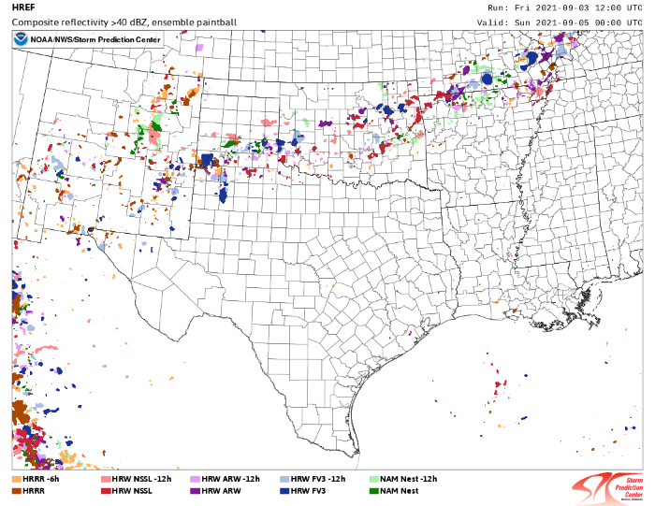
Saturday Afternoon
Slide author: M. Jensen

Slide 23
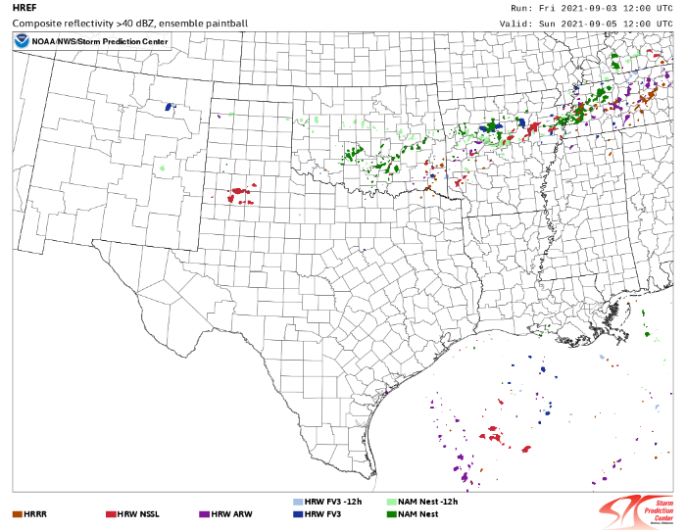
Sunday morning
Slide author: M. Jensen

Slide 24
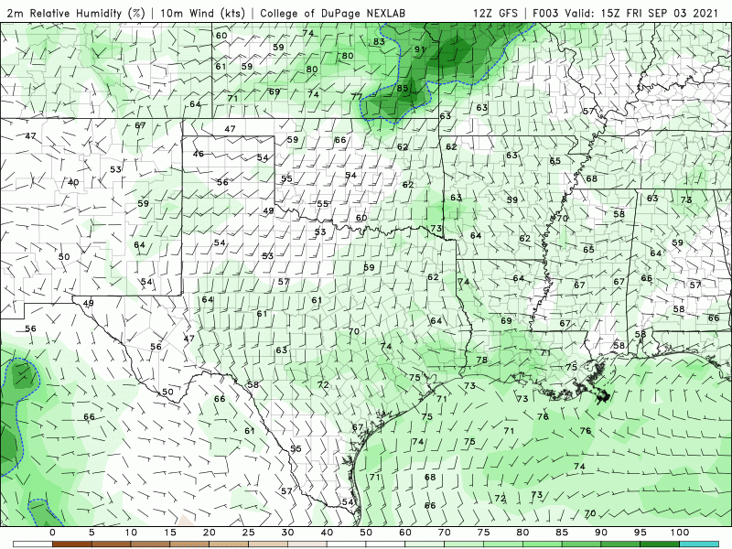
12Z GFS RH
Slide Author: Amber Schlessiger

Slide 25
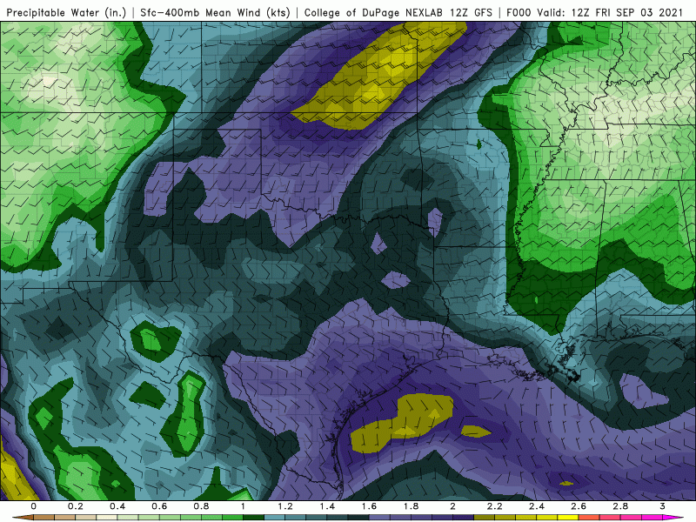
12Z GFS PWAT
Slide Author: Amber Schlessiger

Slide 26
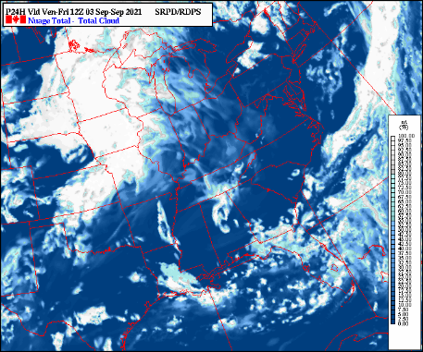
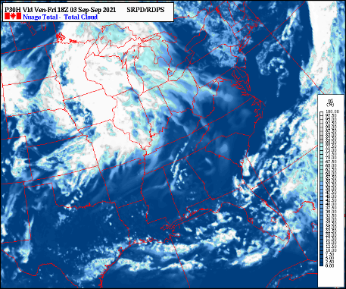
Canadian Model (Fri)

Slide 27
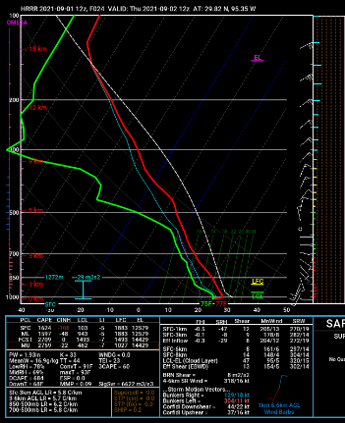
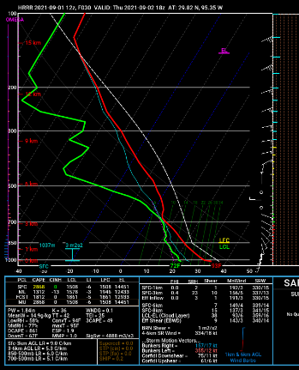
HRRR model sounding - Downtown Houston

Slide 28
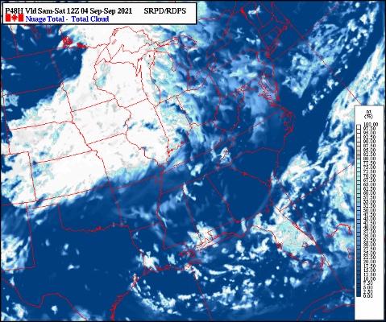
Canadian Model (Sat)

Slide 29
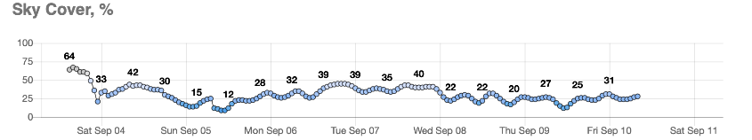
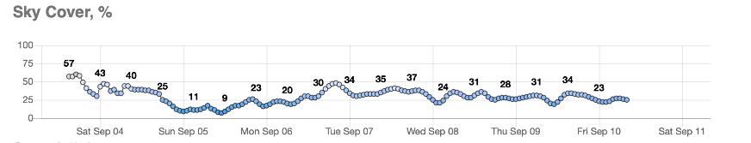
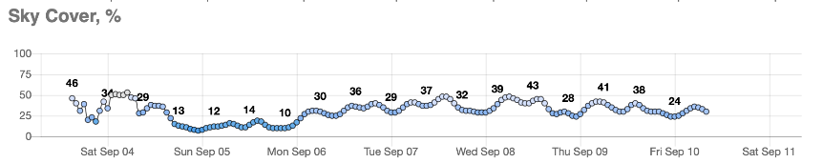
NWS Gridded Forecast
IAH
Slide author: M. Jensen
LaPorte, TX
Galveston, TX

Slide 30
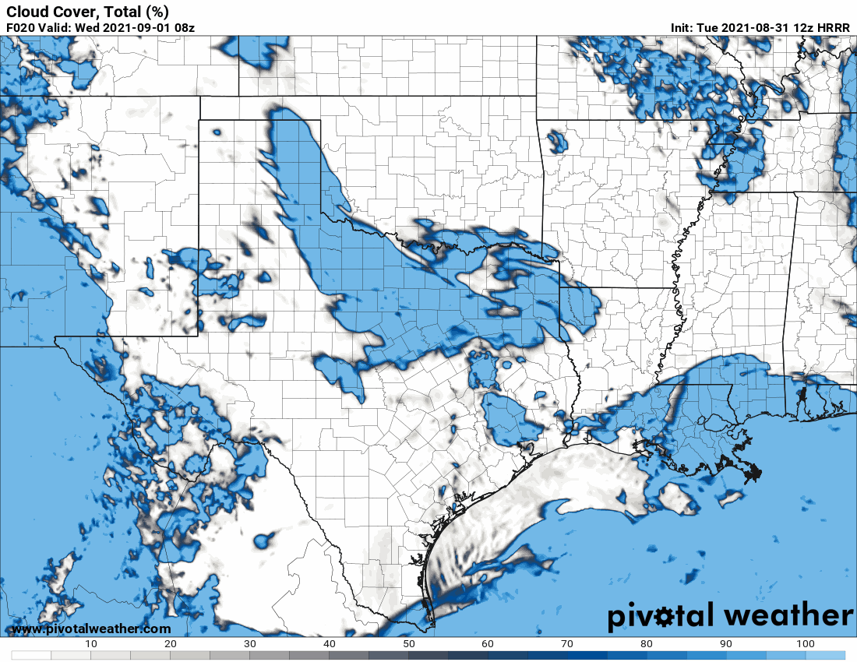
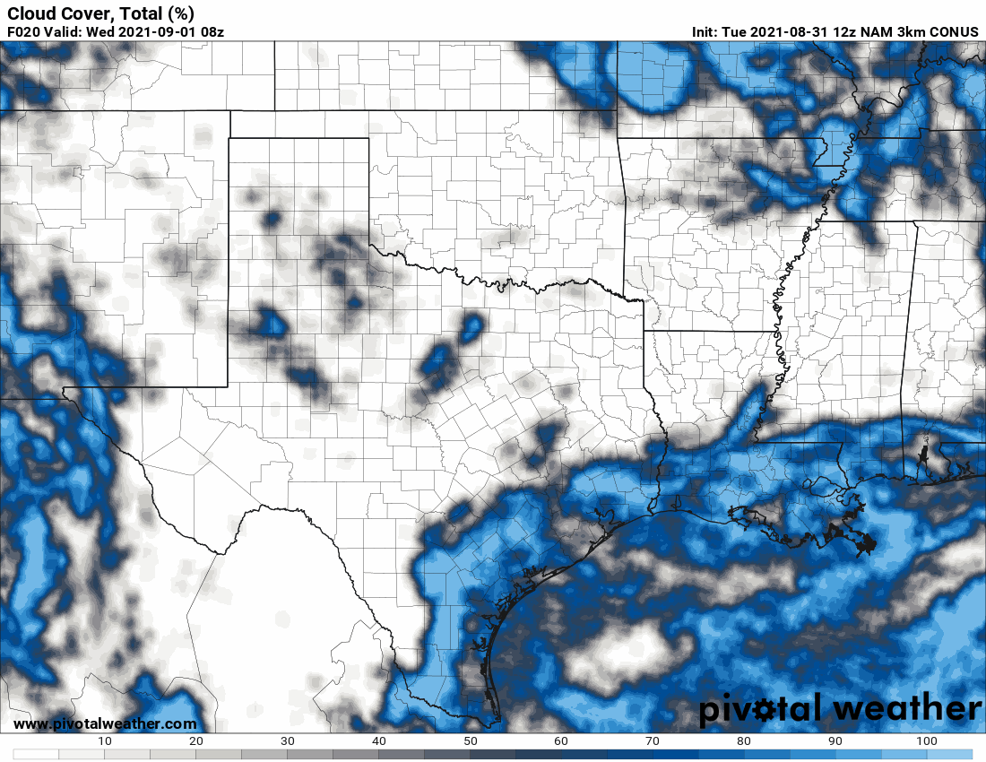
HRRR and NAM Total Cloud Fraction - Wednesday

Slide 31
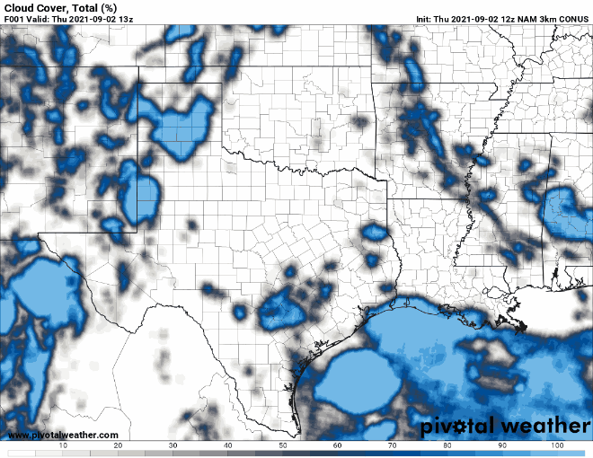
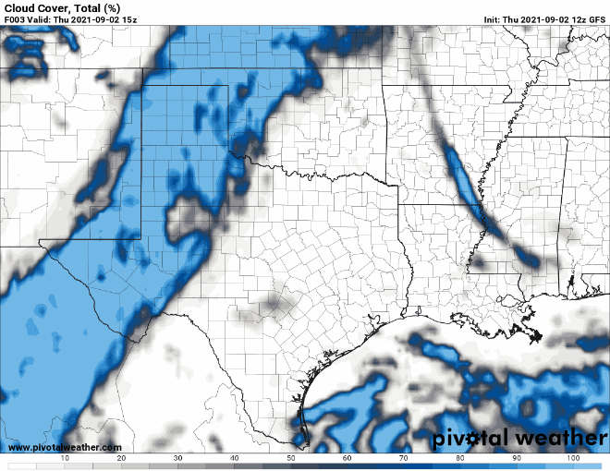
NAM 3km
GFS

Slide 32
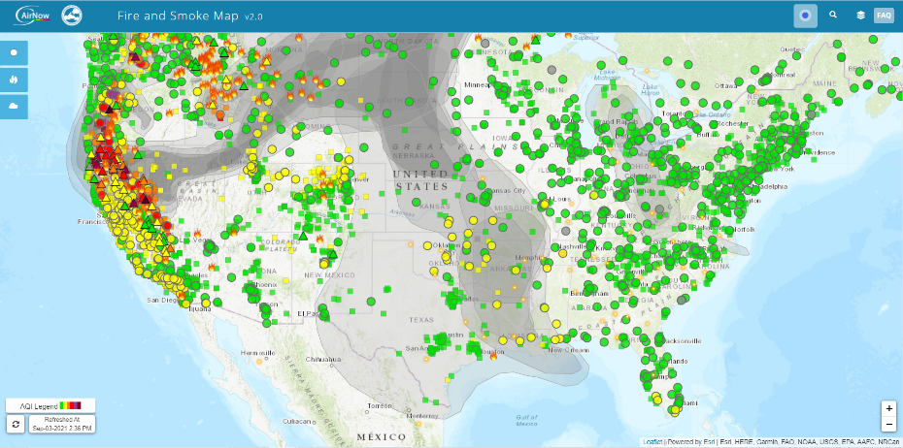
Source

Slide 33
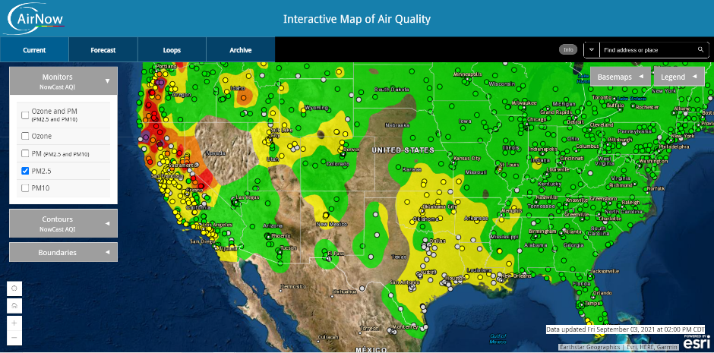
AirNow Map of Current Hourly PM2.5
Source

Slide 34
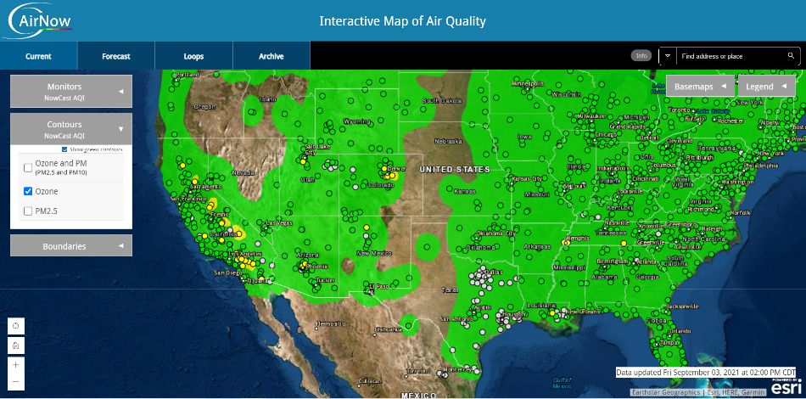
AirNow Map of Current Hourly Ozone
Source

Slide 35


Current Houston Air Quality

Slide 36

Carbon Monoxide (CO) Biomass Burning Tracer - GEOS-CF
Impacts expected late next week
MP4-GIF converter
Source

Slide 37

Saharan dust - GEOS-CF
Moderate dust in south and east Texas, clearing out late next week.

Slide 38


Surface PM2.5 Forecast - GEOS-CF
Saturday 9/4
Sunday 9/5

Slide 39


PM 2.5 - GEOS CF Forecast

Slide 40




Ozone
Sat 9/4 21z
Sun 9/5 21z
Mon 9/5 21z
Source

Slide 41


National Air Quality Forecast Capability (NAQFC) - Maximum 1hr Ozone Forecasts
Friday 9/3
Saturday 9/4
Source
Notes:
CMAQ 12km

Slide 42


Source

Slide 43


Source

Slide 44

HYSPLIT Back Trajectories - NAM 3km CONUS Nest
Source

Slide 45


Ozone Cross Section

Slide 46




Marine
9/4 - Calm winds in the morning, less than 10 kts in the afternoon
9/4 14:00 CDT
9/4 16:00 CDT
Notes:
https://tidesandcurrents.noaa.gov/ofs/ngofs2/ngofs_galveston.html

Slide 47


NWS KHOU forecasting

Slide 48
Forecast summary
Forecast | Sat 9/4 AM | Sat 9/4 PM | Sun 9/5 AM | Sun 9/5 PM | Long Term Outlook (Mon-Tue)
Low-level Cloudiness | Few | Few | Few | Few | Mostly clear on Monday, building cloudiness into Tuesday
Mid-level Cloudiness | Few | Few | Few | Few
Upper level Cloudiness | Few | Few | Few | Few
Convection | Unlikely | Few near coast | Unlikely | Unlikely | More likely Tues.
Seabreeze | Unlikely | Yes | Unlikely | Yes (Weaker) | Unlikely
Ozone | Low | Moderate (N. of Houston) | Low | Moderate | Moderate
PM2.5 | Moderate | Moderate | Moderate | Moderate | Moderate

