Slide 1
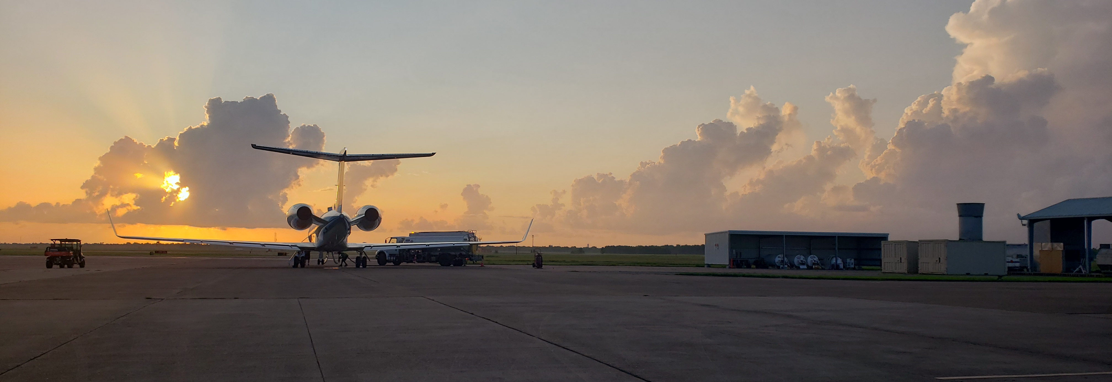
TRACER-AQ Science Flight #2
3 September 2021 13:00-19:30 UTC

Slide 2
