Slide 1
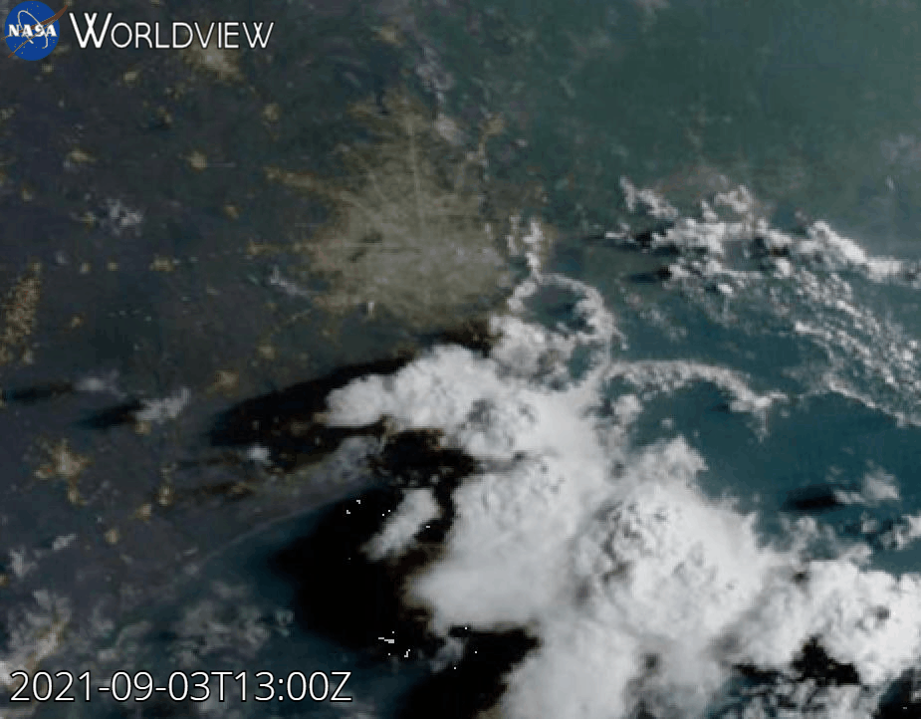
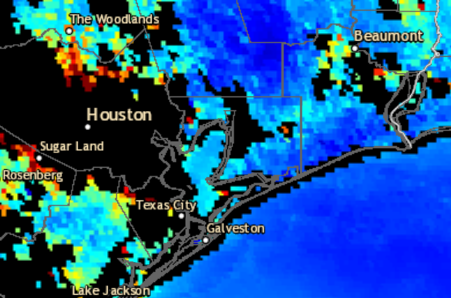
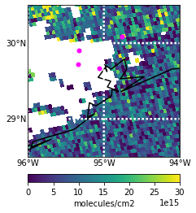
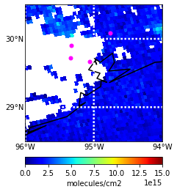
GOES 16 True Color Imagery 09/03/2021 13:00-23:00 UTC
AOD Composite 09/03/2021 19:41 UTC
HCHO 09/03/2021 from 19:37 UTC TROPOMI (v. 2.02.01) Overpass
NO2 09/03/2021 from 19:37 UTC TROPOMI (v. 2.2.0) Overpass
Liberty
Liberty
Aldine
Note: Few valid
measurements from TROPOMI due to clouds.
Aldine
UH
La Porte
La Porte
UH
Qa value:
>0.5
Qa value: >0.75

