Slide 1
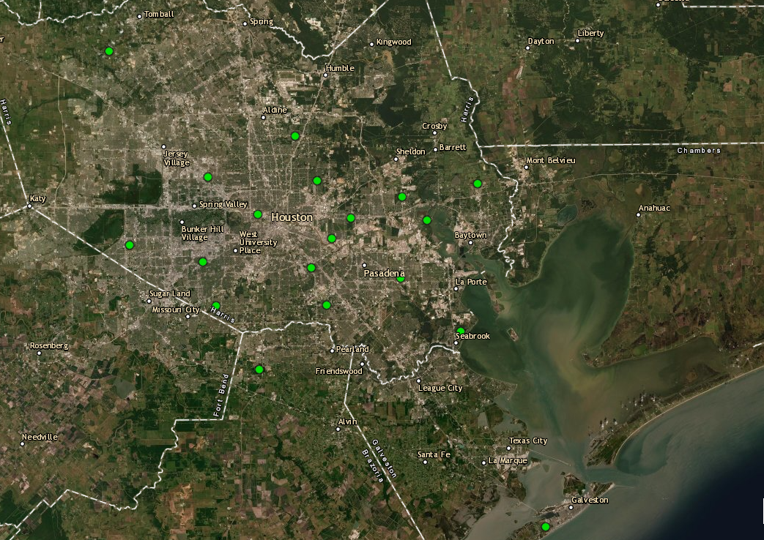
Houston Ozone Monitors September 3rd, 2021
Aldine
Baytown Garth
UH Moody Tower
Deer Park
Site Location | Maximum 8-hour Ozone Concentration
Baytown Garth | 40ppb (Highest reading of the day)
Aldine | 34ppb
UH Moody Tower | N/A
La Porte / Deer Park | 28ppb

Slide 2
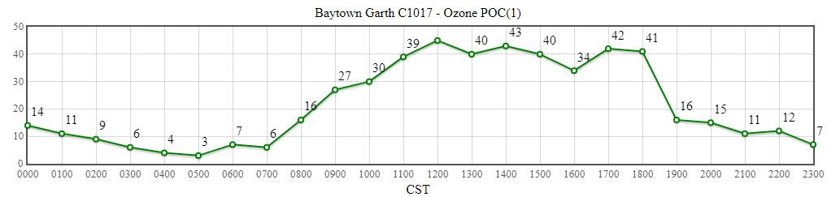
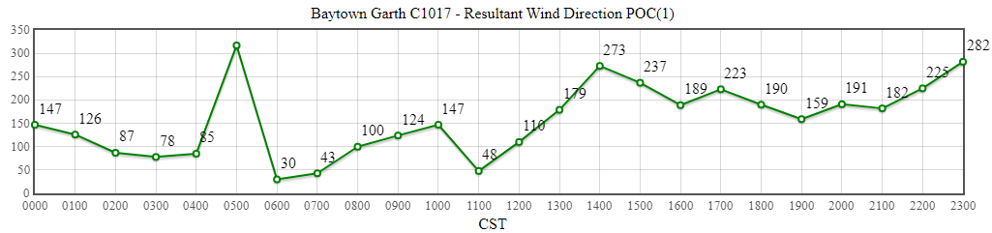
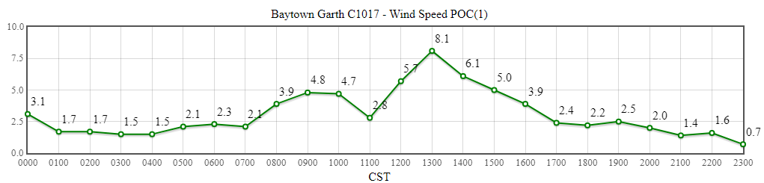
Baytown Garth
Source: https://www.tceq.texas.gov/cgi-bin/compliance/monops/daily_summary.pl

Slide 3
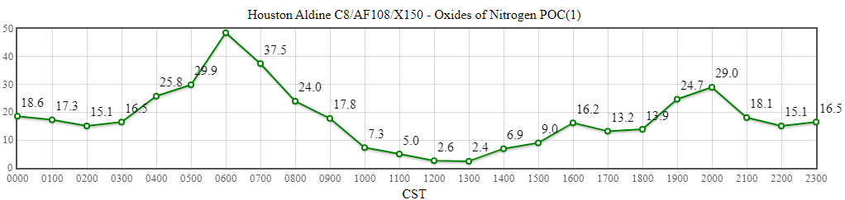
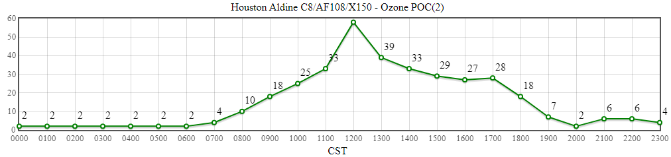
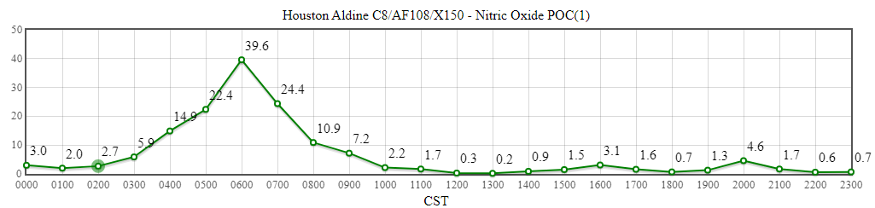
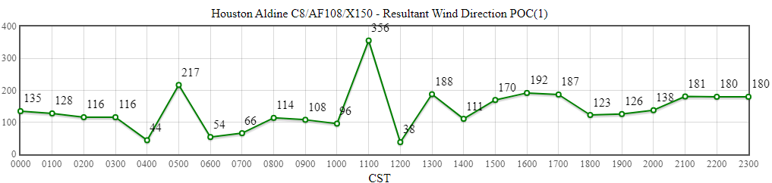
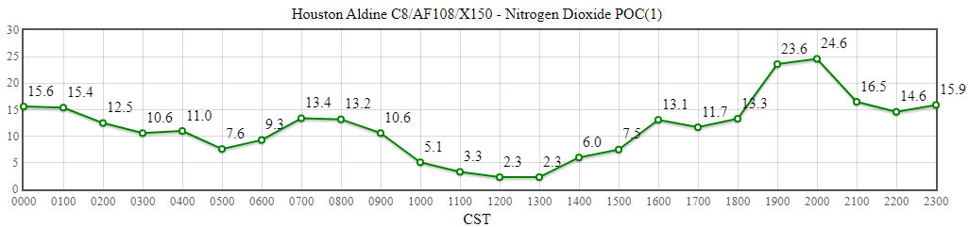
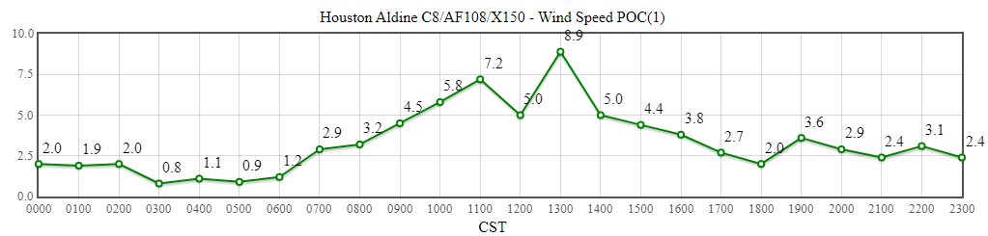
Aldine
Source: https://www.tceq.texas.gov/cgi-bin/compliance/monops/daily_summary.pl

Slide 4
UH Moody Tower
No Data Available This Day

Slide 5
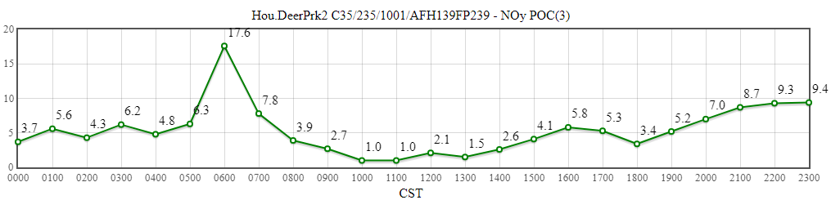
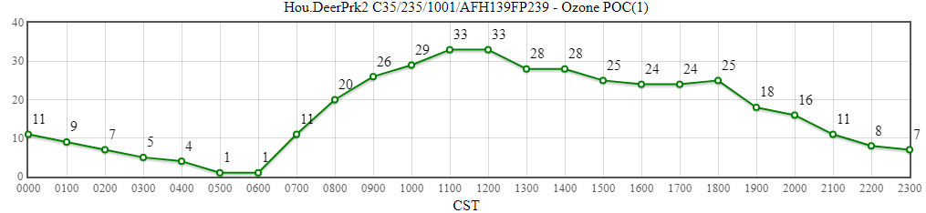
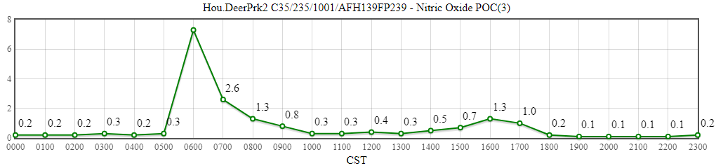
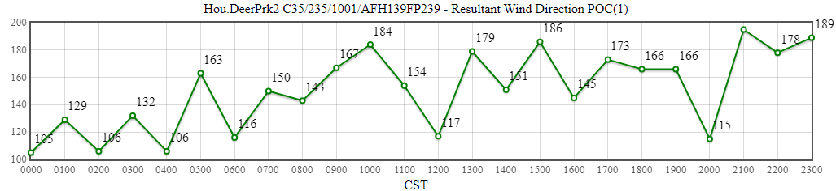
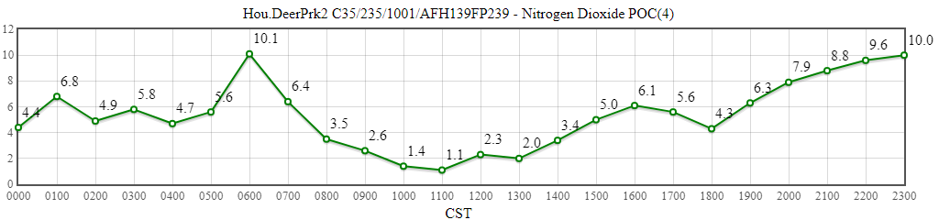
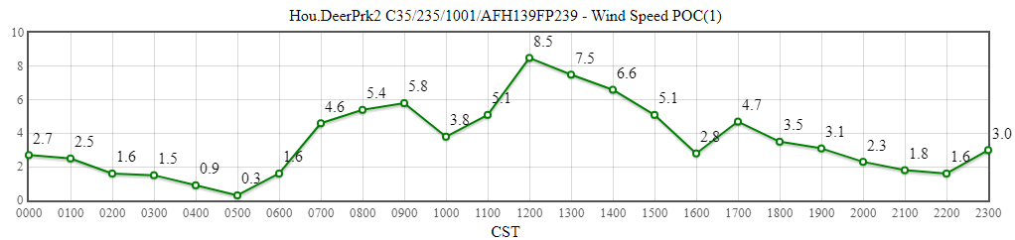
La Porte / Deer Park
Source: https://www.tceq.texas.gov/cgi-bin/compliance/monops/daily_summary.pl

