Slide 1
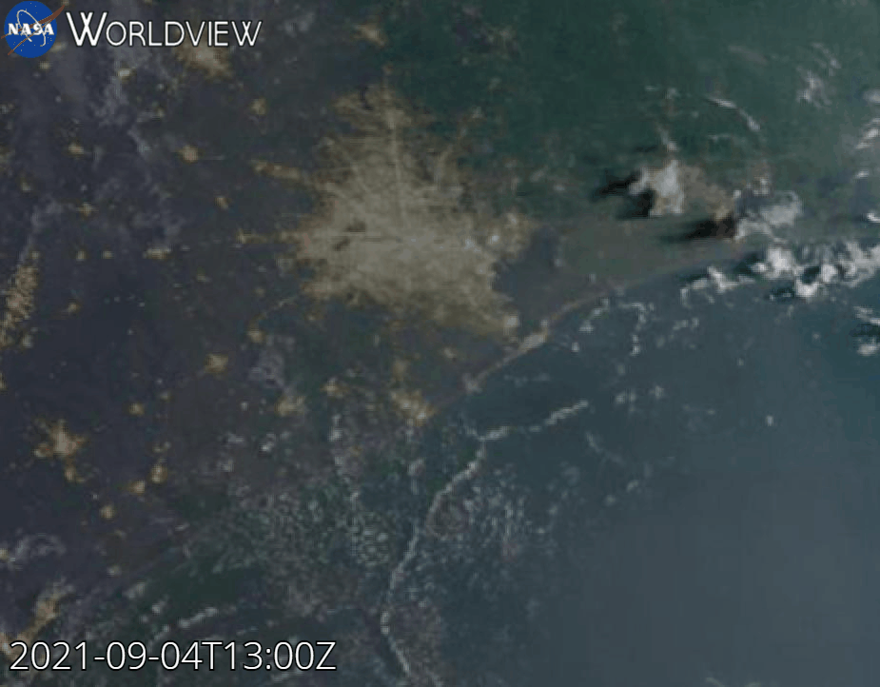
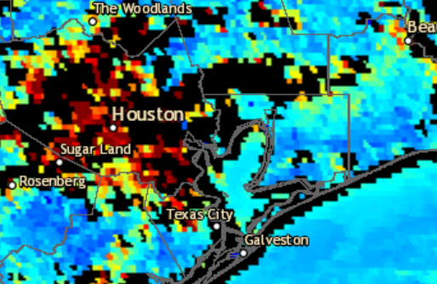
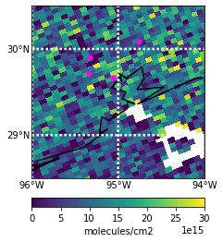
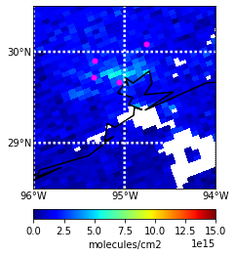
GOES 16 True Color Imagery 09/04/2021 13:00-23:00 UTC
AOD Composite 09/04/2021 19:21 UTC
HCHO 09/04/2021 from 19:18 UTC TROPOMI (v. 2.02.01) Overpass
NO2 09/04/2021 from 19:18 UTC TROPOMI (v. 2.2.0) Overpass
Liberty
Liberty
Aldine
Aldine
UH
La Porte
UH
La Porte
Qa value:
>0.5
Qa value: >0.75

