Slide 1
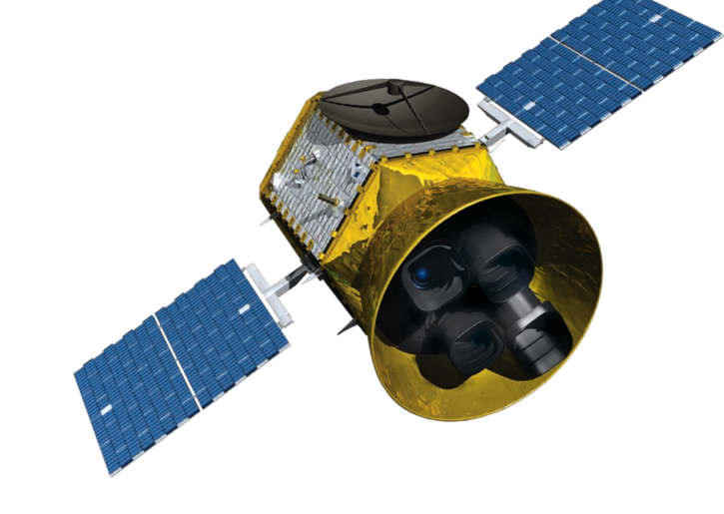
TROPOMI SATELLITE PASSED OVER HOUSTON TWICE ON SEPTEMBER 6TH, 2021.

Slide 2
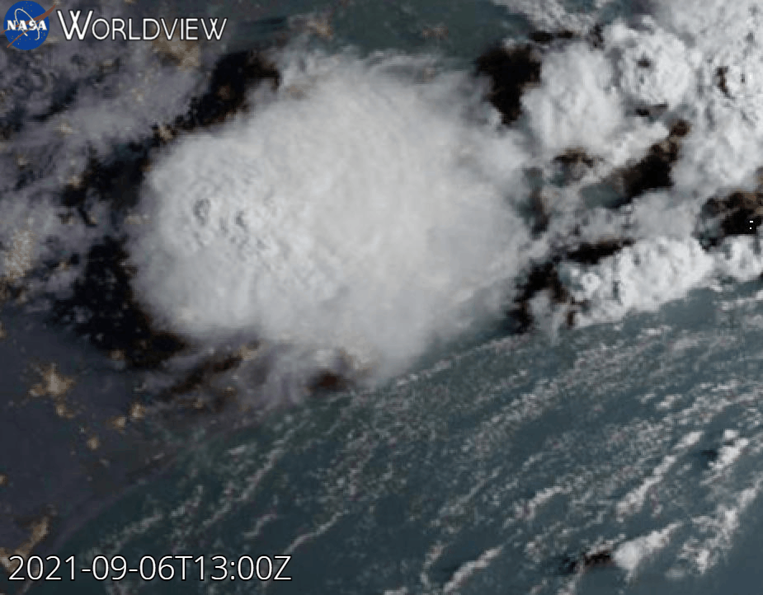
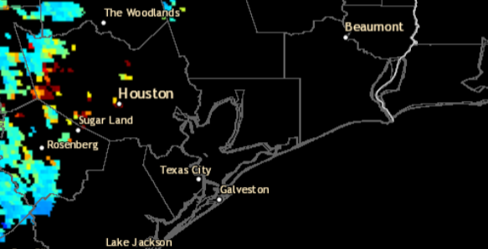
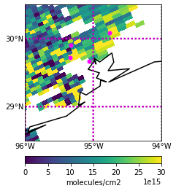
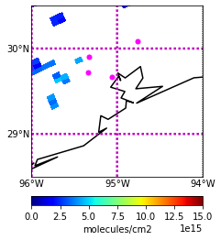
GOES 16 True Color Imagery 09/06/2021 13:00-23:00 UTC
AOD Composite 09/06/2021 18:51 UTC
Source:https://worldview.earthdata.nasa.gov/?lg=false&t=2021-09-29-T19%3A45%3A52Z
Source:https://www.star.nesdis.noaa.gov/smcd/spb/aq/AerosolWatch/?product_date=20210919&zoom=8&lat0=29.66467011272428&lon0=-94.83121297319396&layers=67108865&region=conus
HCHO 09/06/2021 from 18:47 UTC TROPOMI (v. 2.02.01) Overpass
NO2 09/06/2021 from 18:47 UTC TROPOMI (v. 2.2.0) Overpass
Liberty
Liberty
Aldine
La Porte
Note: Few valid
measurements from TROPOMI due to clouds.
Aldine
La Porte
UH
UH
Qa value:
>0.5
Qa value: >0.75

Slide 3
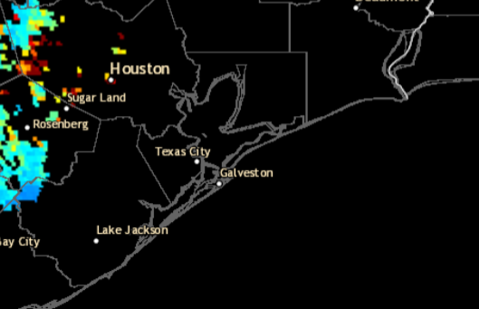
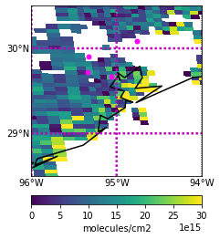
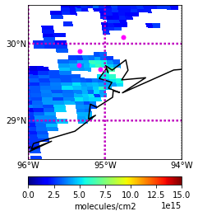
GOES 16 True Color Imagery 09/06/2021 13:00-23:00 UTC
AOD Composite 09/06/2021 20:21 UTC
Source:https://worldview.earthdata.nasa.gov/?lg=false&t=2021-09-29-T19%3A45%3A52Z
Source:https://www.star.nesdis.noaa.gov/smcd/spb/aq/AerosolWatch/?product_date=20210919&zoom=8&lat0=29.66467011272428&lon0=-94.83121297319396&layers=67108865&region=conus
HCHO 09/06/2021 from 20:20 UTC TROPOMI (v. 2.02.01) Overpass
NO2 09/06/2021 from 20:20 UTC TROPOMI (v. 2.2.0) Overpass
Liberty
Liberty
Aldine
Note: Few valid
measurements from TROPOMI due to clouds.
Aldine
UH
La Porte
UH
La Porte
Qa value:
>0.5
Qa value: >0.75

