Slide 1
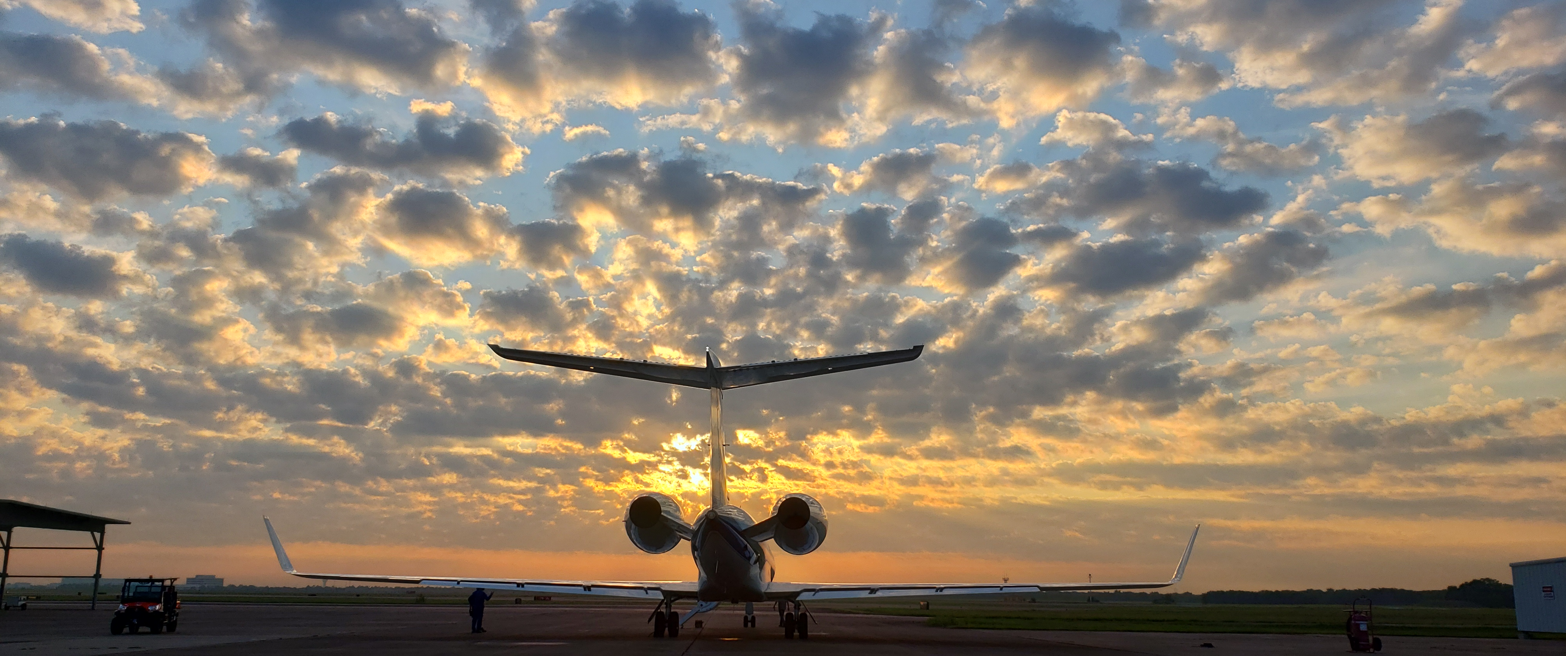
TRACER-AQ Science Flight #3
8 September 2021

Slide 2
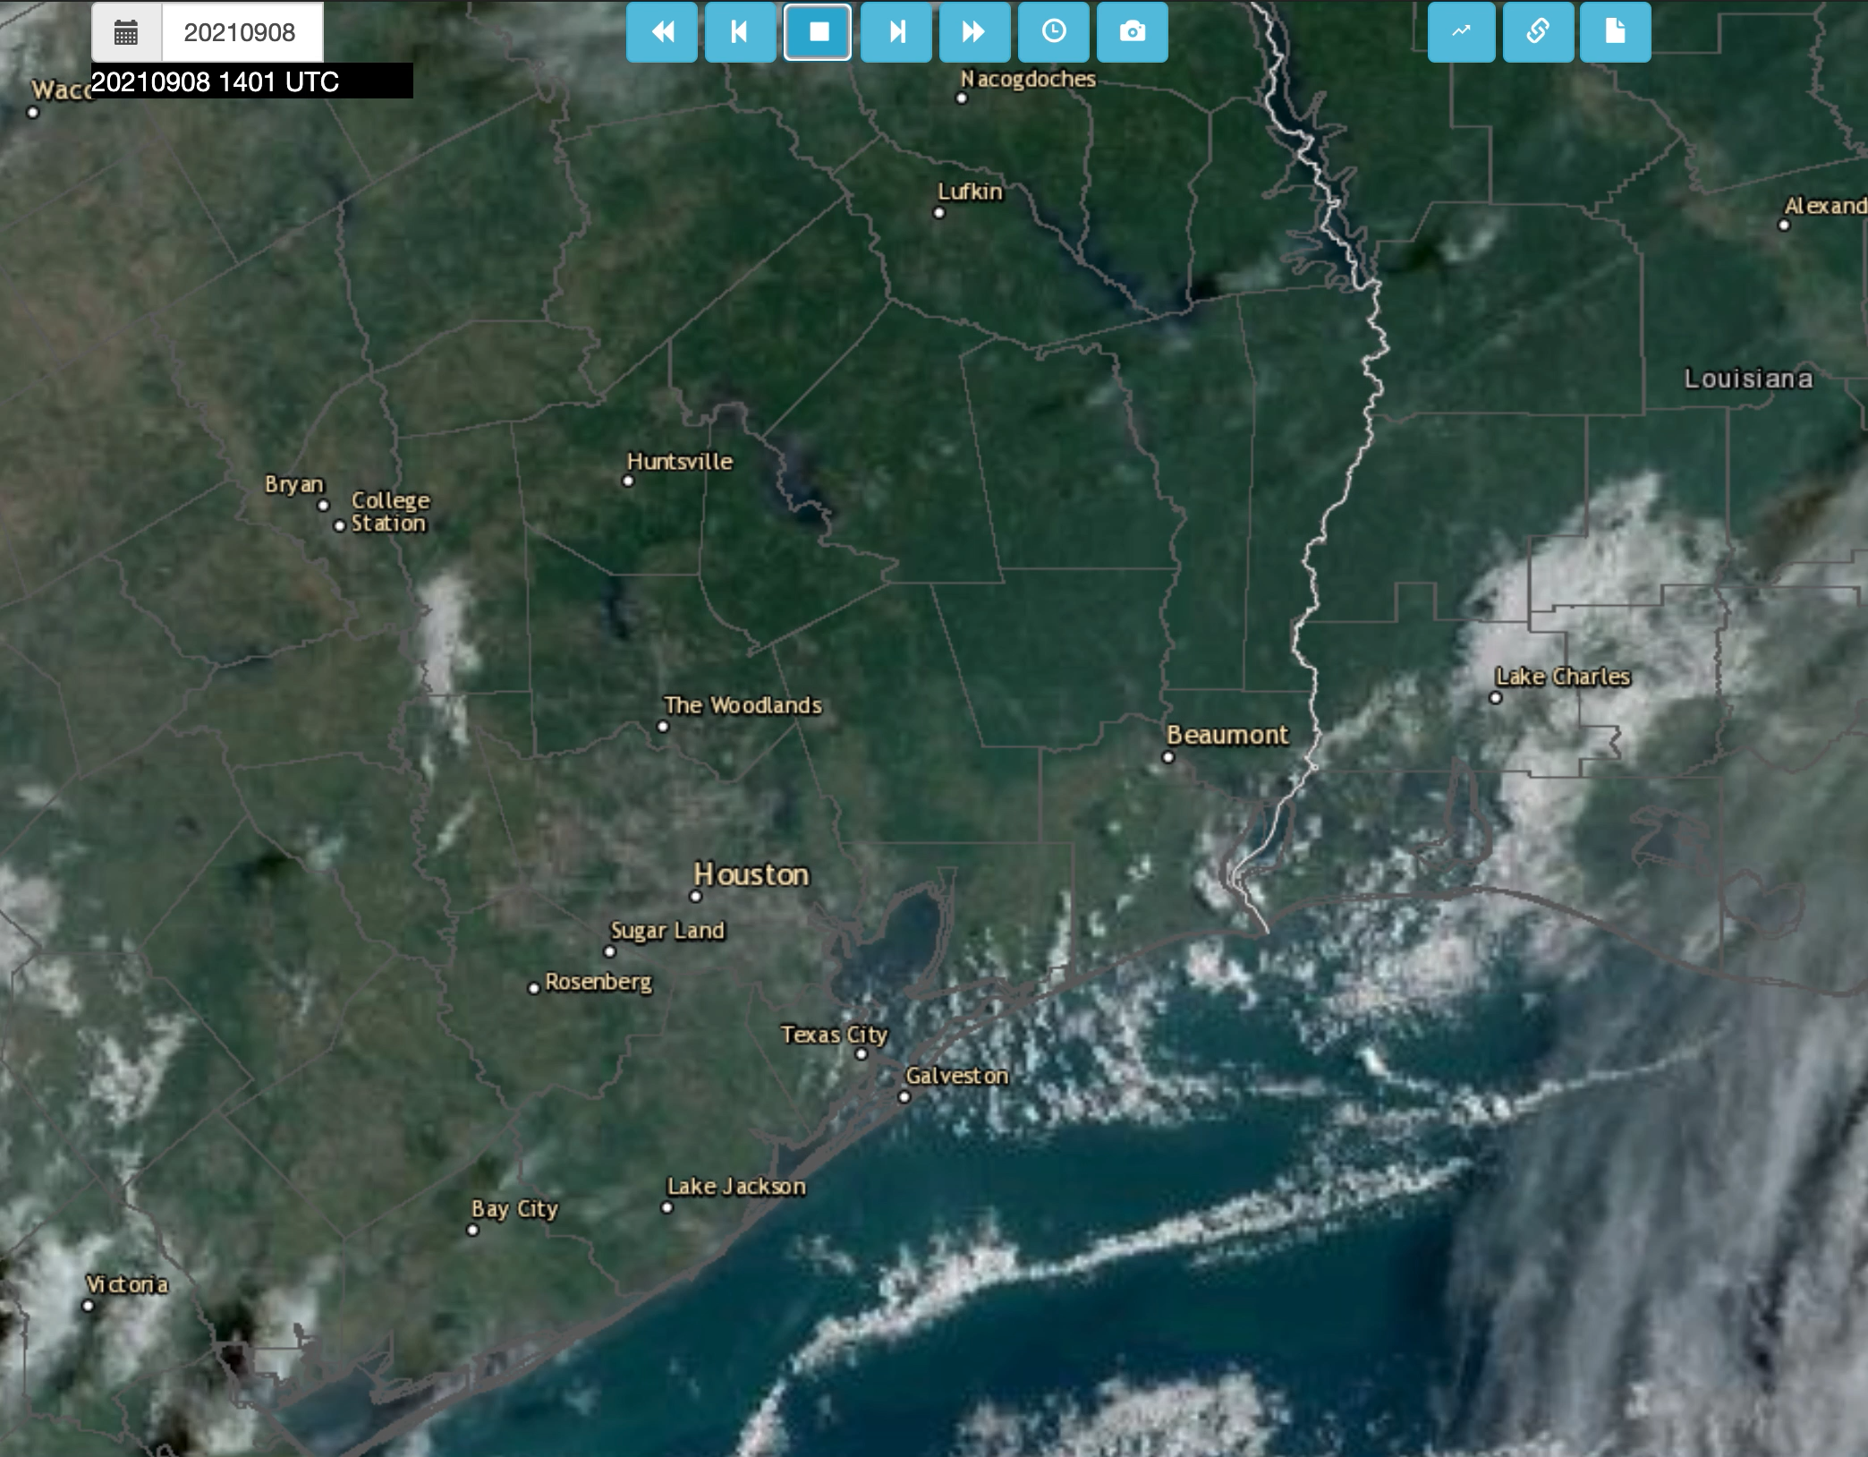

Slide 6
