Slide 1
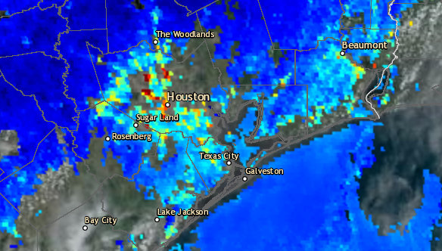
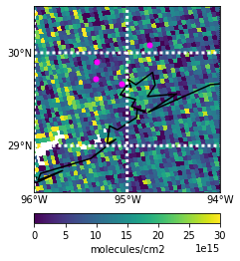
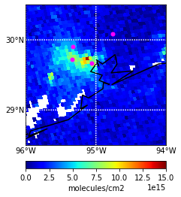
GOES 16 True Color Imagery 09/08/2021 11:06-19:21 UTC
AOD Composite 09/08/2021 18:01 UTC
Source: https://weather.cod.edu/satrad/?parms=continental-conus-02-24-0-100-1&checked=map&colorbar=undefined
Source: https://www.star.nesdis.noaa.gov/smcd/spb/aq/AerosolWatch/?product_date=20210908&zoom=8&lat0=30.47293396021489&lon0=-95.16090146122589&layers=67108881&region=conus
HCHO 09/08/2021 from 20:02 UTC TROPOMI Overpass
NO2 09/08/2021 from 20:02 UTC TROPOMI Overpass
Liberty
Liberty
Aldine
Aldine
UH
La Porte
UH
La Porte
Qa value:
>0.5
Qa value: >0.75

