Slide 1
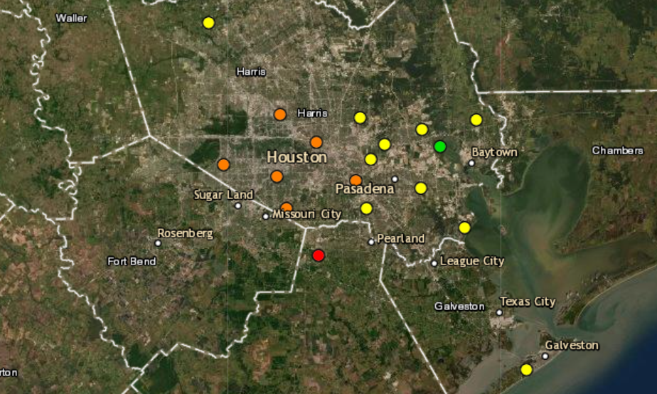
Houston Ozone Monitors September 8th, 2021
UH Moody Tower
Deer Park
Site Location | Maximum 8-hour Ozone Concentration
Manvel Croix | 89ppb (Highest reading of the day)
Aldine | N/A
UH Moody Tower | 74ppb
La Porte / Deer Park | 69ppb
Manvel Croix

Slide 2
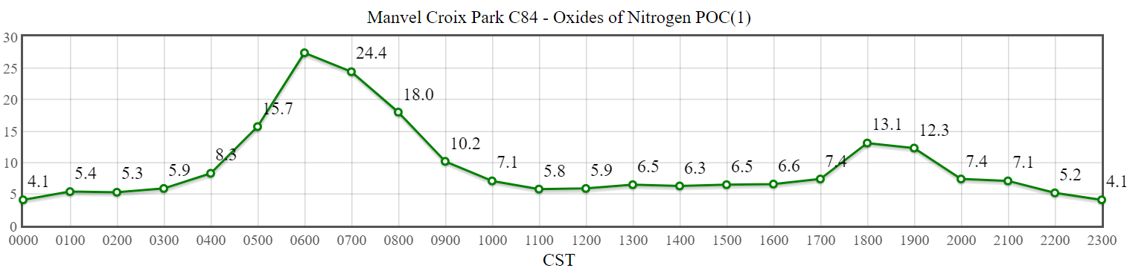
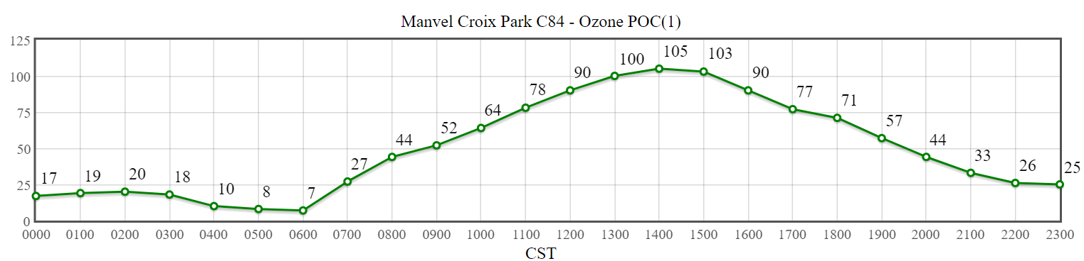
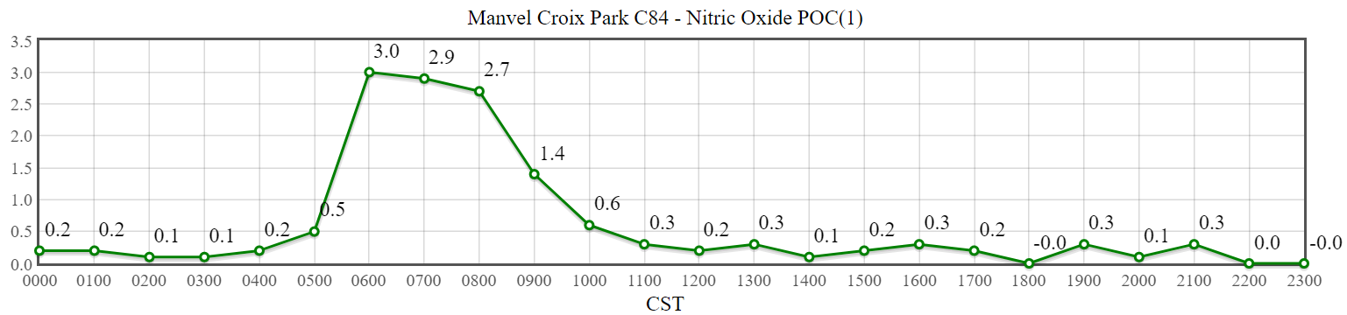
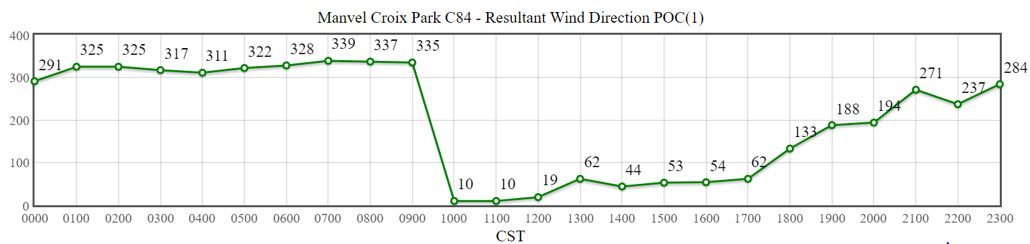
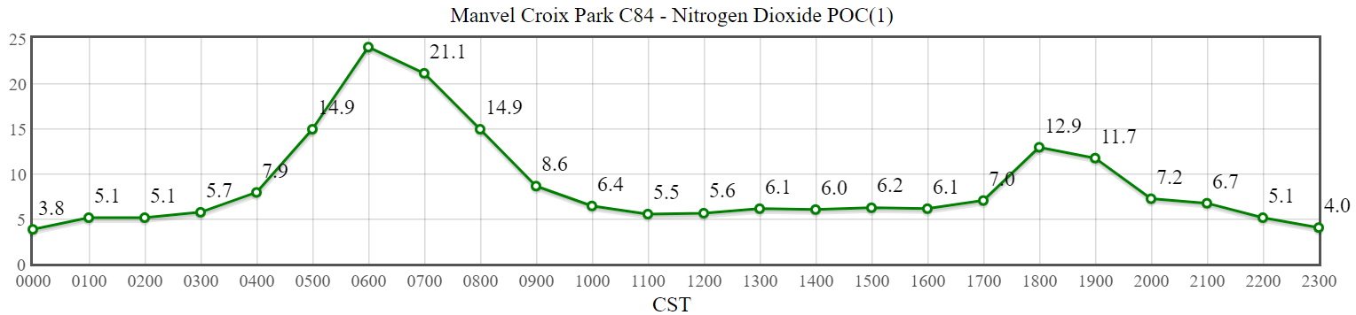
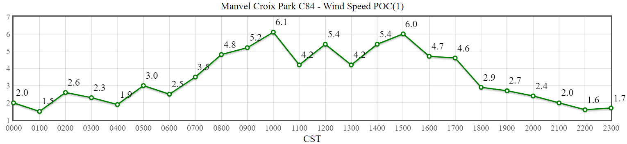
Manvel Croix
Source: https://www.tceq.texas.gov/cgi-bin/compliance/monops/daily_summary.pl

Slide 3
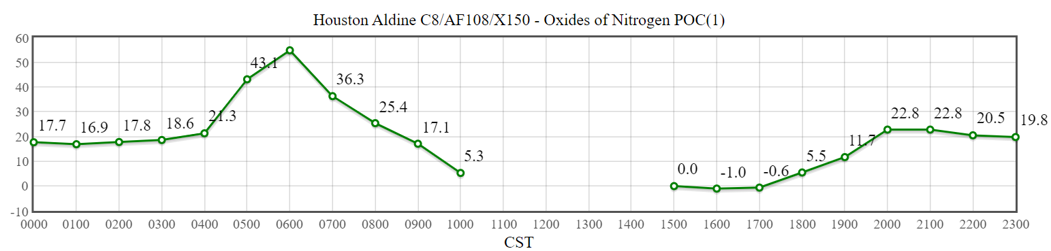
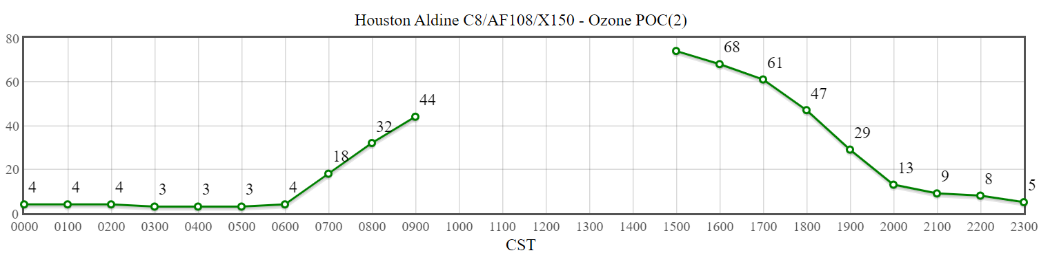
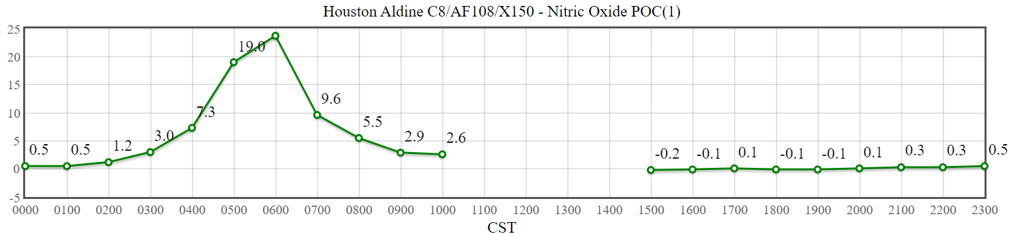
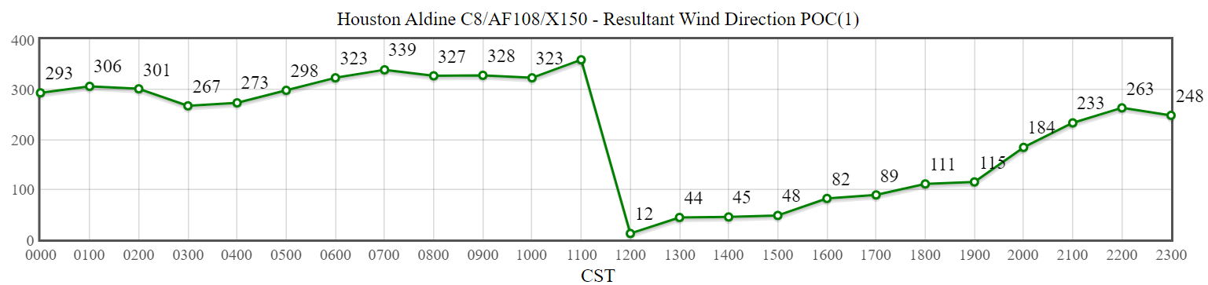
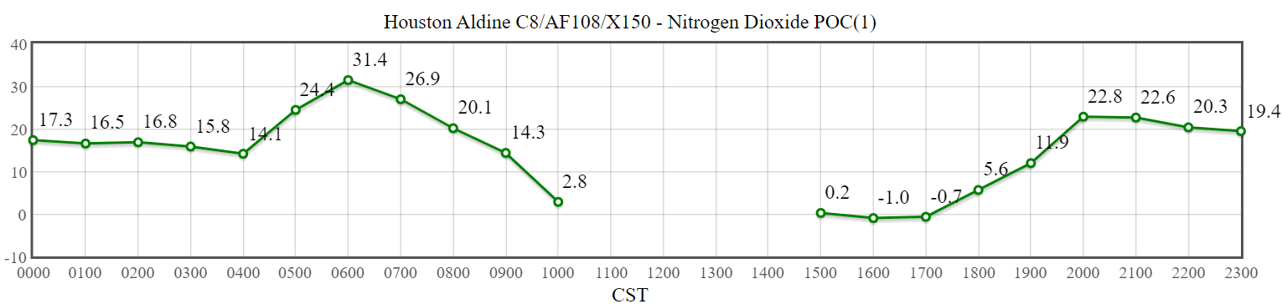
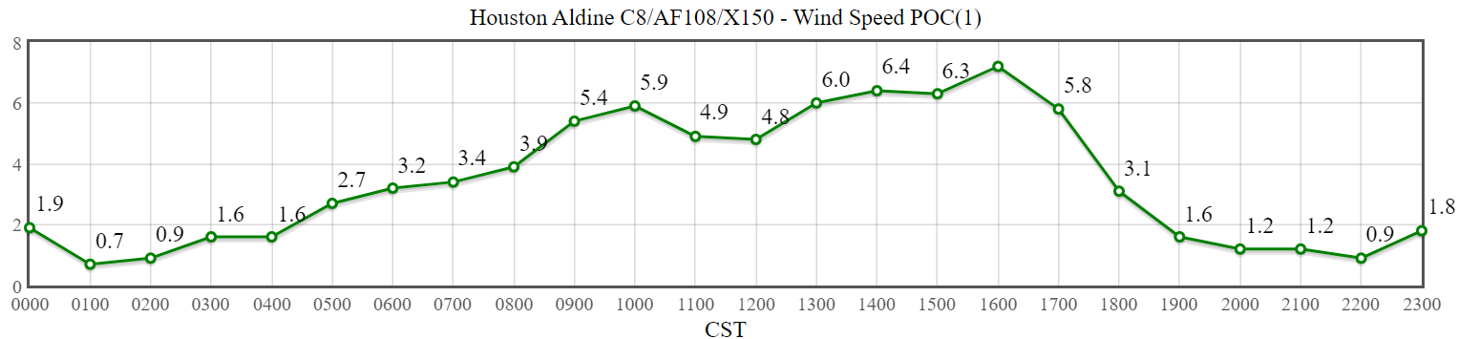
Aldine
Source: https://www.tceq.texas.gov/cgi-bin/compliance/monops/daily_summary.pl

Slide 4
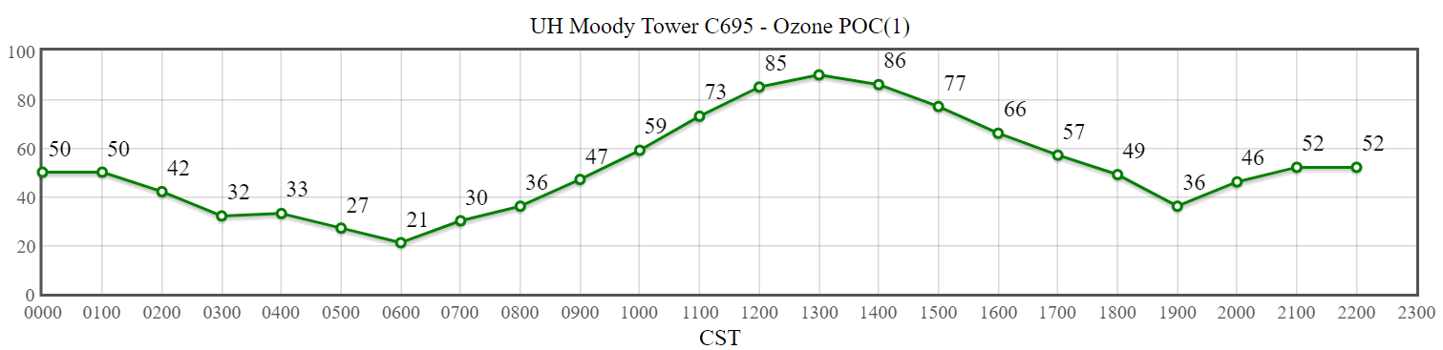
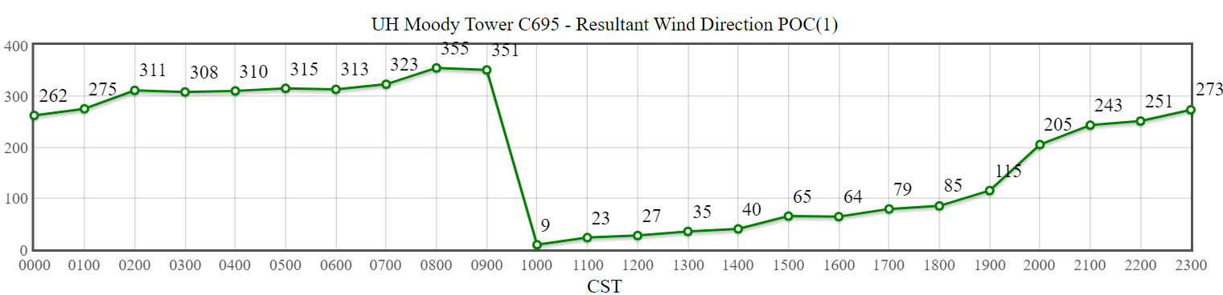
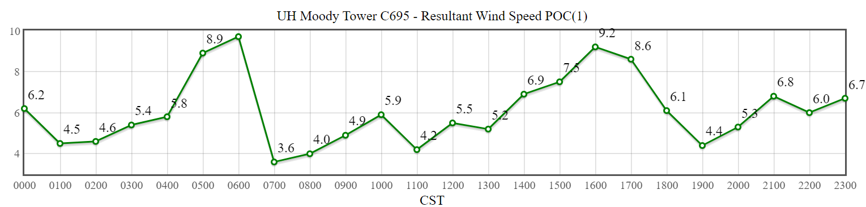
UH Moody Tower
Source: https://www.tceq.texas.gov/cgi-bin/compliance/monops/daily_summary.pl

Slide 5
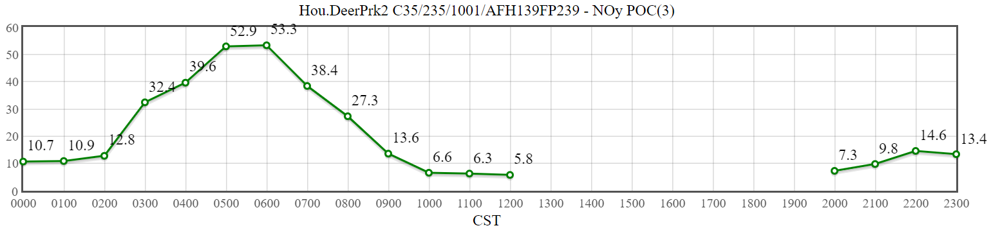
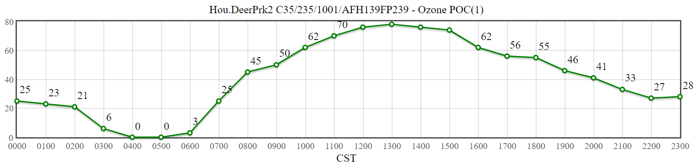
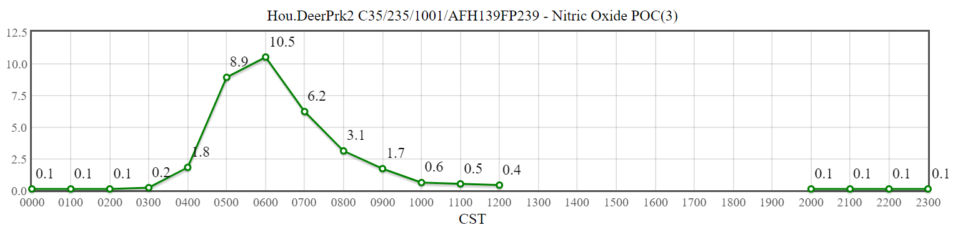
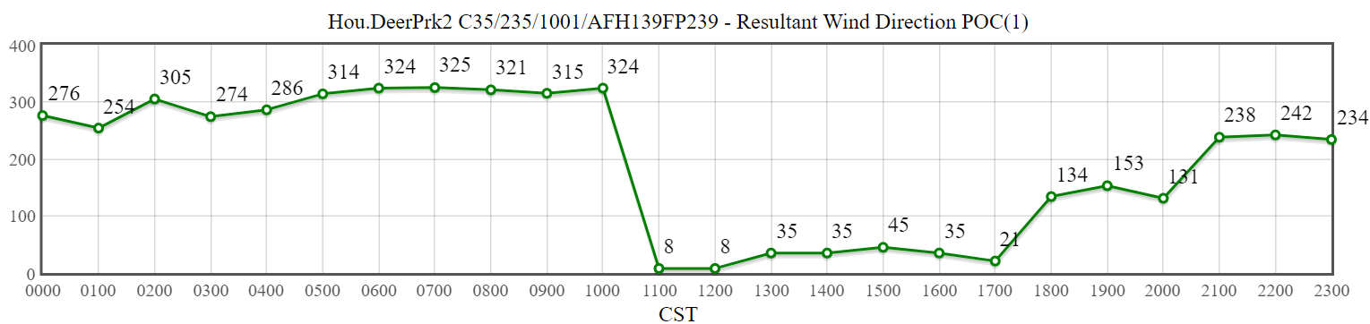
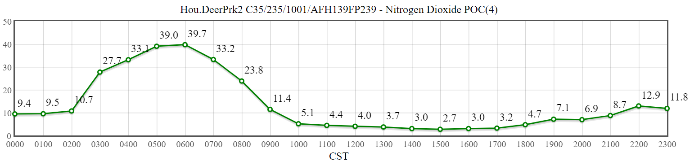
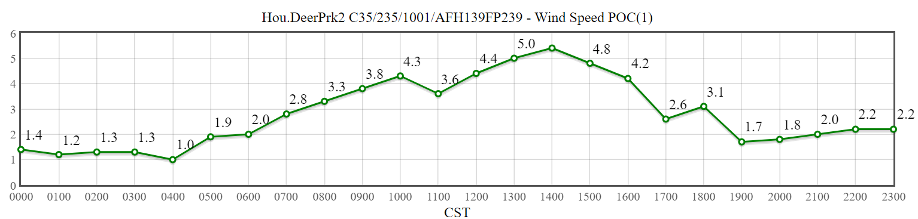
La Porte / Deer Park
Source: https://www.tceq.texas.gov/cgi-bin/compliance/monops/daily_summary.pl

