Slide 1
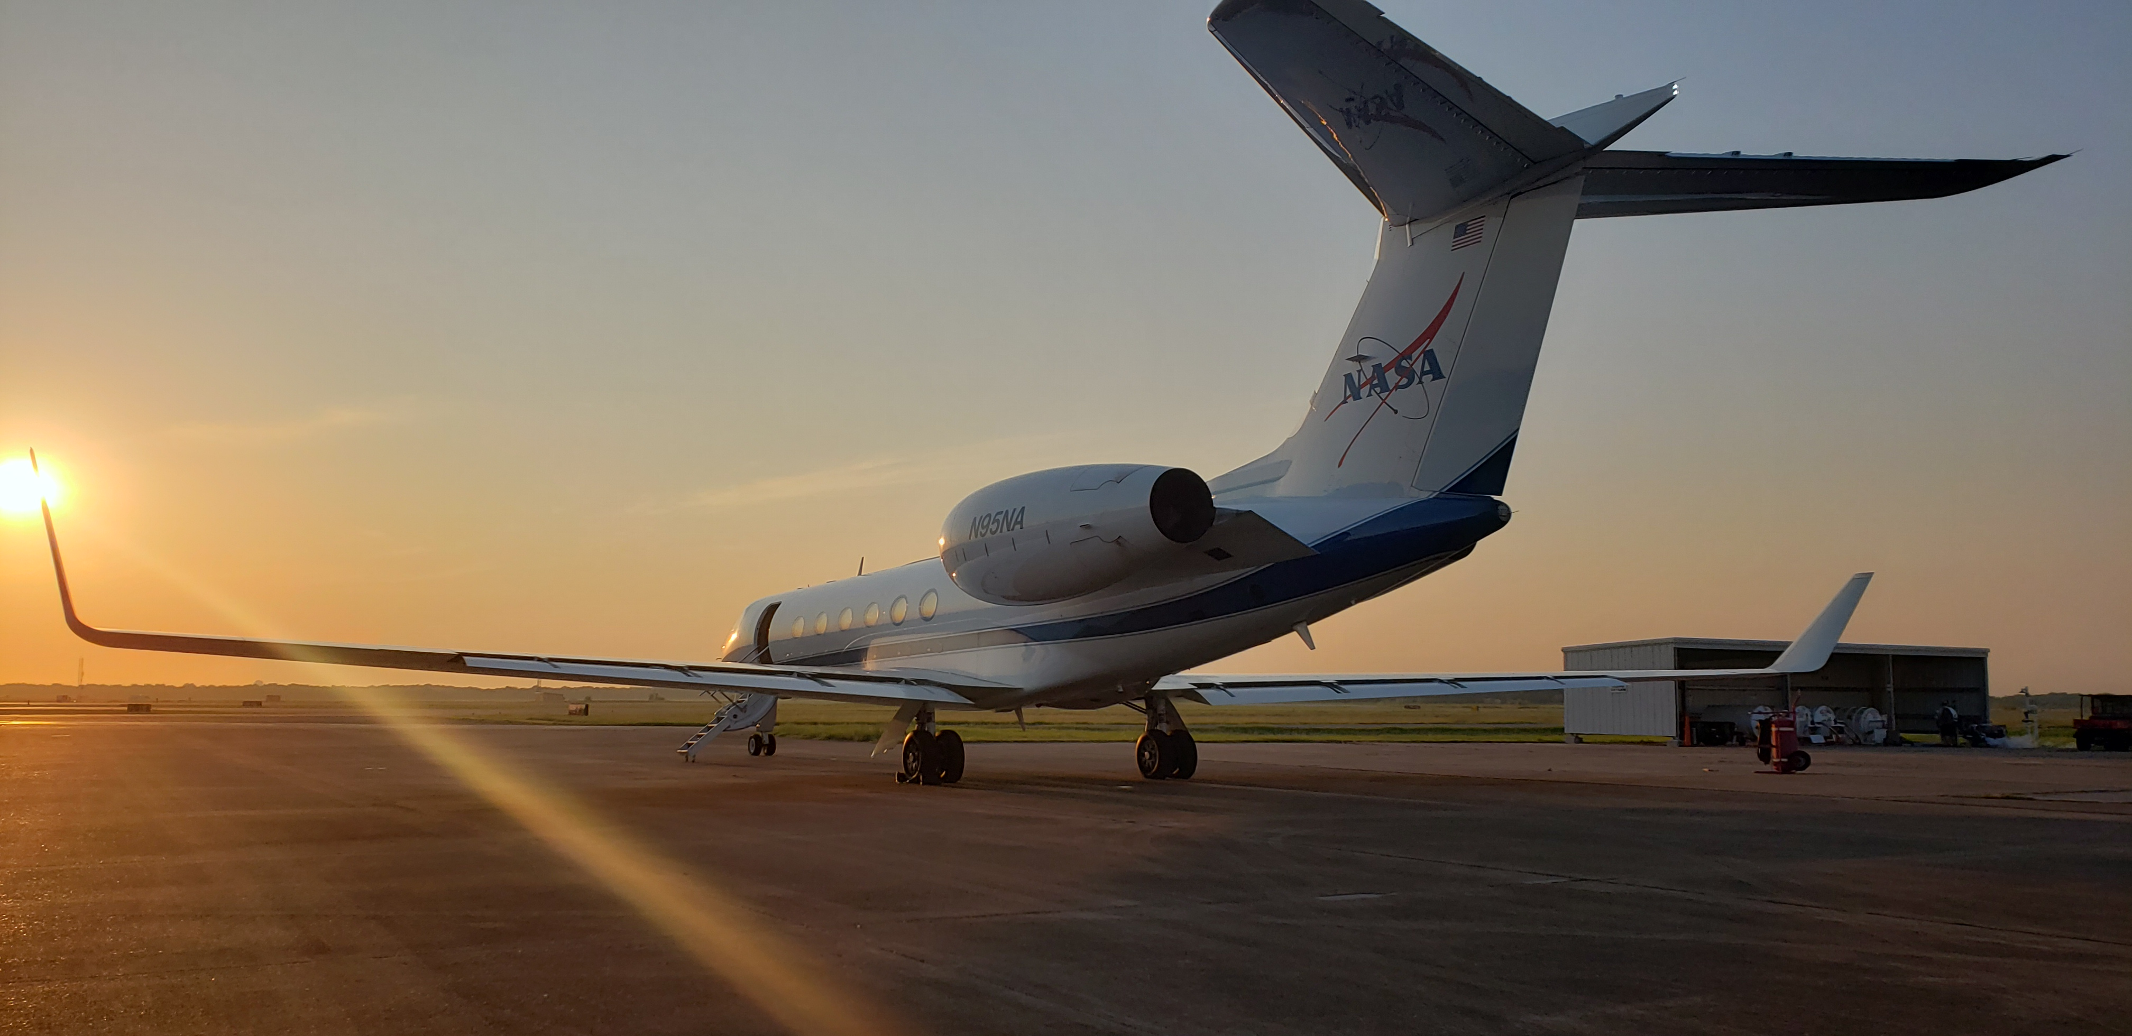
TRACER-AQ Science Flight #4
9 September 2021

Slide 2
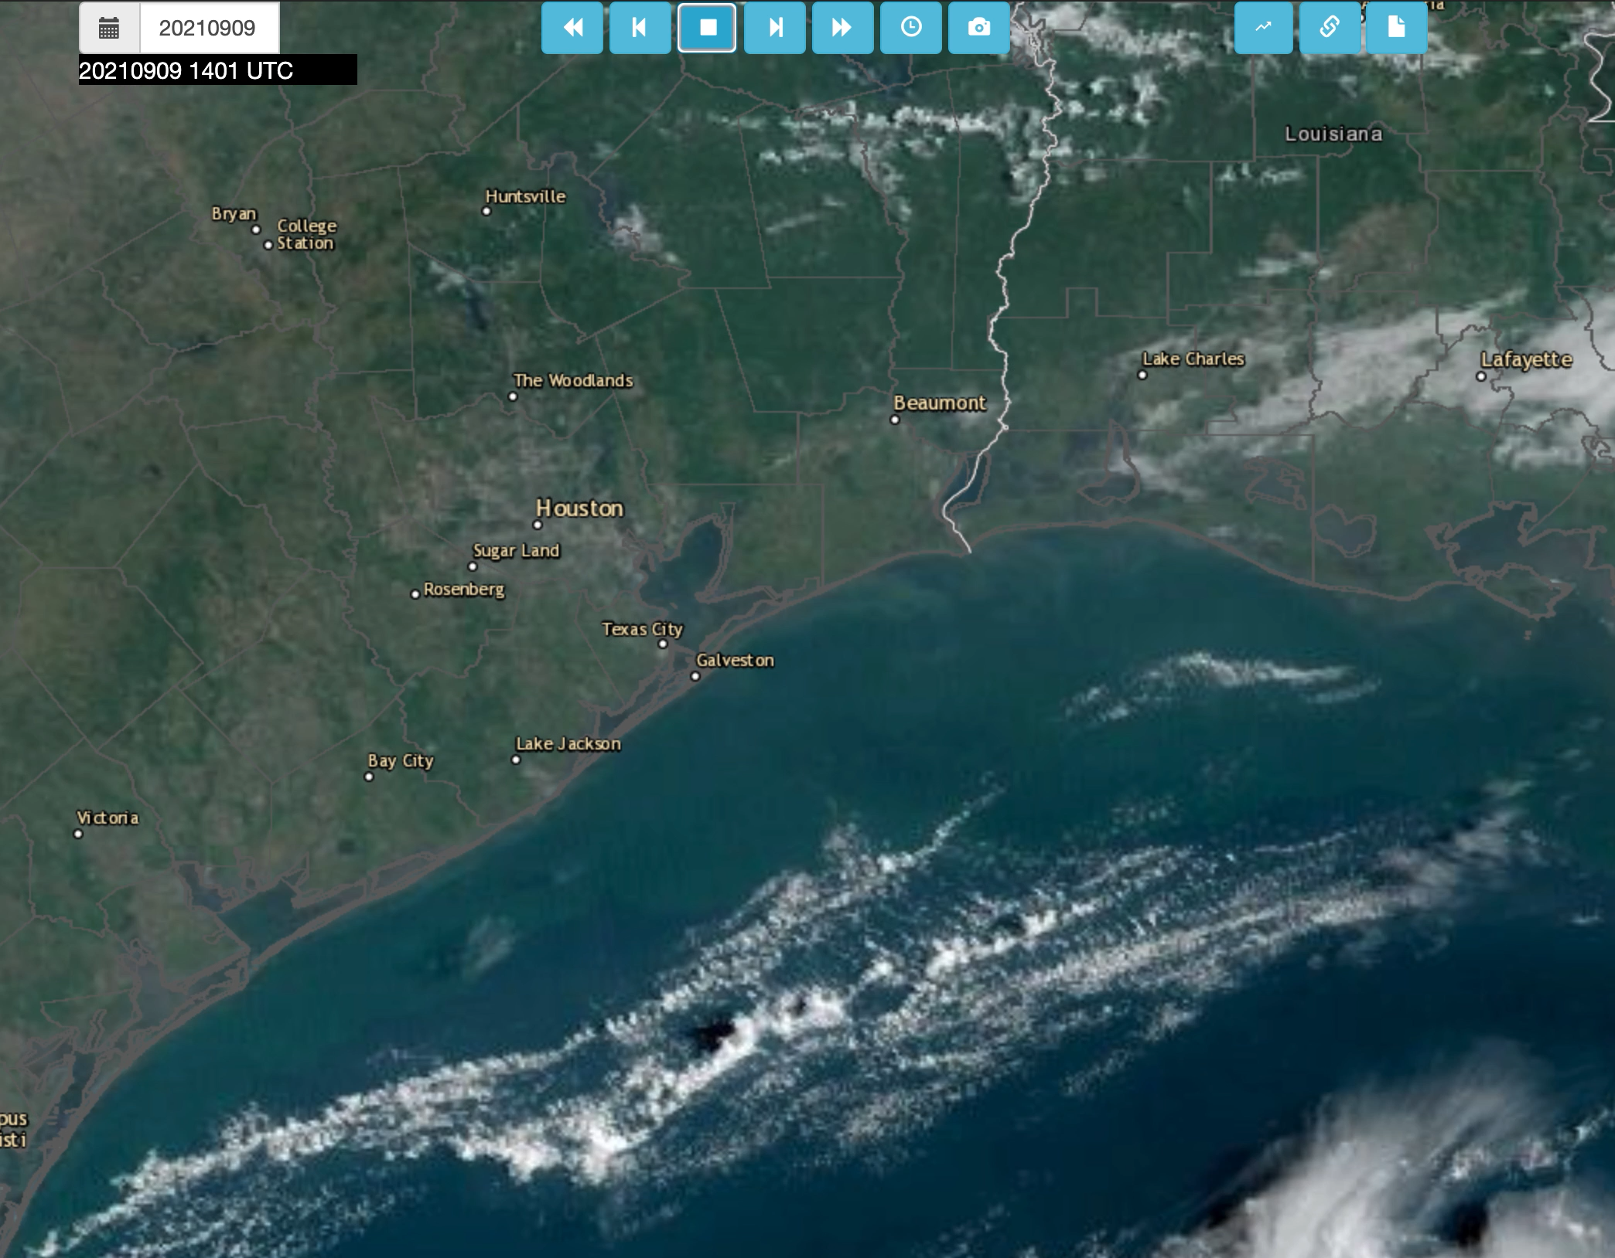

Slide 6
