Slide 1
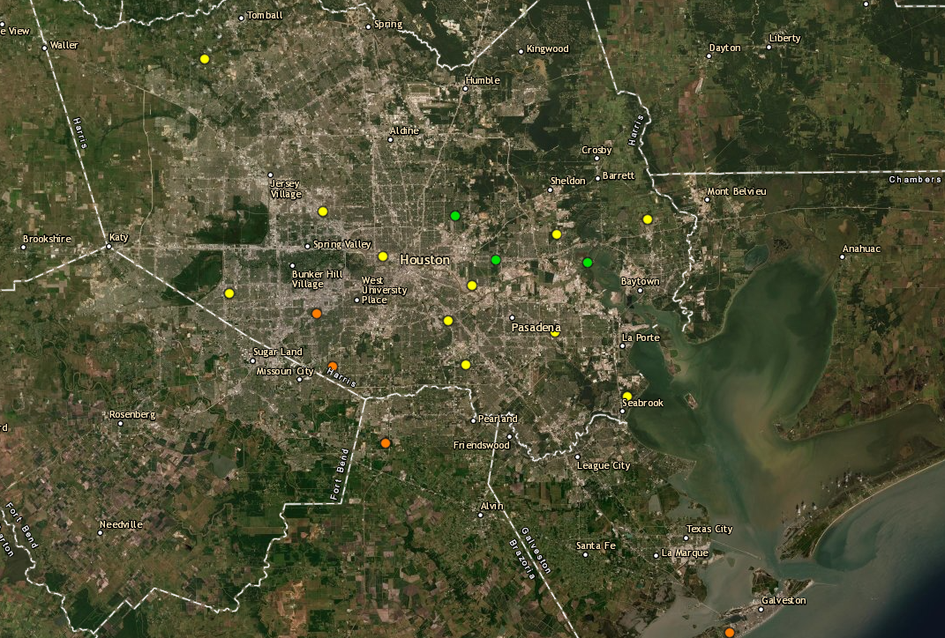
Houston Ozone Monitors September 9th, 2021
UH Moody Tower
Deer Park
Site Location | Maximum 8-hour Ozone Concentration
Manvel Croix | 79ppb (Highest reading of the day)
Aldine | N/A
UH Moody Tower | 62ppb
La Porte / Deer Park | 65ppb
Manvel Croix

Slide 2
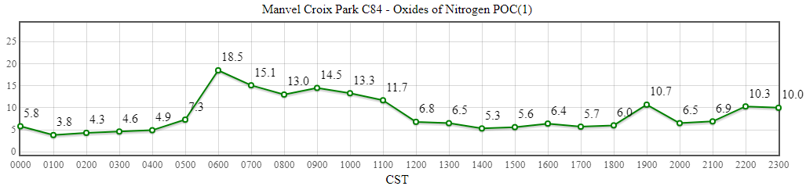
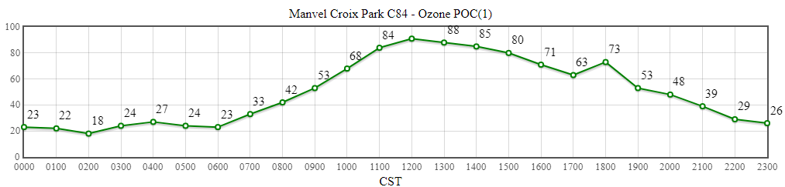
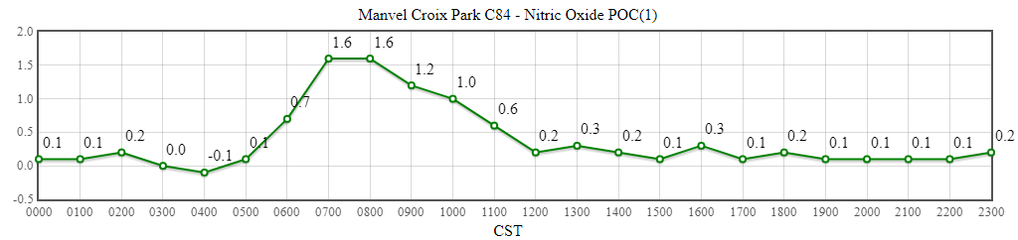
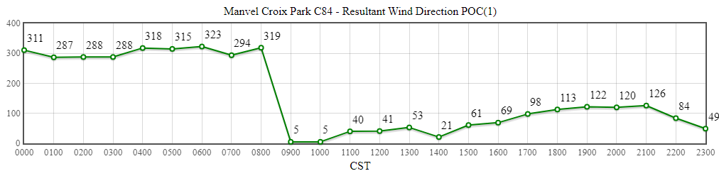
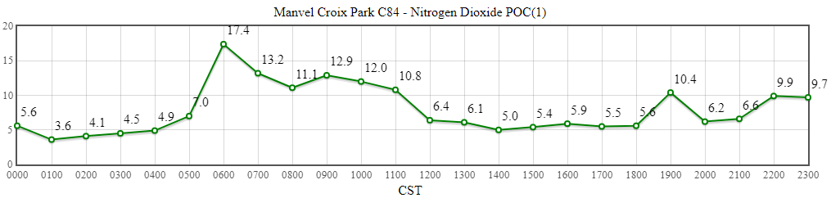
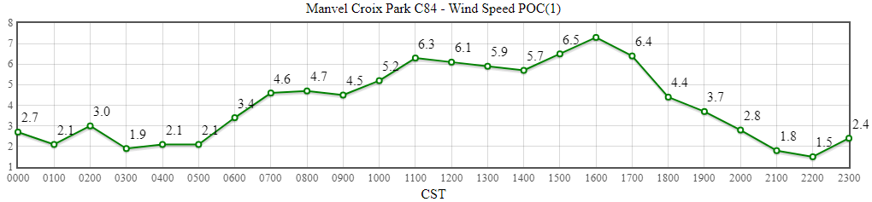
Manvel Croix
Source: https://www.tceq.texas.gov/cgi-bin/compliance/monops/daily_summary.pl

Slide 3
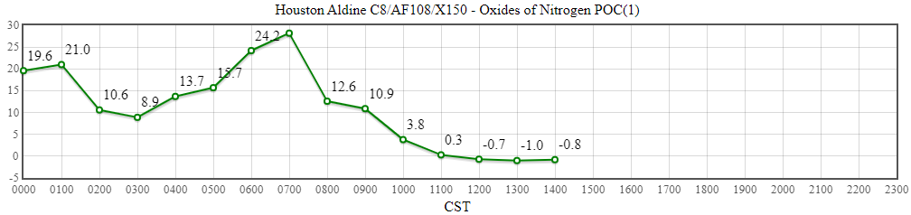
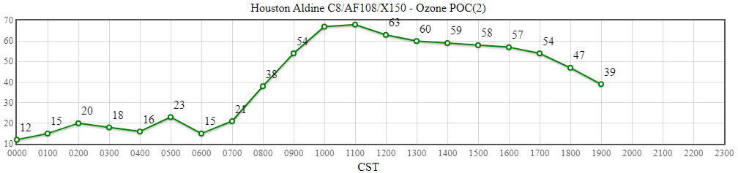
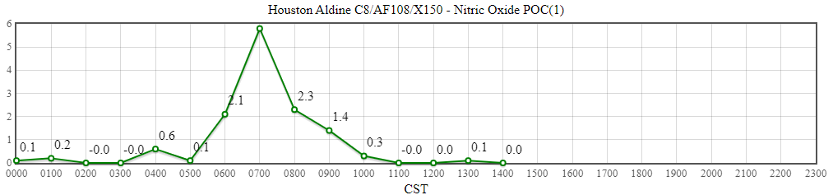
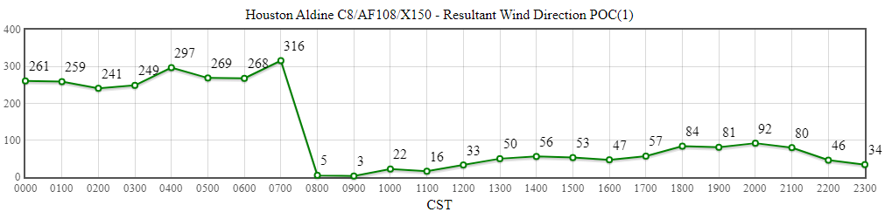
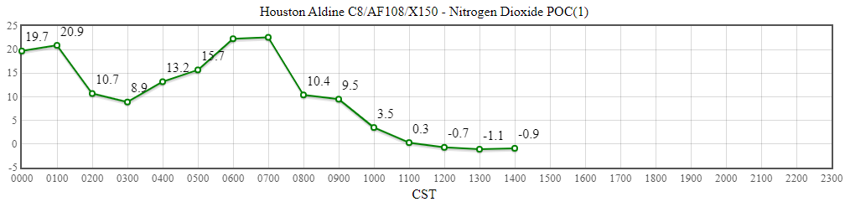
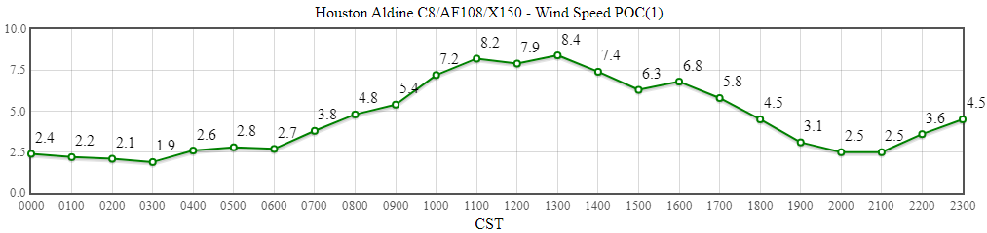
Aldine
Source: https://www.tceq.texas.gov/cgi-bin/compliance/monops/daily_summary.pl

Slide 4
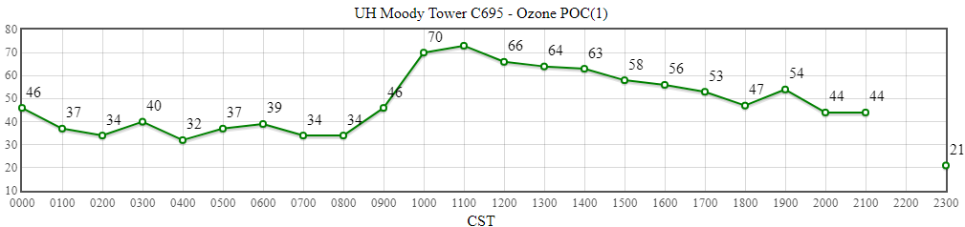
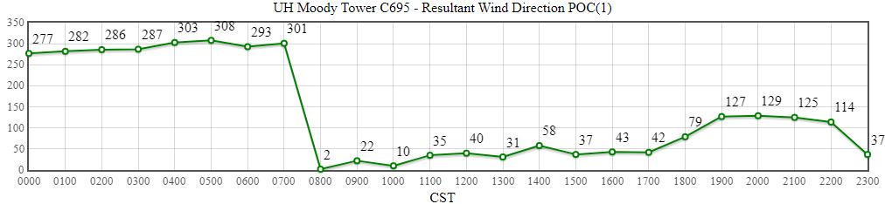
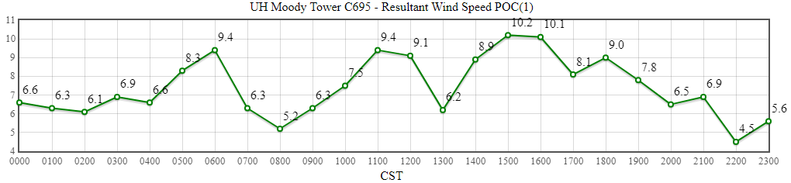
UH Moody Tower
Source: https://www.tceq.texas.gov/cgi-bin/compliance/monops/daily_summary.pl

Slide 5
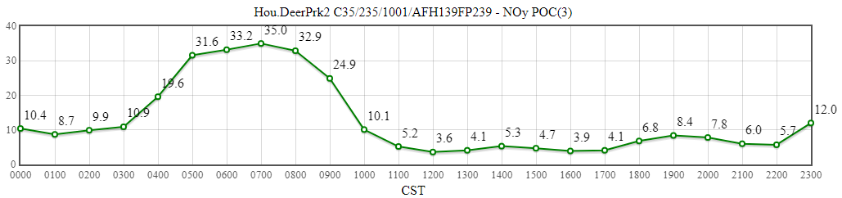
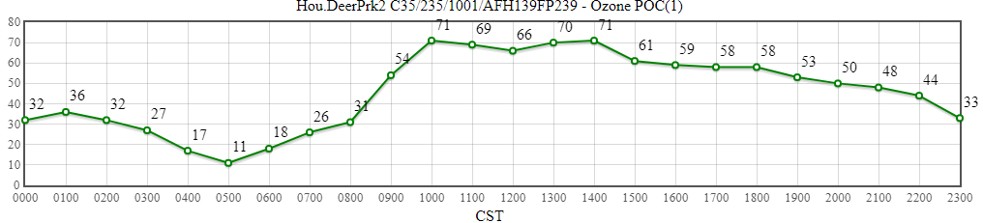
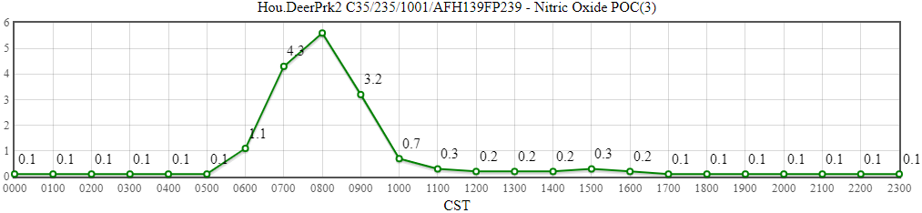
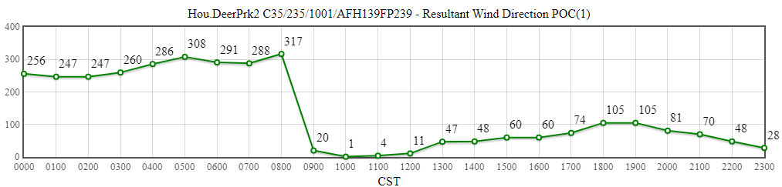
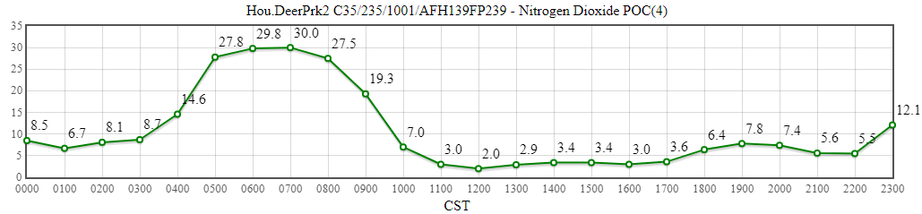
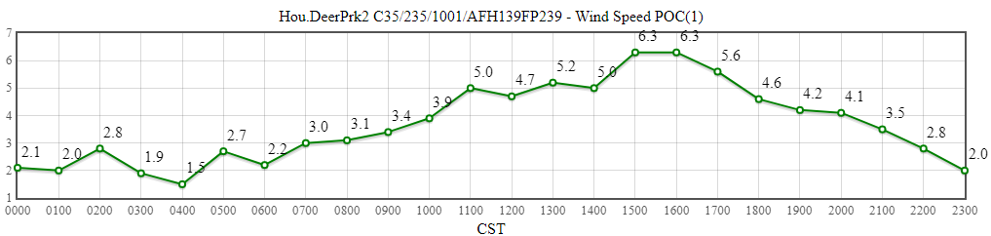
La Porte / Deer Park
Source: https://www.tceq.texas.gov/cgi-bin/compliance/monops/daily_summary.pl
Note: The TCEQ La Porte site only measures meteorological variables. The closest working monitor with ozone availability is located about 4 miles away in Deer Park. These plots are from Deer Park.

