Slide 1
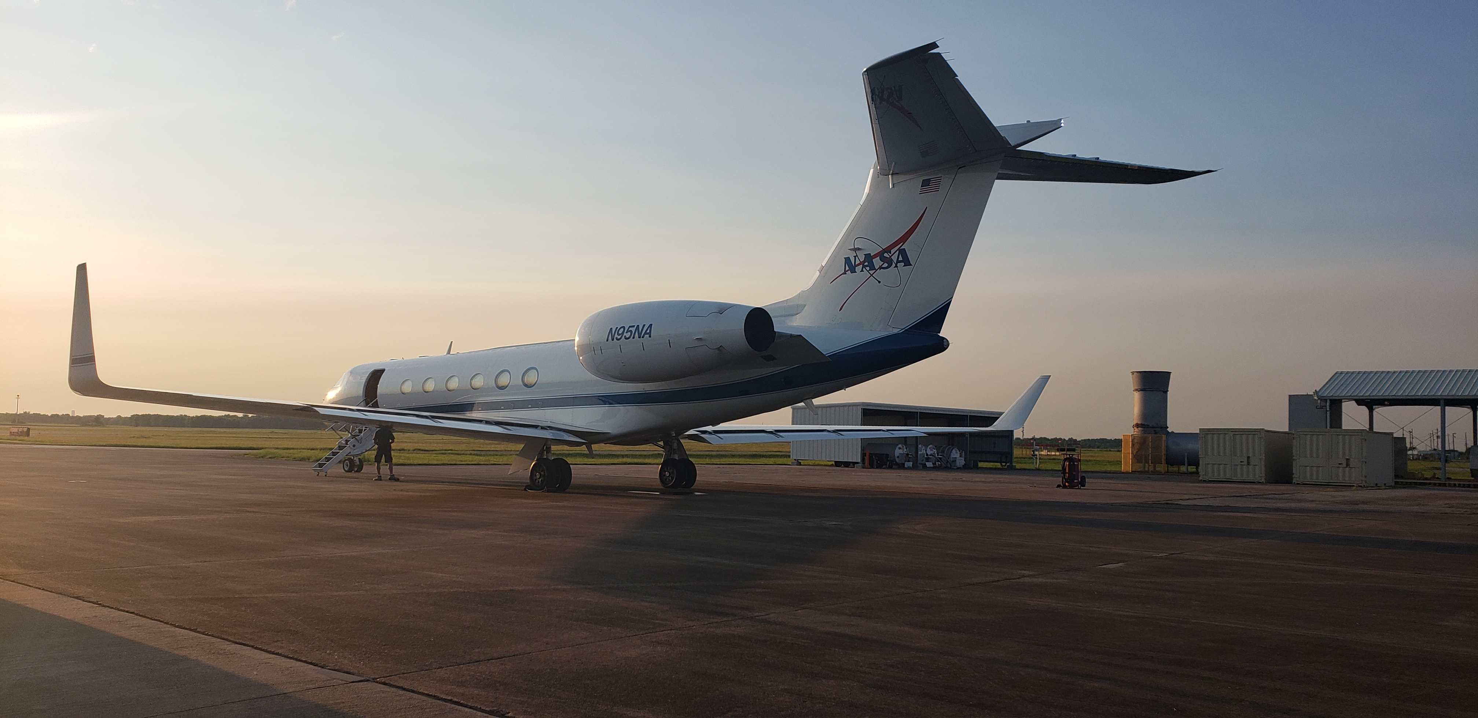
TRACER-AQ Science Flight #5
10 September 2021

Slide 2
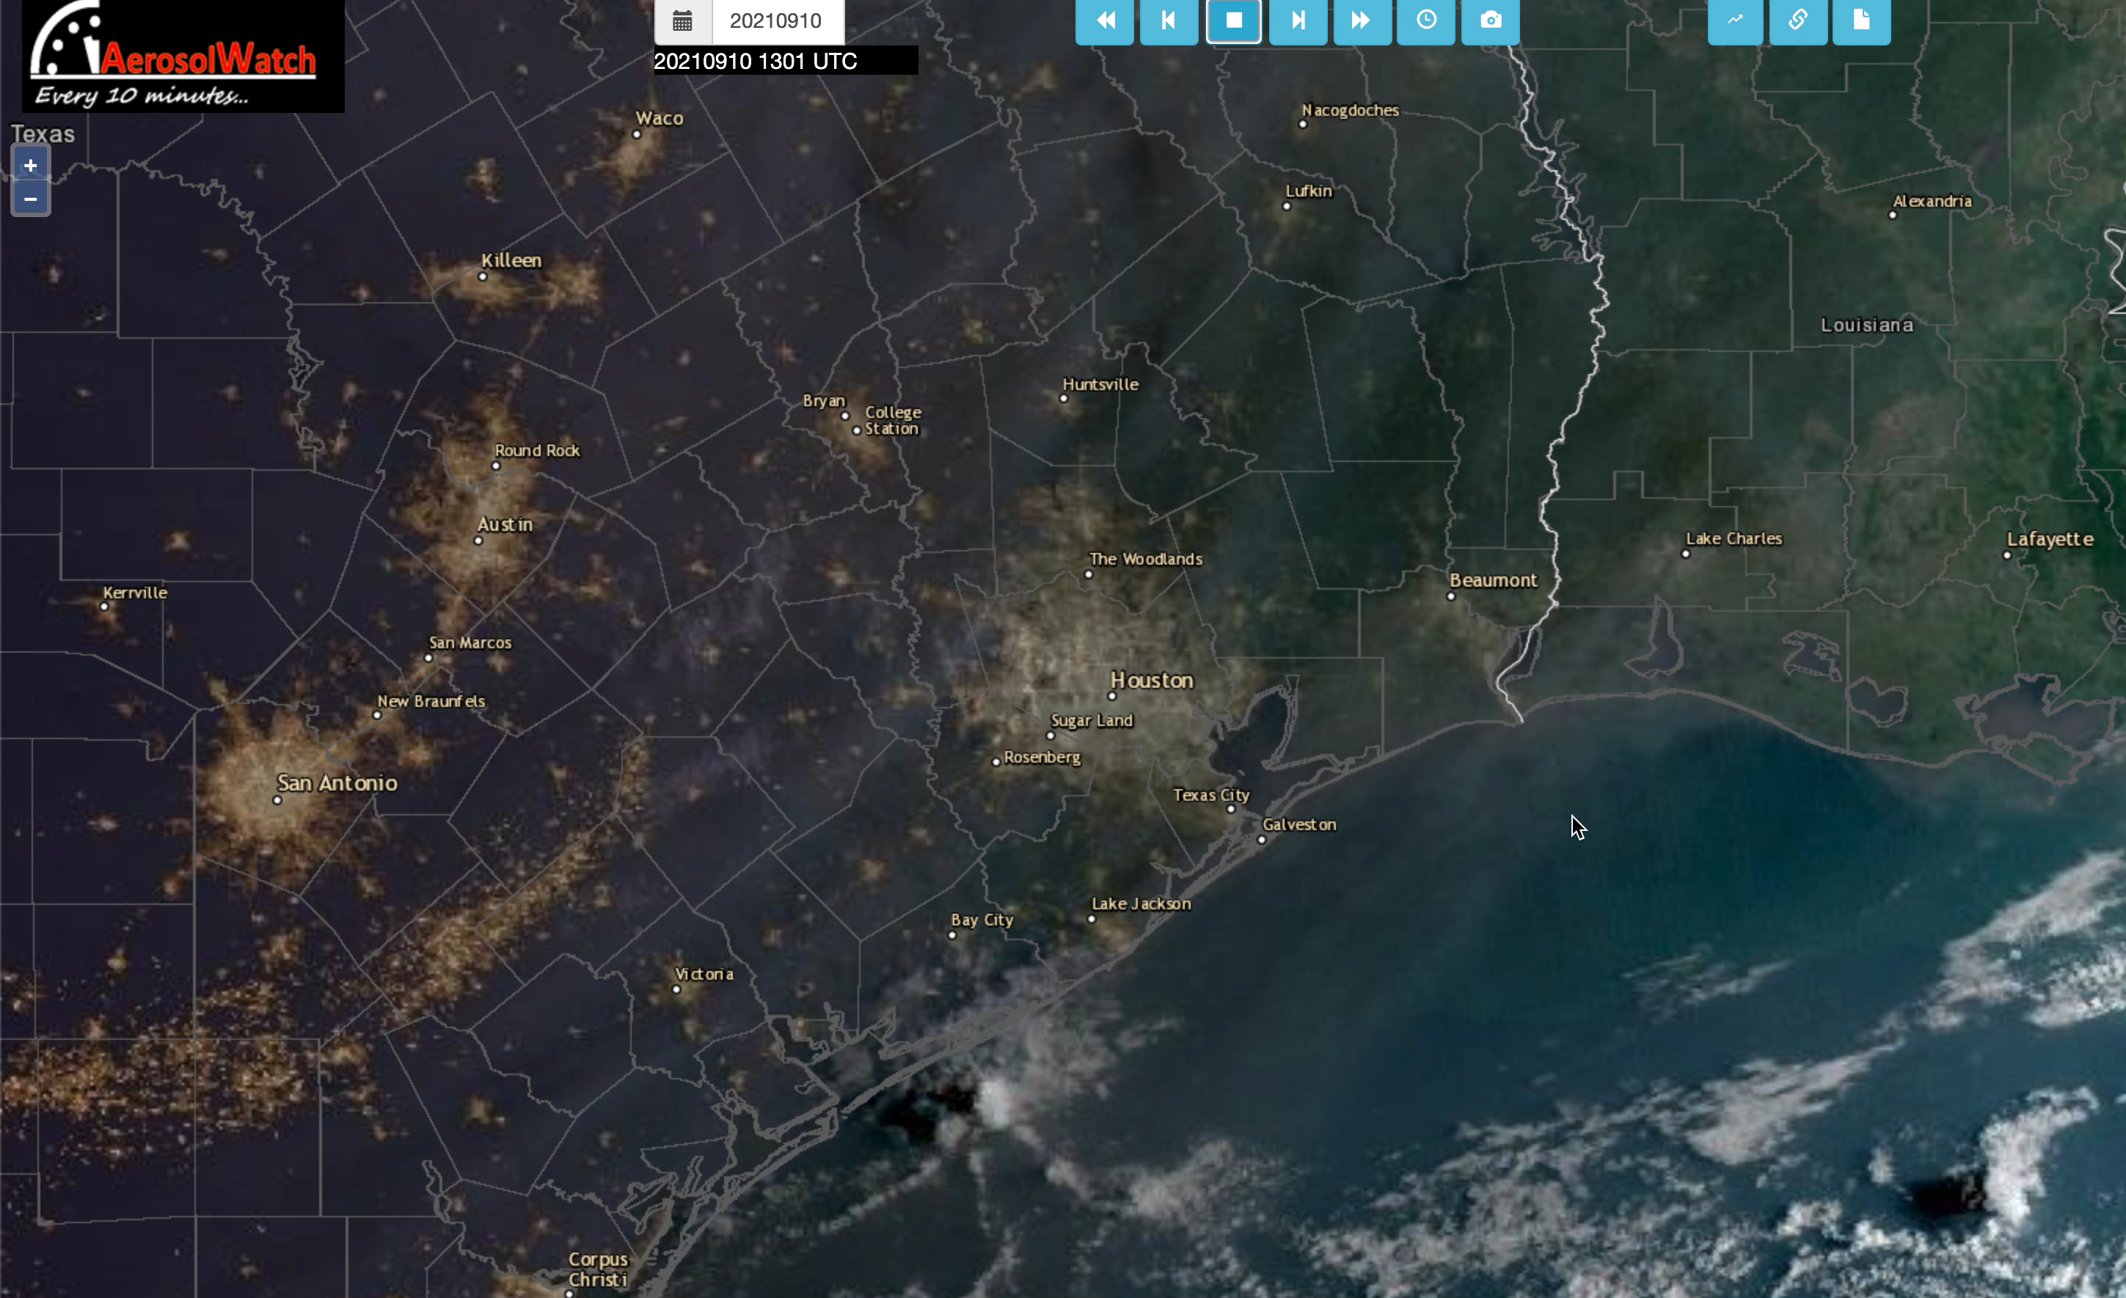

Slide 6
