Slide 1
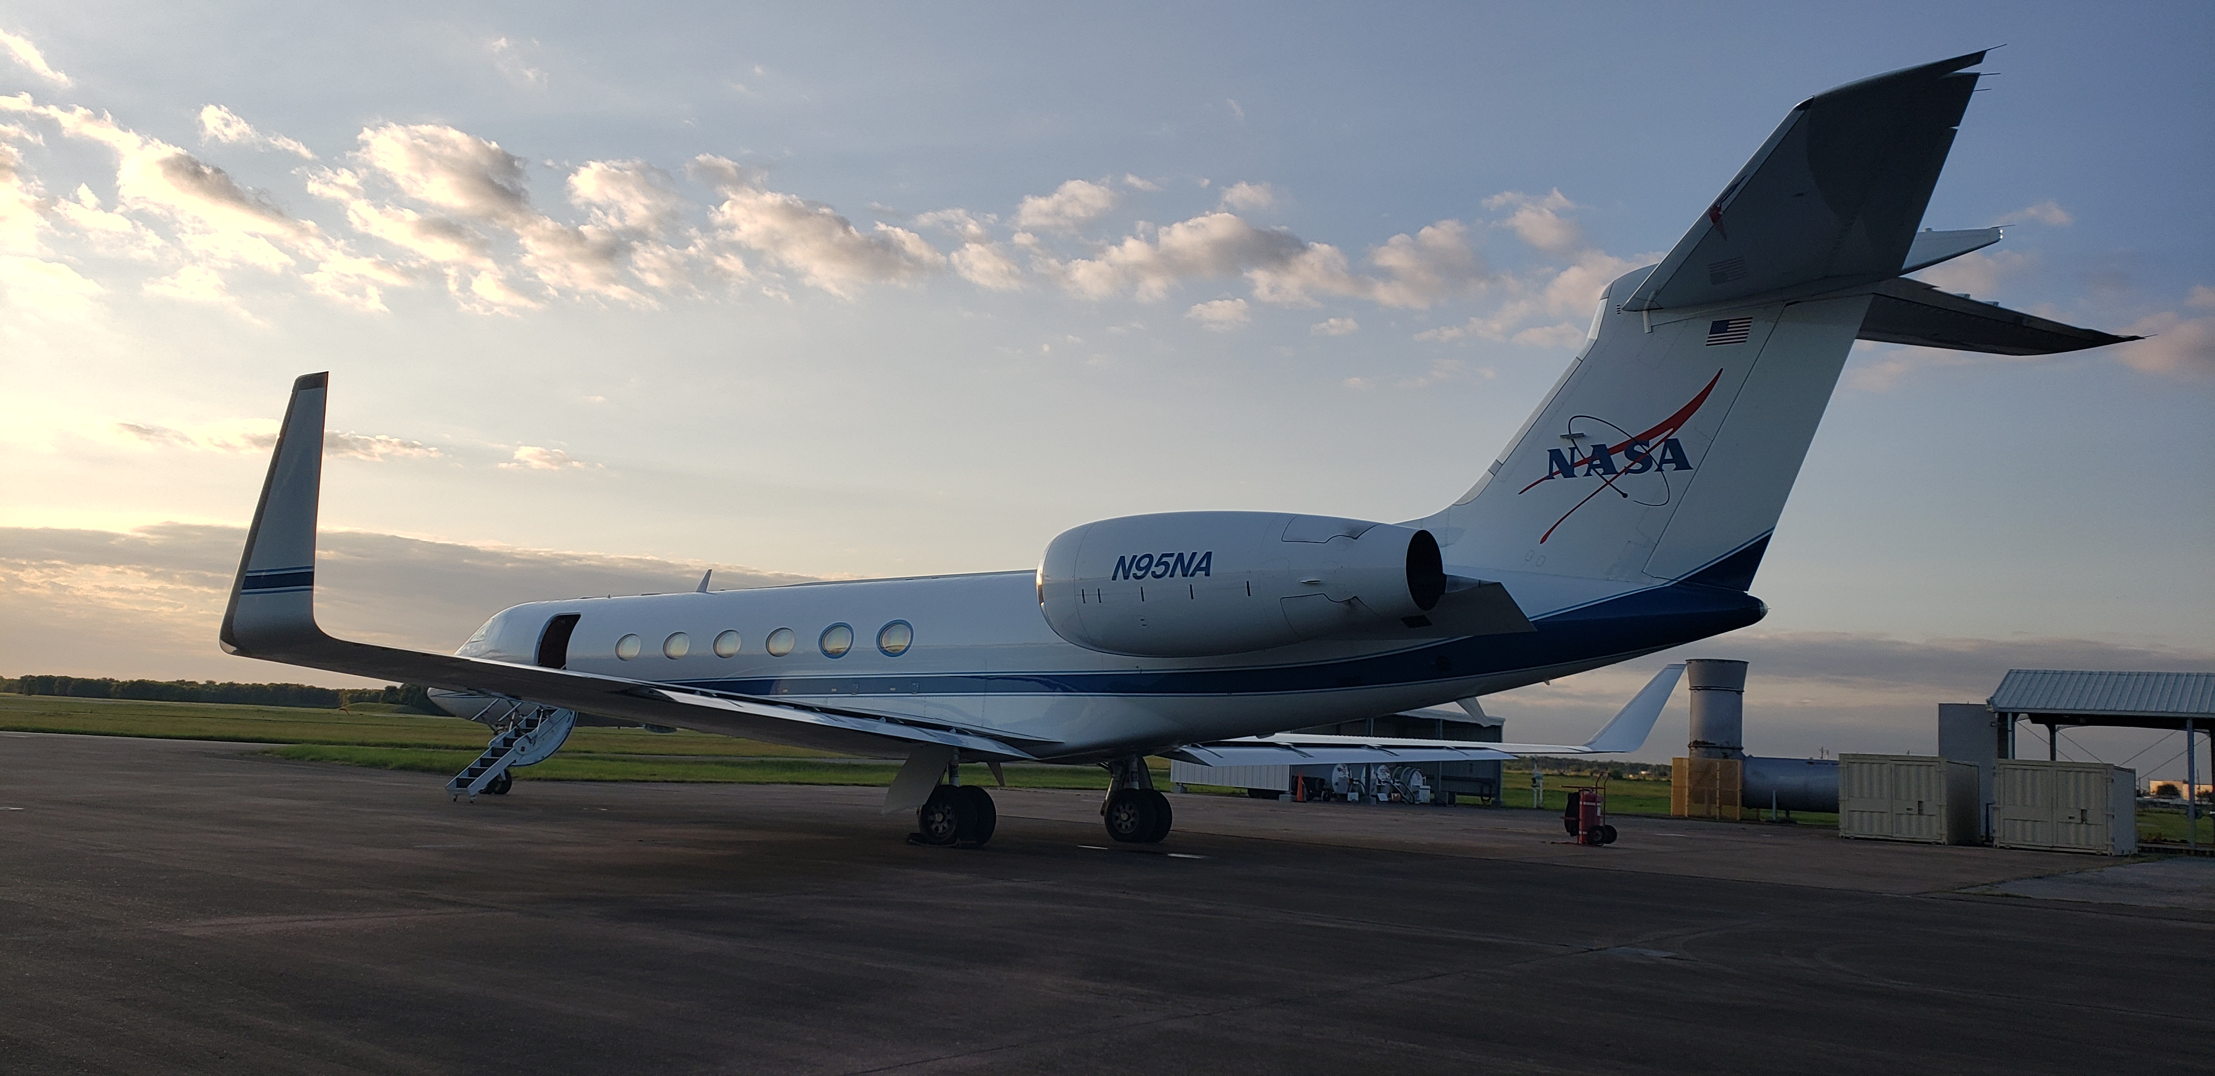
TRACER-AQ Science Flight #6
11 September 2021

Slide 2
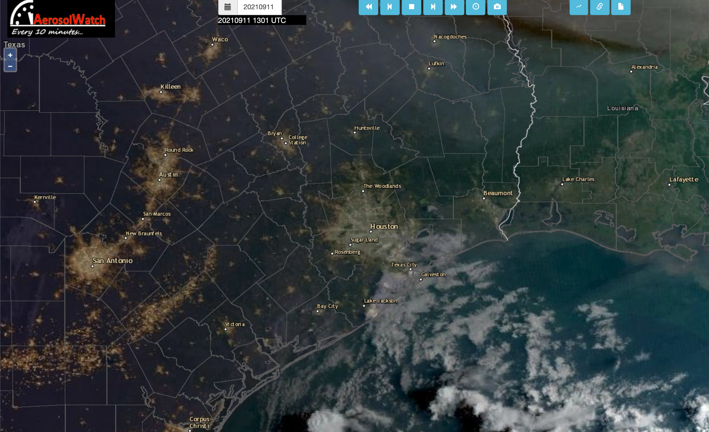

Slide 5
