Slide 1
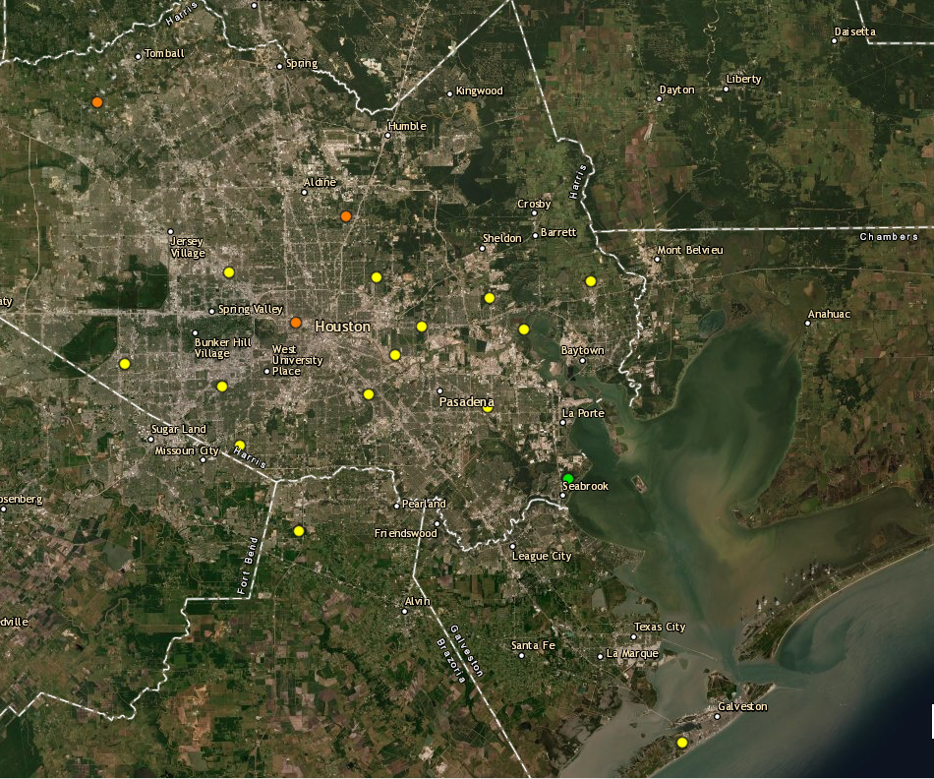
Houston Ozone Monitors September 11th, 2021
Aldine
UH Moody Tower
Deer Park
Site Location | Maximum 8-hour Ozone Concentration
Aldine | 74ppb (Highest reading of the day)
UH Moody Tower | 61ppb
La Porte / Deer Park | 62ppb

Slide 2
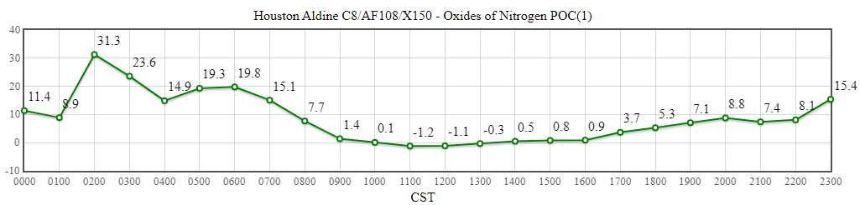
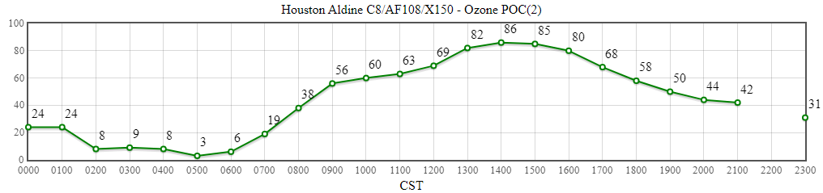
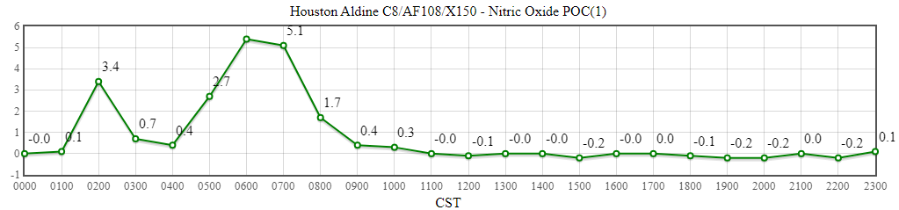
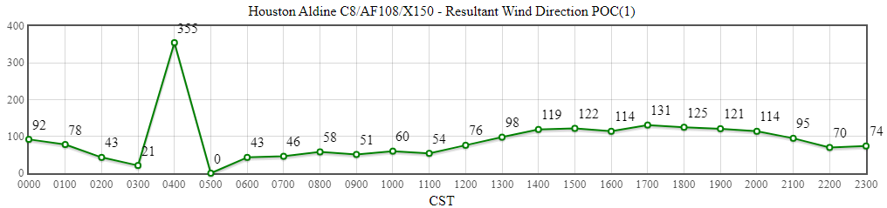
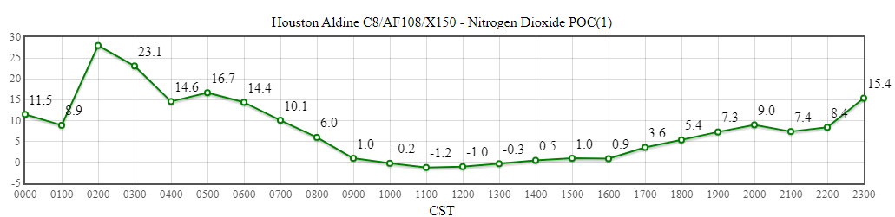
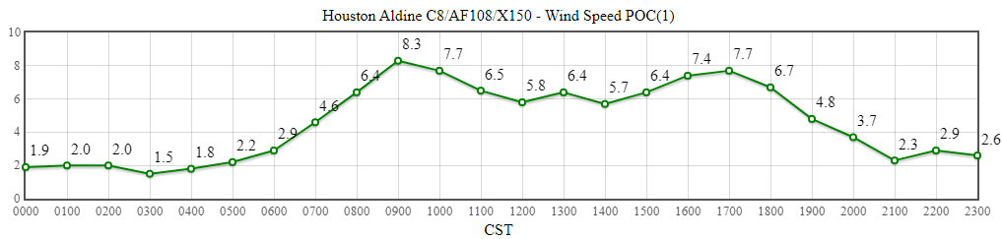
Aldine
Source: https://www.tceq.texas.gov/cgi-bin/compliance/monops/daily_summary.pl

Slide 3
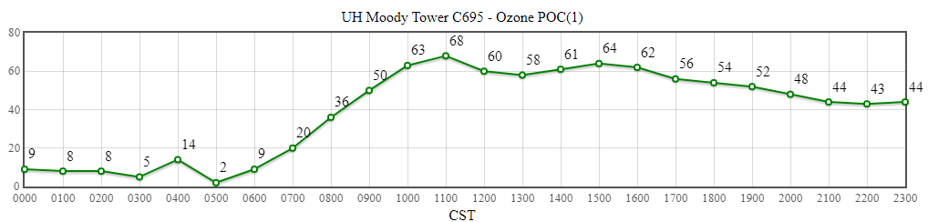
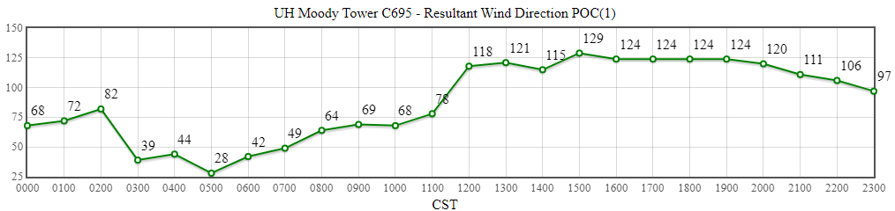
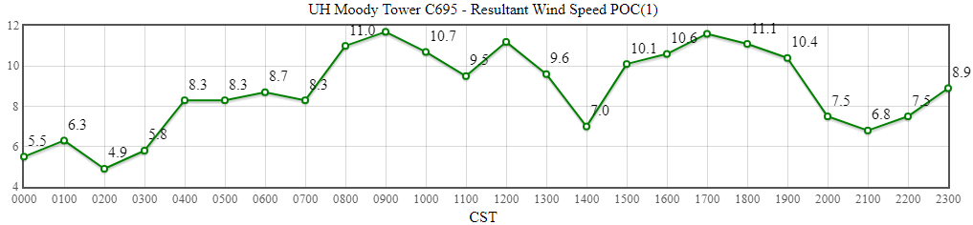
UH Moody Tower
Source: https://www.tceq.texas.gov/cgi-bin/compliance/monops/daily_summary.pl

Slide 4
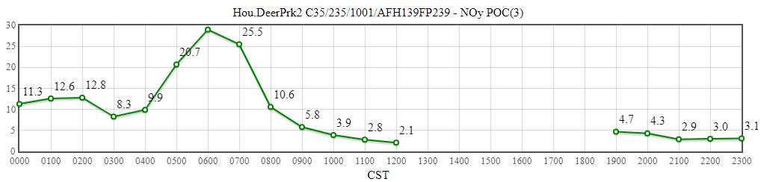
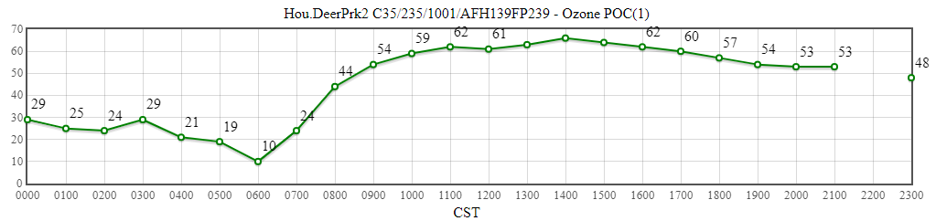
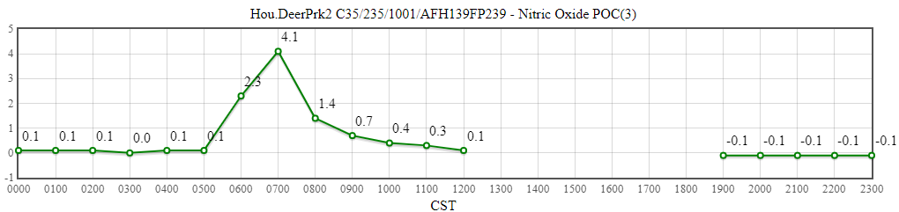
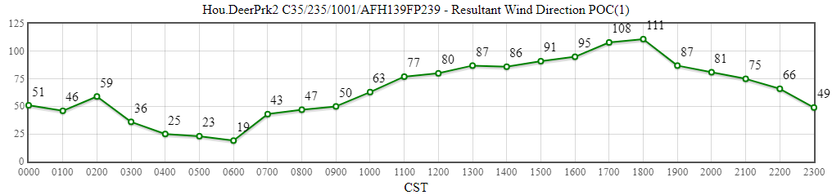
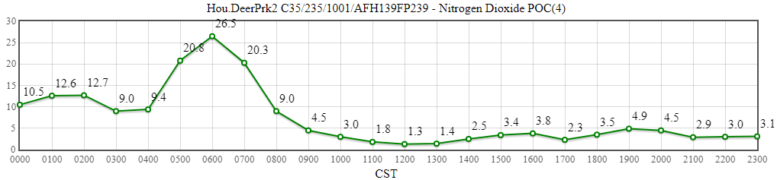
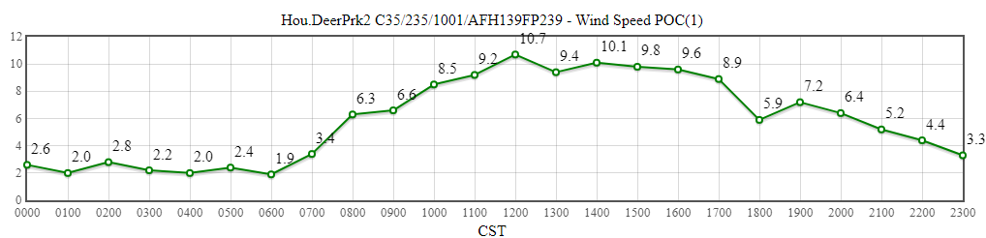
La Porte / Deer Park
Source: https://www.tceq.texas.gov/cgi-bin/compliance/monops/daily_summary.pl
Note: The TCEQ La Porte site only measures meteorological variables. The closest working monitor with ozone availability is located about 4 miles away in Deer Park. These plots are from Deer Park.

