Slide 1
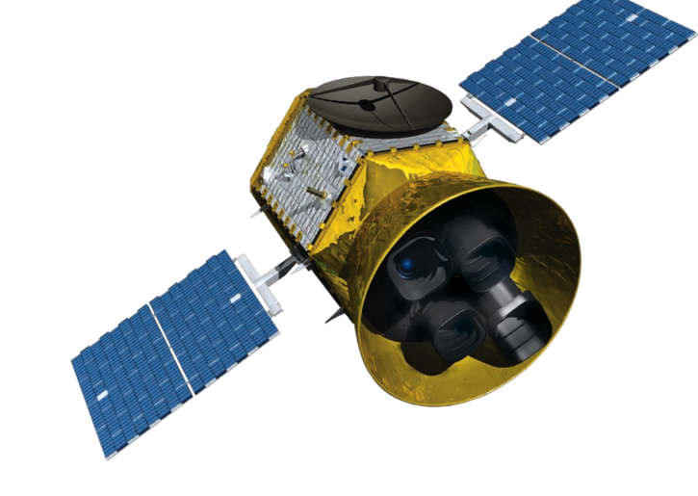
TROPOMI SATELLITE PASSED OVER HOUSTON TWICE ON SEPTEMBER 22ND, 2021.

Slide 2
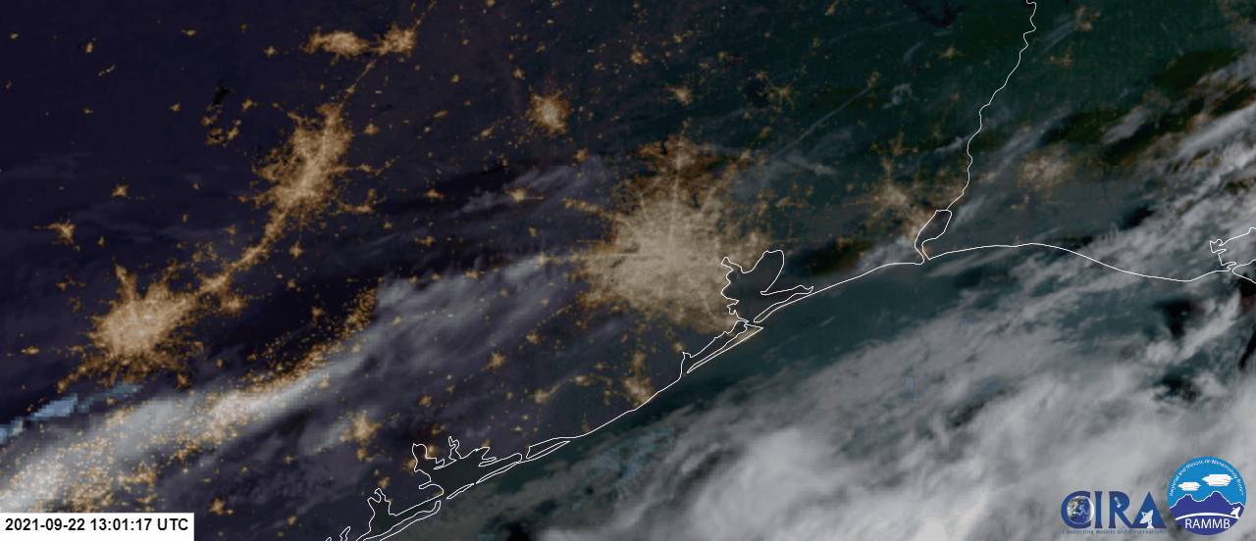
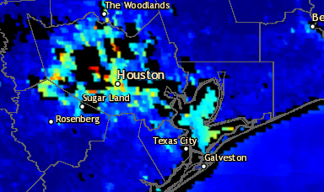
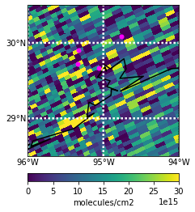
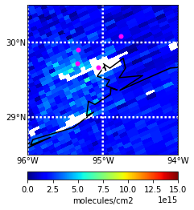
GOES 16 True Color Imagery 09/22/2021 13:01-23:01 UTC
AOD Composite 09/22/2021 18:41 UTC
Source:https://rammb.cira.colostate.edu/ramsdis/online/archive.asp?data_folder=goes16/mesoscale_01_band_02_sector_02&width=1000&height=1000
Source:https://www.star.nesdis.noaa.gov/smcd/spb/aq/AerosolWatch/?product_date=20210919&zoom=8&lat0=29.66467011272428&lon0=-94.83121297319396&layers=67108865&region=conus
HCHO 09/22/2021 from 18:41 UTC TROPOMI (v. 2.02.01) Overpass
NO2 09/22/2021 from 18:41 UTC TROPOMI (v. 2.2.0) Overpass
Liberty
Liberty
Aldine
UH
Aldine
UH
La Porte
La Porte
Qa value:
>0.5
Qa value: >0.75

Slide 3
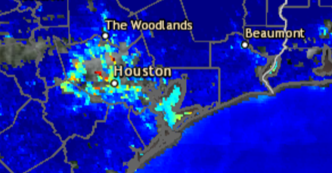
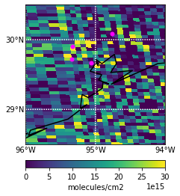
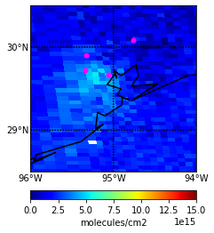
GOES 16 True Color Imagery 09/22/2021 13:01-23:01 UTC
AOD Composite 09/22/2021 20:21 UTC
Source:https://rammb.cira.colostate.edu/ramsdis/online/archive.asp?data_folder=goes16/mesoscale_01_band_02_sector_02&width=1000&height=1000
Source:https://www.star.nesdis.noaa.gov/smcd/spb/aq/AerosolWatch/?product_date=20210919&zoom=8&lat0=29.66467011272428&lon0=-94.83121297319396&layers=67108865&region=conus
HCHO 09/22/2021 from 20:20 UTC TROPOMI (v. 2.02.01) Overpass
NO2 09/22/2021 from 20:20 UTC TROPOMI (v. 2.2.0) Overpass
Liberty
Liberty
Aldine
Aldine
La Porte
La Porte
UH
UH
Qa value:
>0.5
Qa value: >0.75

