Slide 1
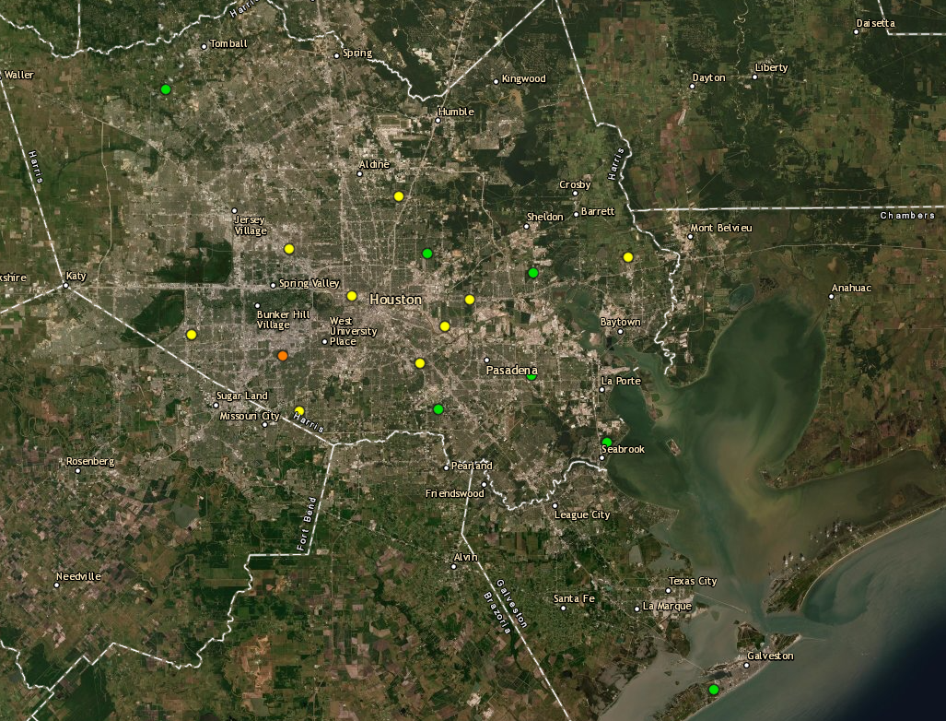
Houston Ozone Monitors September 23rd, 2021
Aldine
UH Moody Tower
Bayland Park
Deer Park
Site Location | Maximum 8-hour Ozone Concentration
Bayland Park | 73ppb (Highest reading of the day)
Aldine | 56ppb
UH Moody Tower | 63ppb
La Porte / Deer Park | 54ppb

Slide 2
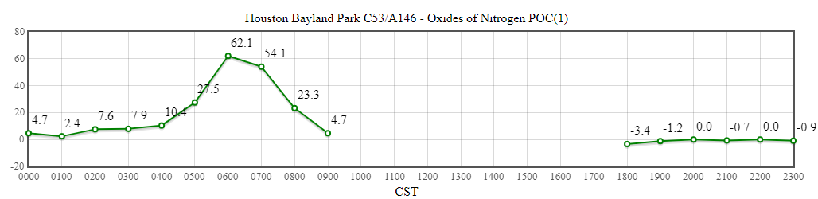
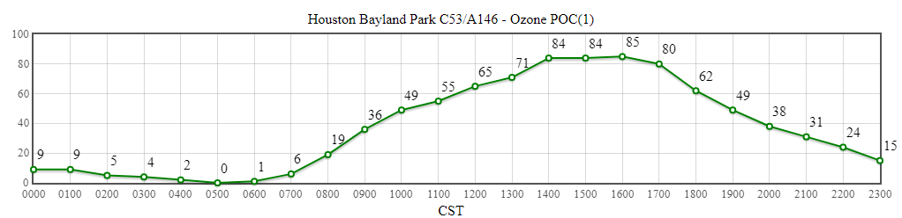
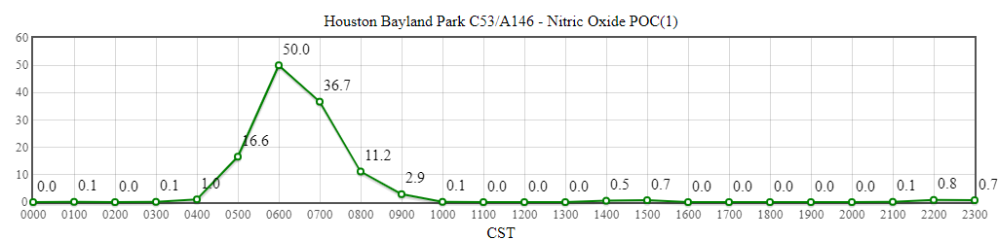
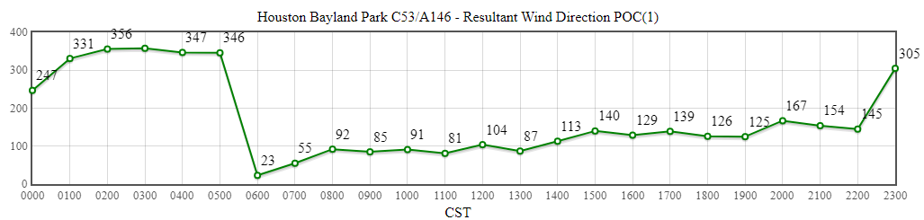
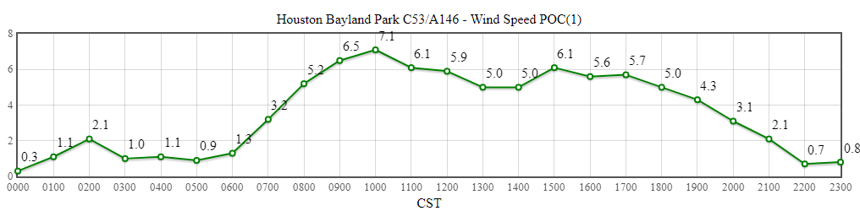
Bayland Park
Source: https://www.tceq.texas.gov/cgi-bin/compliance/monops/daily_summary.pl

Slide 3
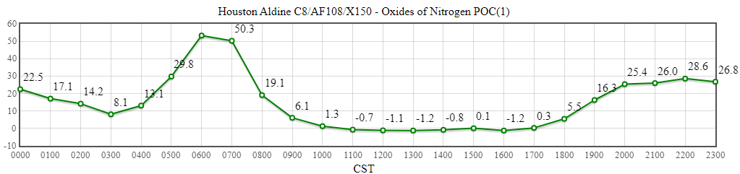
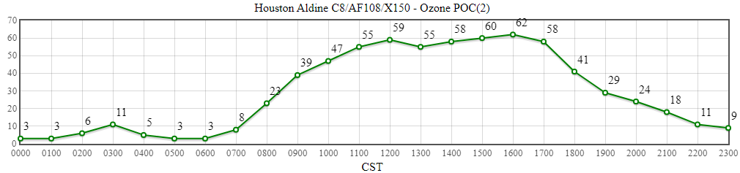
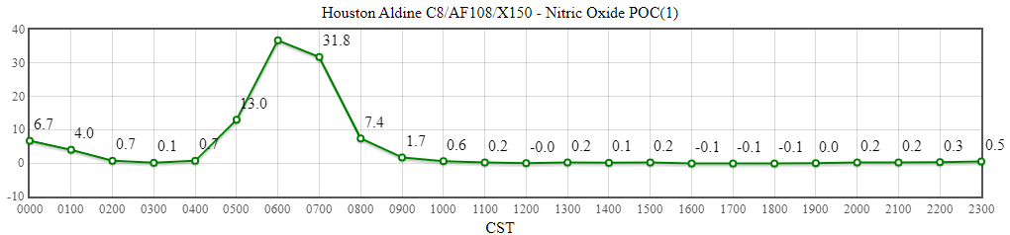
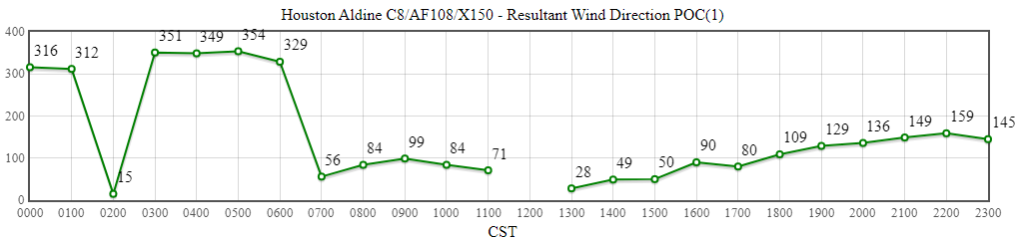
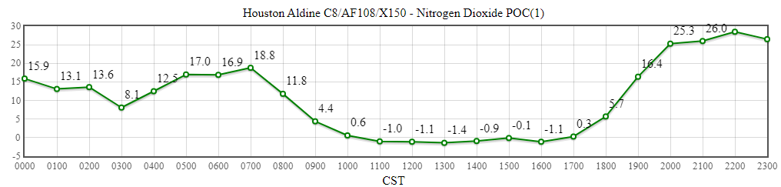
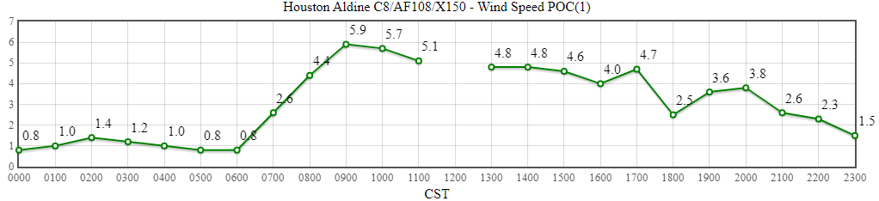
Aldine
Source: https://www.tceq.texas.gov/cgi-bin/compliance/monops/daily_summary.pl

Slide 4
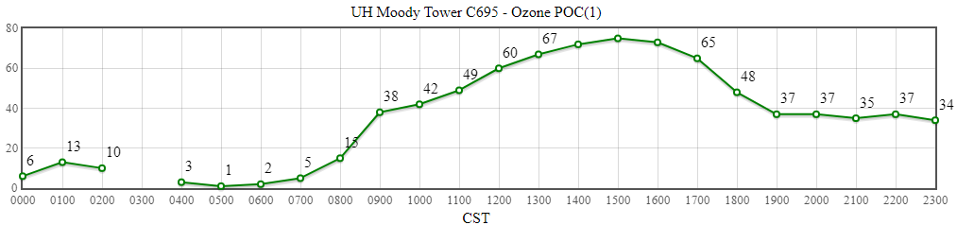
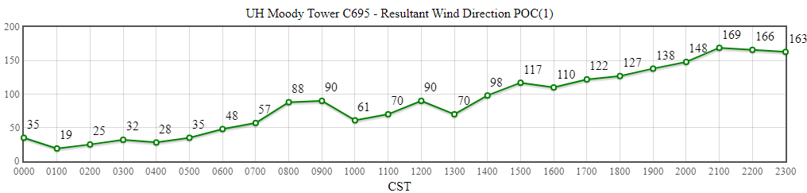
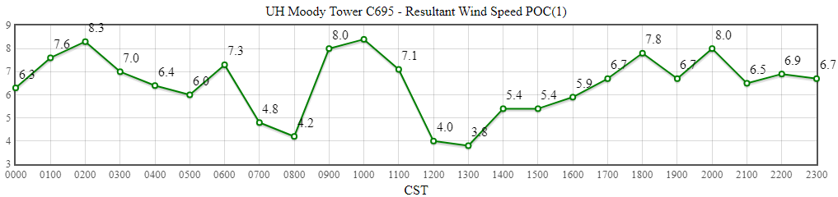
UH Moody Tower
Source: https://www.tceq.texas.gov/cgi-bin/compliance/monops/daily_summary.pl

Slide 5
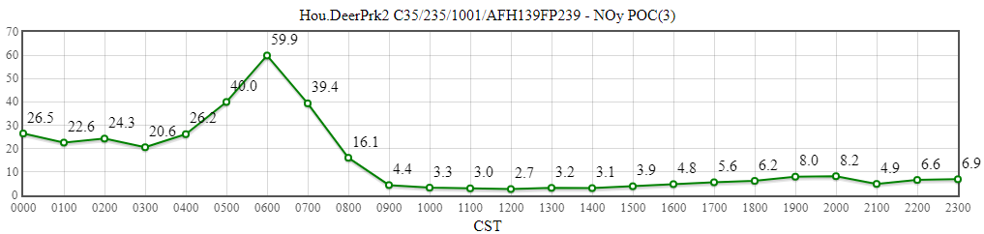
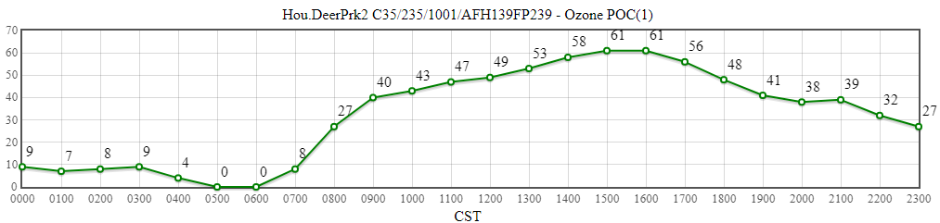
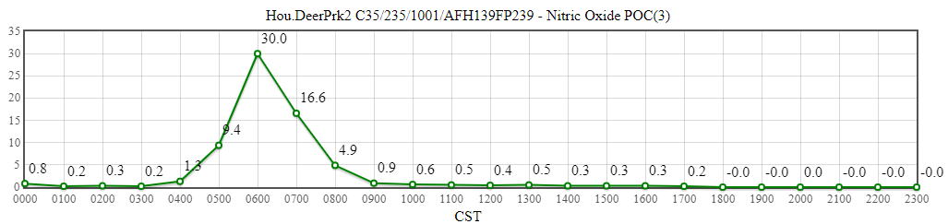
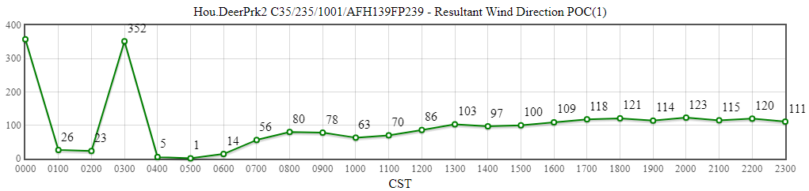
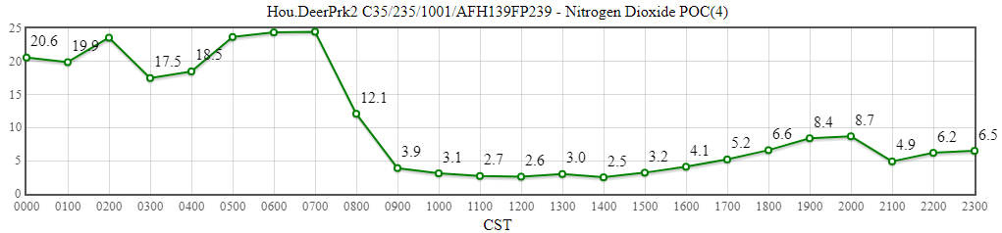
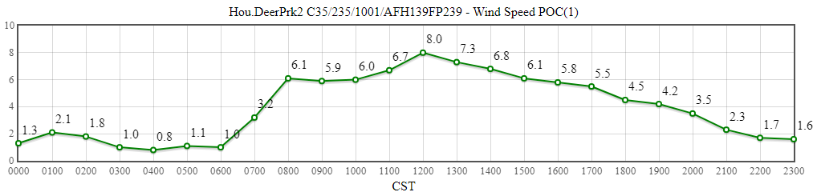
La Porte / Deer Park
Source: https://www.tceq.texas.gov/cgi-bin/compliance/monops/daily_summary.pl
Note: The TCEQ La Porte site only measures meteorological variables. The closest working monitor with ozone availability is located about 4 miles away in Deer Park. These plots are from Deer Park.

