Slide 1
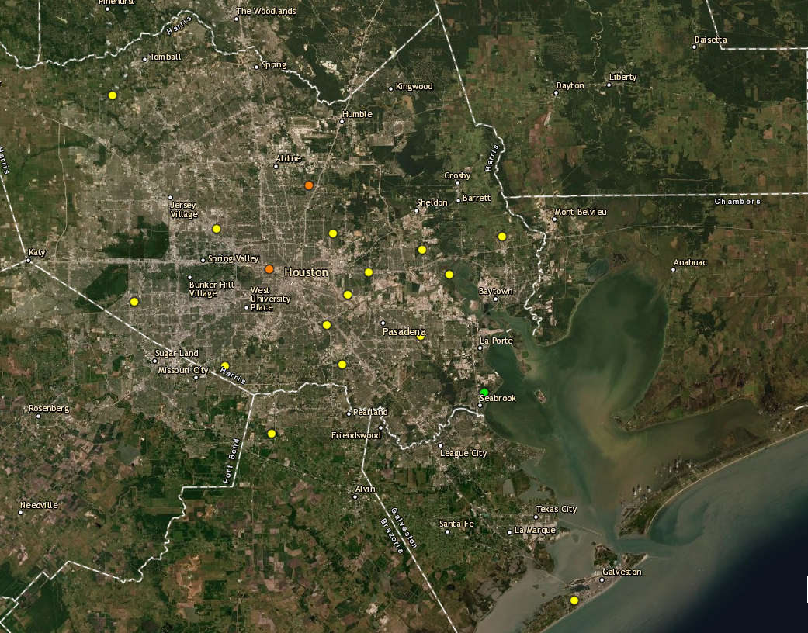
Houston Ozone Monitors September 26th, 2021
Aldine
Harvard Street
UH Moody Tower
Deer Park
Site Location | Maximum 8-hour Ozone Concentration
Harvard Street | 81ppb (Highest reading of the day)
Aldine | 71ppb
UH Moody Tower | 63ppb
La Porte / Deer Park | 64ppb

Slide 2
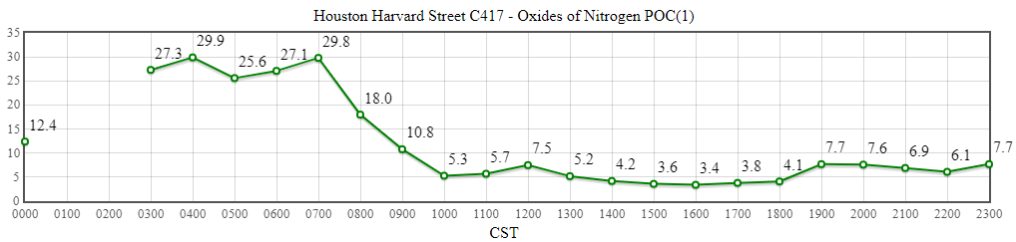
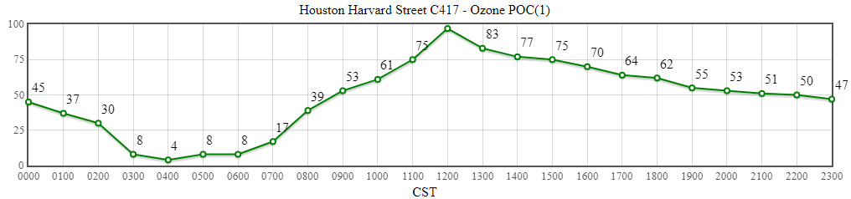
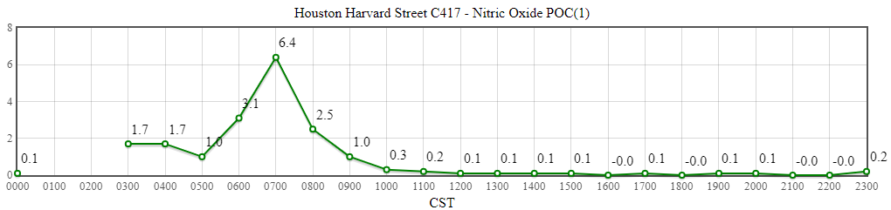
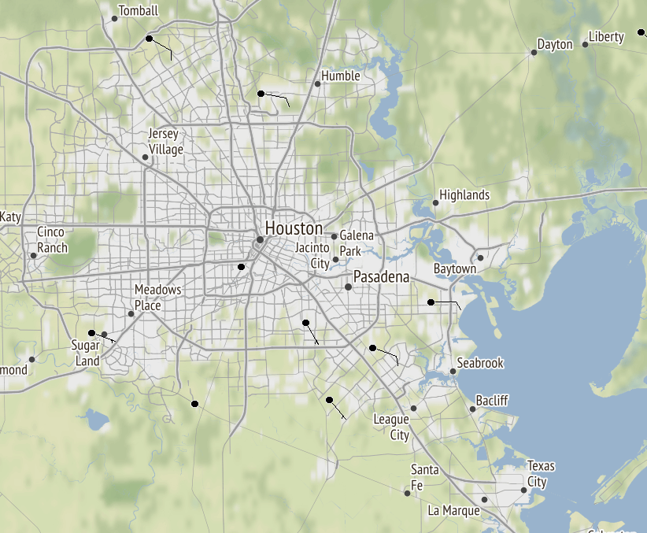
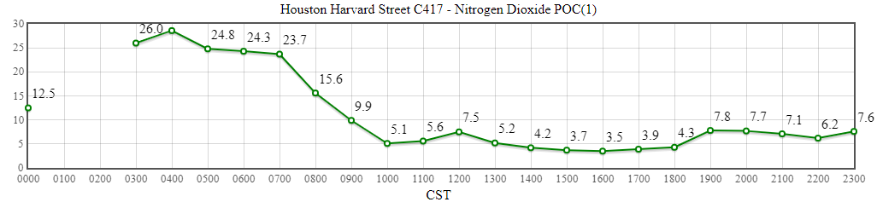
Harvard Street
Source: https://www.tceq.texas.gov/cgi-bin/compliance/monops/daily_summary.pl
Note: No wind data available at the Harvard Street site. To look at wind data, archived surface observations over Houston were taken from MesoWest. Image valid for September 26th , 2021 at 19:00 UTC.
Source: https://mesowest.utah.edu/cgi-bin/droman/mesomap.cgi?state=TX&rawsflag=3

Slide 3
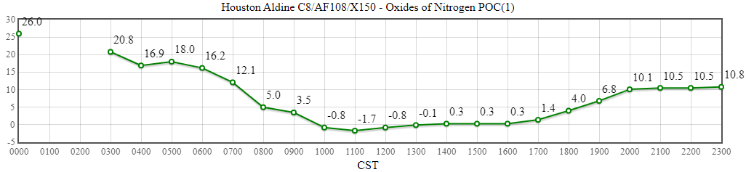
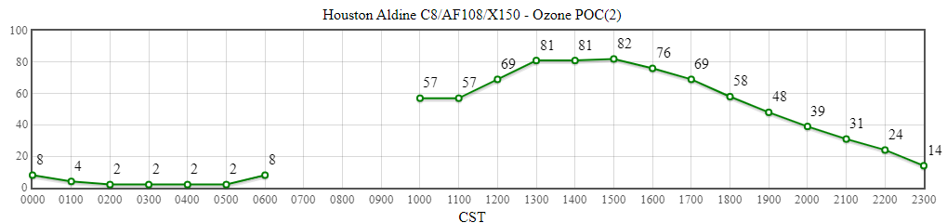
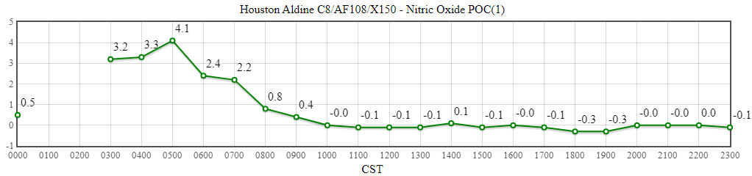
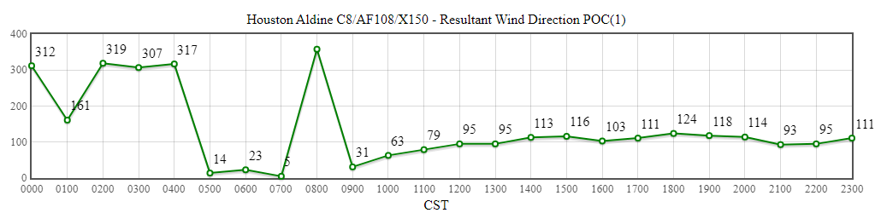
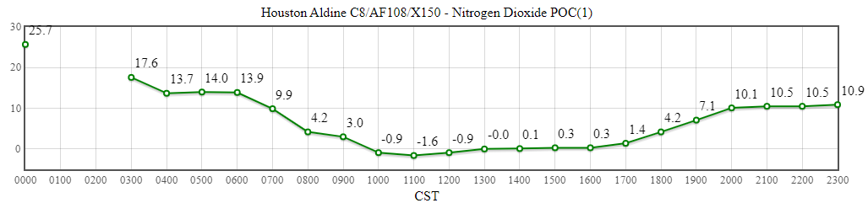
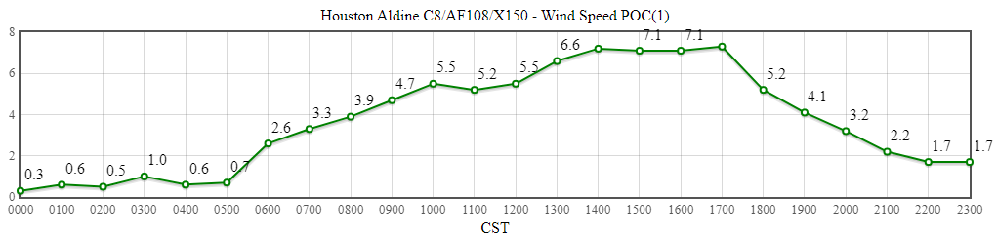
Aldine
Source: https://www.tceq.texas.gov/cgi-bin/compliance/monops/daily_summary.pl

Slide 4
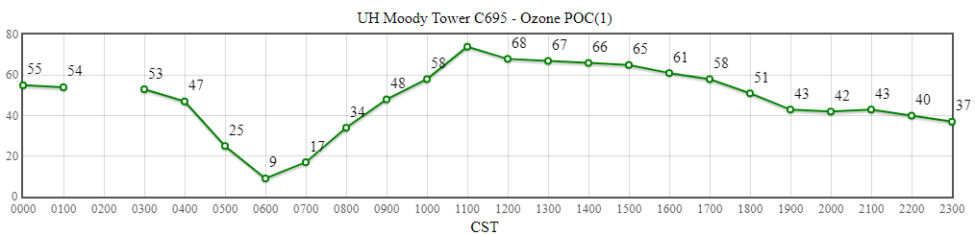
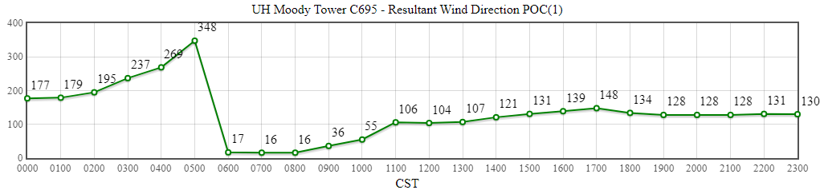
UH Moody Tower
Source: https://www.tceq.texas.gov/cgi-bin/compliance/monops/daily_summary.pl

Slide 5
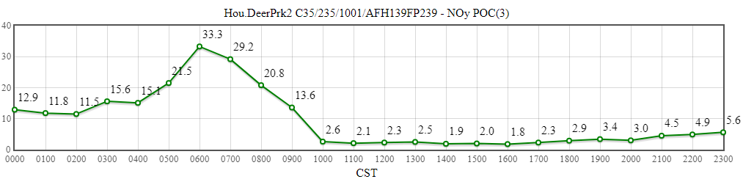
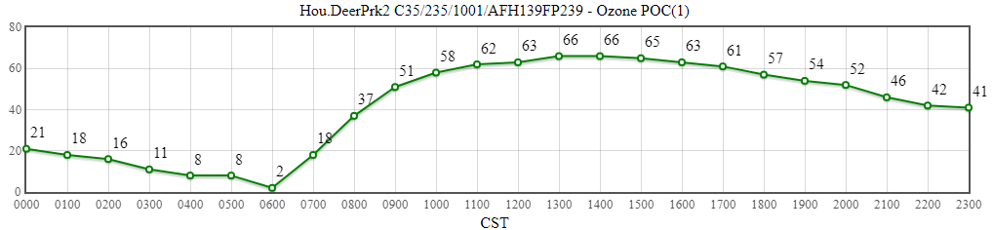
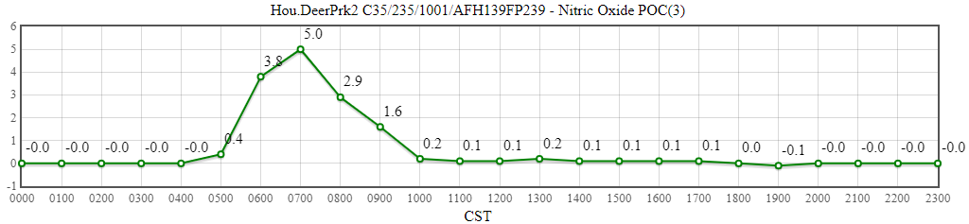
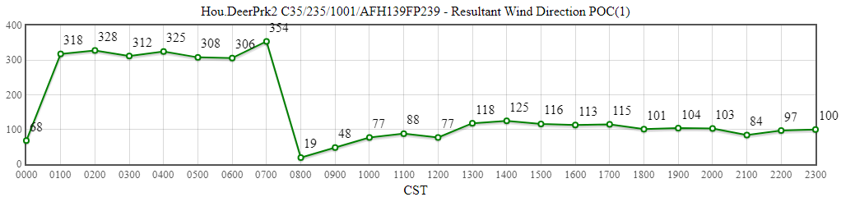
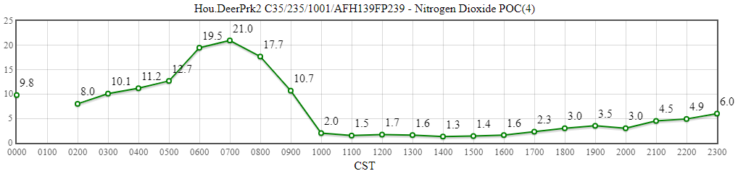
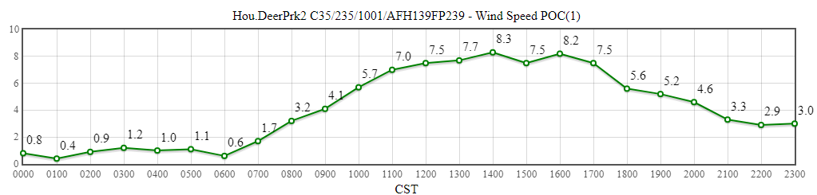
La Porte / Deer Park
Source: https://www.tceq.texas.gov/cgi-bin/compliance/monops/daily_summary.pl
Note: The TCEQ La Porte site only measures meteorological variables. The closest working monitor with ozone availability is located about 4 miles away in Deer Park. These plots are from Deer Park.

