Slide 1
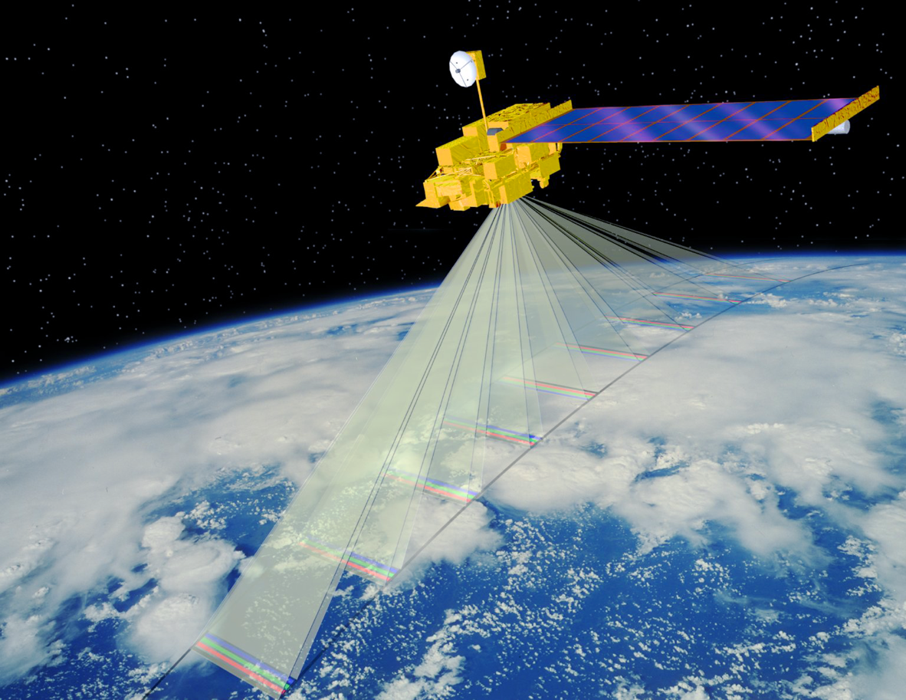
Adaptation of ground data processing to Terra’s drifting orbit
Jet Propulsion Laboratory,
California Institute of Technology
NASA Atmospheric Science Data Center
October 2023

Slide 2
Main changes
Modification of map projection algorithms
Inclusion of an improved digital elevation model (DEM)
Retention of numerical block reference but elimination of custom “stacked block” product format
Product release in NetCDF
LaRC ASDC data production and access update
1

Slide 3
Impacts of change in orbit altitude
The largest impact of Terra’s lower altitude is that the orbit period no longer results in repeating ground tracks within the Worldwide Reference System (WRS-2).
Reference imagery associated with each of the 233 WRS-2 paths was previously used to geolocate and co-register newly acquired data for all bands and angles.
Because Terra no longer follows the exact WRS-2 paths, modified algorithms to preserve georectification and co-registration accuracies using ray casting in conjunction with Simultaneous Bundle Adjustment and globally distributed Ground Control Points were developed and made operational at ASDC.
Historically MISR products have been mapped to the 233 WRS-2 paths that uniquely correspond to the subsatellite track during each 16-day repeat cycle (i.e. “static” orbit).
With the new orbit where subsatellite track equator crossings are shifting in a dynamic non-repetitive manner (i.e. “dynamic” orbit), MISR data for any given orbit are mapped to the closest WRS-2 path.
Widening the east-west extent of MISR’s swath-based data products avoids any cross-track truncation of the measurements.
2

Slide 4
Key Level 1 processing updates
“Static” orbit
“Dynamic” orbit
Level 1B1 Production
Level 1B1 Production
Level 1B2 Production
Camera Geometric Model
Reference Orbit Imagery Projection Parameters
Level 1B2 Production
Camera Geometric Model Simultaneous Bundle Adjustment/GCP
Dynamic Ray Casting
Intermediate GRP
Non-specific path
Final GRP
Actual WRS-2 path
Level 1B2 Re-sampler
GRP = L1B2 Georectified Radiance Product
Final GRP
Closest WRS-2 path (wide-swath)
3

Slide 5
Key attributes of “dynamic” orbit mapping
Camera Geometric Model (CGM)
CGM recalibrated following the orbit maneuvers. A shift in the Da (aftmost) camera geometric model has been corrected.
Simultaneous Bundle Adjustment (SBD)
Orbit based dynamic corrections to camera pointing is based on tie points and matching of ground control points (GCPs) across all nine cameras.
Ray casting – Terrain projection
Subpixel (3x3) projections to the DEM utilize the updated CGM, SBD results, and spacecraft navigation data.
Ellipsoid projection
Sparse grid projection (same method as used for ”static” orbit) utilize the updated CGM, SBD results, and spacecraft navigation data.
4

Slide 6
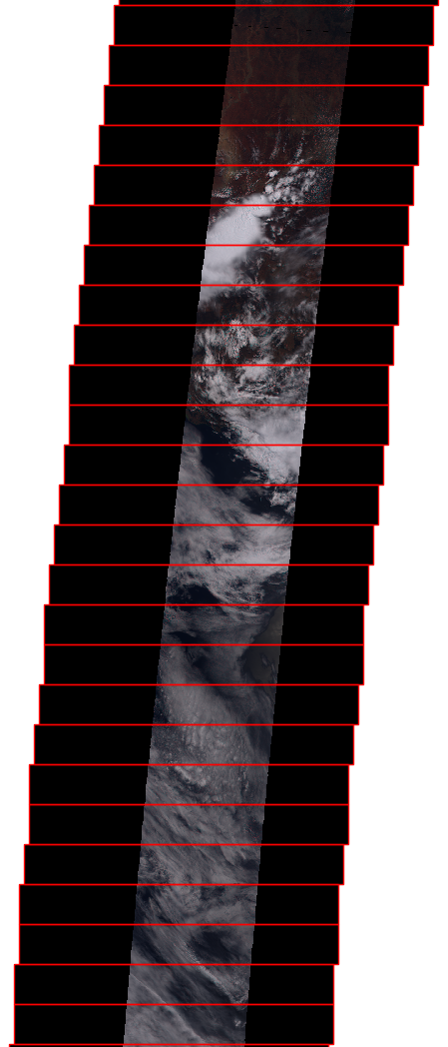
Using wider Space Oblique Mercator (SOM) blocks limits disruption of familiar product labeling
Prior products used a static set of 233 SOM paths.
Without the software update, misalignment of orbits with these paths would result in data clipping where swath edges fall outside of the old SOM block boundaries. Geolocation accuracy would be degraded.
New processing uses dynamic SOM path fitted to orbit parameters, parameterized to center orbit data within SOM blocks and minimize geometric distortion.
Wider SOM blocks reuse the familiar path-numbering paradigm, but prevent clipping
Original blocks are 140 km × 560 km.
New blocks are 140 km × 1120 km.
V30 orbit data on static SOM path with wide blocks
V30 orbit data on dynamically fitted SOM path
V24 orbit data on misaligned static SOM path (clipped)
5

Slide 7
Impacts of change in orbit altitude on MISR data
The lower orbit has negligible or minor impact on:
The 275 m map-projected spatial grid (data are resampled to this grid)
The imaged swath width, which narrows by <1%
View zenith angles; these are handled in the data processing algorithms
Product quality
6

Slide 8
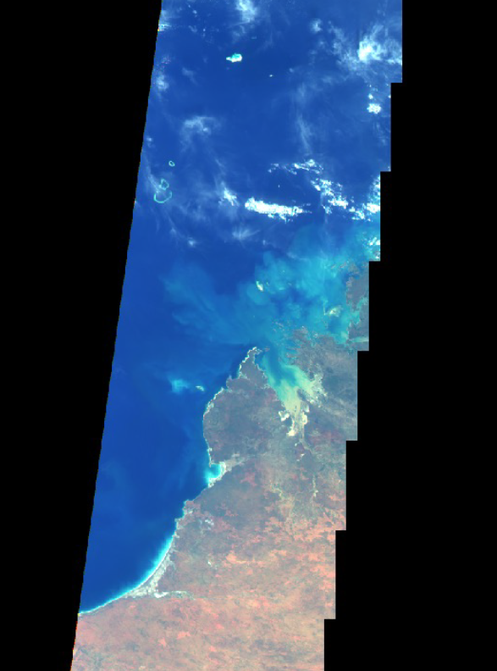
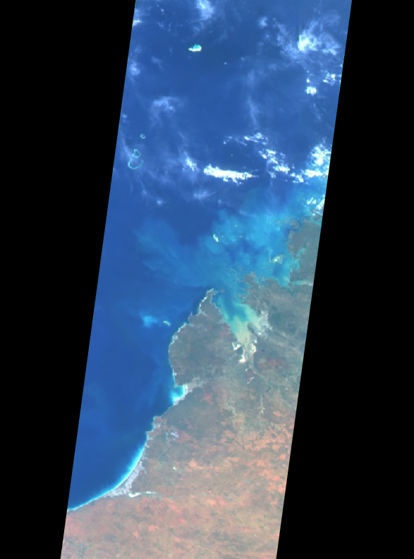
Comparison of pre- and post-maneuver
L1 data production algorithms
Original algorithm
Mapped to WRS-2 path 111 for this orbit
Data are shifted from the Terra track
Geolocation accuracy reduced
Data truncated at edge of FOV
New algorithm
Dynamically mapped and presented in wide-swath WRS-2 path 110 for this orbit
Data are centered on the Terra track
Geolocation accuracy maintained
Data preserved at edge of FOV
Post-maneuver orbit 121418 (October 16, 2022).
Data were processed through the software pipeline at ASDC.
7

Slide 9
Original MISR DEM Source
Code 1 – DTED1 HE: 16m RMS
Code 2 – DTED1 HE: 20m RMS
Code 3 – DTED1 HE: 54m RMS
Code 4 – DTED1 HE: 76m RMS
Code 5 – DTED1 HE: 70m RMS
Code 6 – DTED1 HE: 80m RMS
Code 7, 8, 11-14 – DCW HE: 71m RMS
Code 9 – Australia/New Zealand HE: 104m RMS
Code 10 – DCW/ETOP05 Meld HE: 61m RMS
Code15– DCW/WCS Meld HE: 53m RMS
8

Slide 10
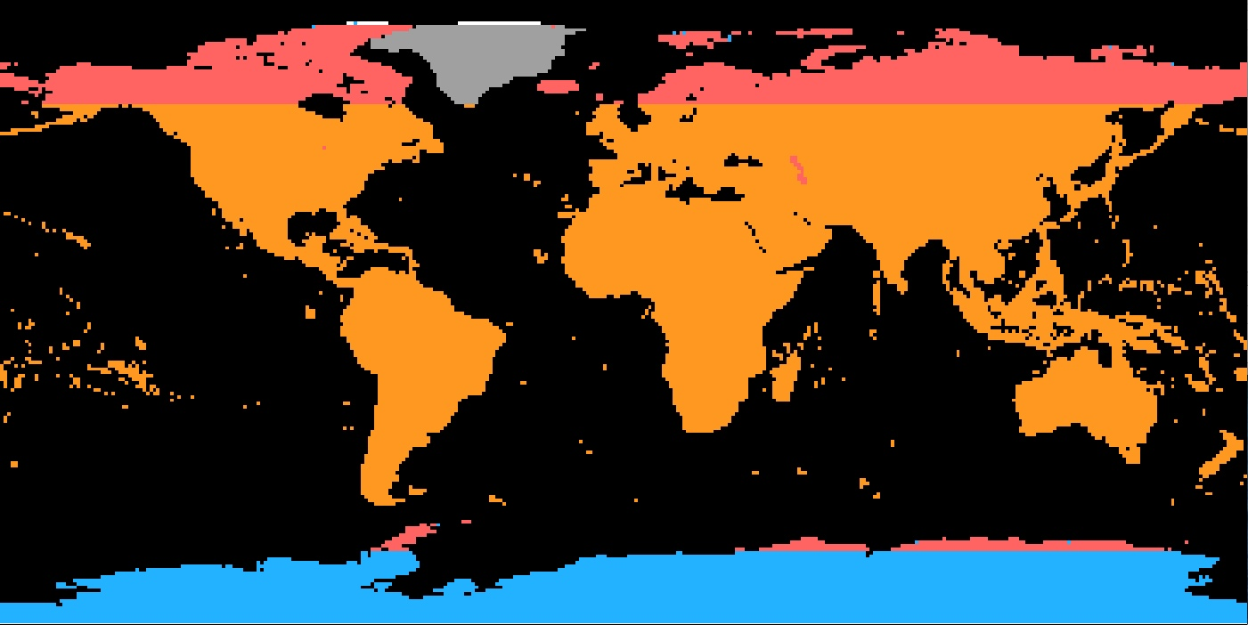
Updated MISR DEM - NASADEM/ASTERv3 DEM
Assembly of primarily NASADEM and ASTERv3 at 30m/pxl used as the source to process MISR DEM at 90 m resolution.
Significant improvement globally except in the Antarctica.
NASADEM is SRTM4 with improved height calibrations from ICESat and is a more geographically complete version of SRTMv3
ASTERv3 is the latest version of ASTER GDEMv3 and is a significant improvement over ASTERv2.
NASADEM 30m DEM (Latest SRTMv4 Update): HE: 9 m RMS
ASTERv3 30m DEM (Latest Update): HE: 17 m RMS
RAMP 200m DEM (with ASTERv2 30m in Arctic): HE: 50 m RMS, 100 m RMS rugged mountainous regions
GIMP/Greenland 30m DEM: HE: 10 m RMS
ALOSv3.1 30m DEM (N83-N84):
9

Slide 11
New L1B2 and L2 products use NetCDF format
The format of MISR products is updated from HDF-EOS4 to NetCDF4
This update has long been requested by end-users
It is offered now in conjunction with other necessary changes that break legacy compatibility
New product format is consistent with MISR Aerosol product, which already transitioned to NetCDF
Relative to HDF-EOS4, NetCDF4 provides
More ubiquitous 3rd party software support, e.g. plotting tools such as panoply
Enhanced compression
Simpler and more standardized self-documenting conventions
Removal of stacked-block specification
Prior HDF-EOS products specified geographic data via a complicated convention
Convention required specialized tools and user expertise for analysis and visualization
New NetCDF products specify geographic data via simple 2-D (x,y) format
NetCDF’s more advanced compression facilitates this simpler convention
Addition of directly specified per-retrieval latitude and longitude
Facilitates mapping of most MISR data without MISR-specific expertise
Product file size increased by at most 16 MB
10

Slide 12
LaRC ASDC data production and access update
Data Production
Forward processing stream will resume with Nov 1, 2023 (orbit 126974).
A separate processing stream will be run to fill the gap between October 14, 2022 and October 31, 2023.
Gap fill is expected to take 2-3 months.
Data Products
For this initial release, only Level 1 and Level 2 products will be available.
ALL products for MISR acquisitions from orbit 121388 (October 14, 2022. forward will have product version number 30.
11

Slide 13
LaRC ASDC data production and access update
Data Products
The following products will now be in netCDF format and have new ESDT collection version numbers:
MIB2GEOP.003
MI1B2E.004
MI1B2T.004
MIRCCMF.002
MIL2TCSP.002
MIL2TCCF.002
MISR Tools
The MISR Browse Orbit-Path Correspondence tools do not currently function properly for orbits 121388 and later.
The MISR subsetting tool does not currently function properly for the new collections listed above.
Data visualization tools requiring stacked block format (e.g., MINX) do not currently work with the new product format.
Fixes for these tools are forthcoming and will be announced when available.
12

